Slide 1

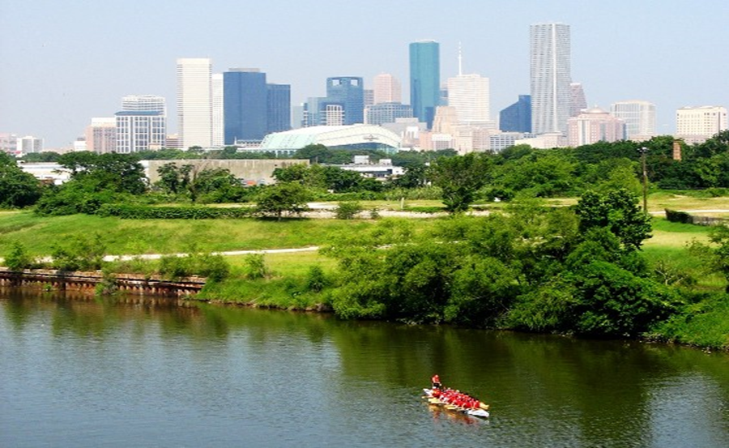

Municipal Setting Designations
Mark A. Wooten Jr.
Program Coordinator

Slide 2
What is an MSD?
A voluntary deed restriction that prohibits the use of impaired groundwater as potable water
    A tool property owners can use to address environmental impairments to groundwater
    Allows reinvestment and redevelopment of impaired properties
A public health protection

Slide 3
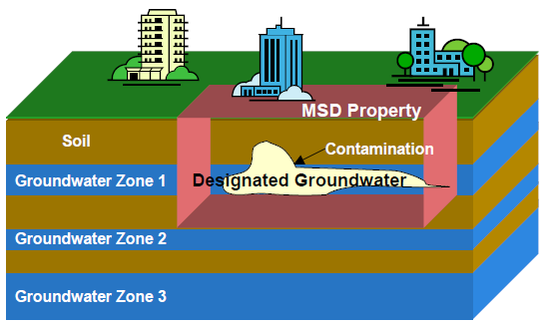
MSD Depiction

Slide 4
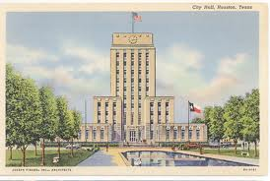
What is an MSD?
It is a State Program
    Administered by the Texas Commission on Environmental Quality (TCEQ)
    Requires Local Support
Article 13 of Chapter 47
    Public Hearing Required

Slide 5
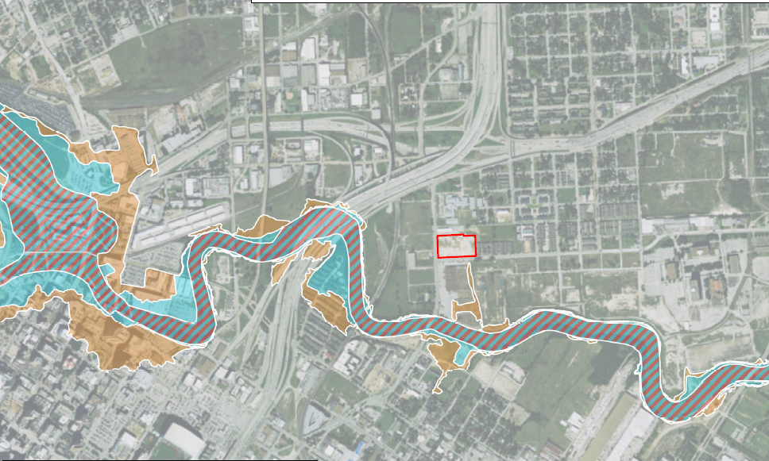
2701 Clinton Drive

Slide 6
Asian Pacific Texas, LLC
The Site operated as Standco Industries from approximately 1940 until 2010. The Site was undeveloped prior to the 1920s, between the 1920s and 1940, the Site was a shipping warehouse.
Previous manufacturing activities between 1940 and 2010 included oilfield brake linings/blocks, “snubber” pads for use in aircraft landing gear, valve seats, molded friction resistant products, corrosion resistant coatings for studded bolts, spiral gaskets, and wash pipes.
Standco’s historic operations have been identified as the soil and groundwater contaminant source.
Enrolled in the TCEQ Voluntary Cleanup Program in January 2016

Slide 7
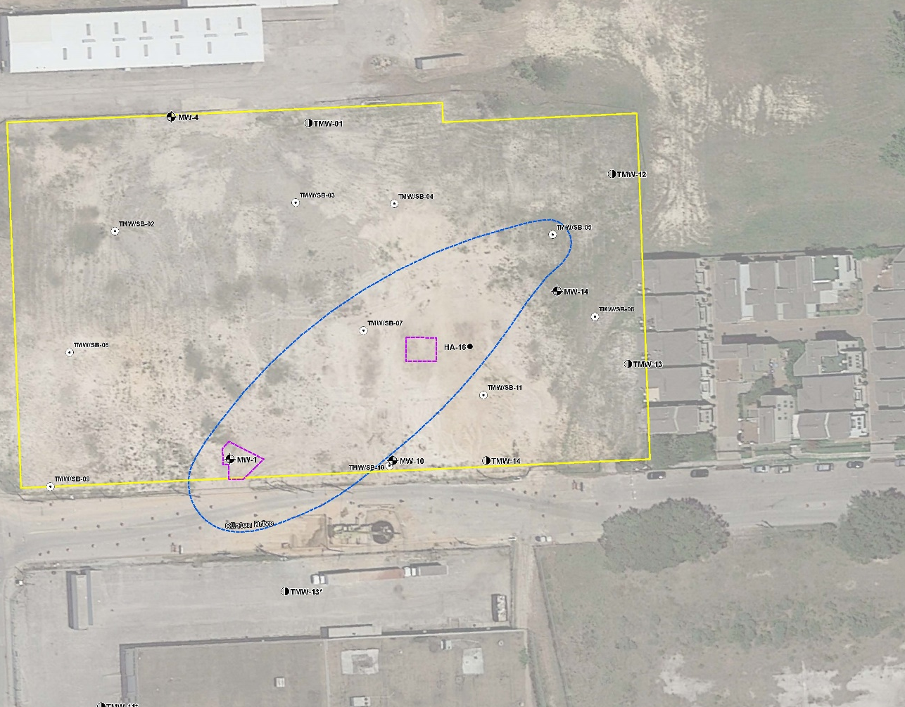
Groundwater Impacts

Slide 8
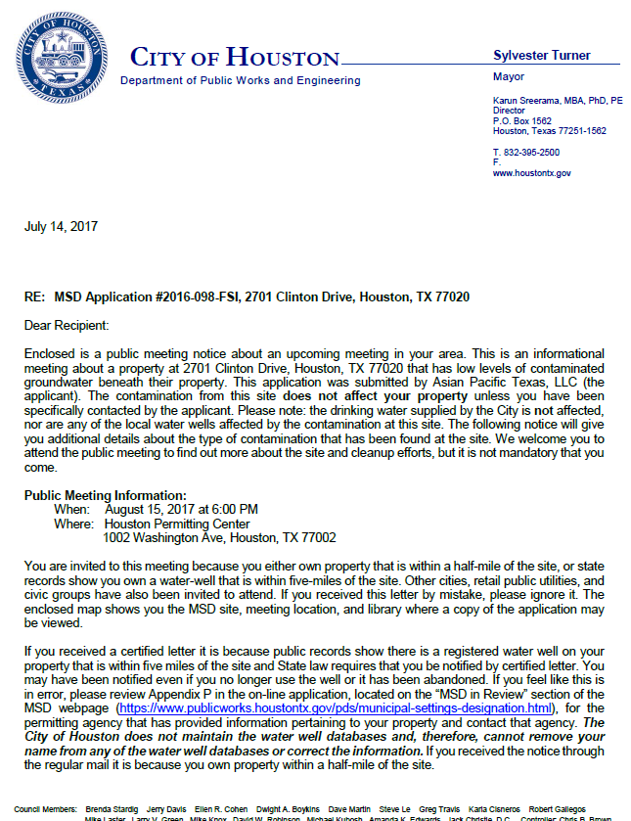
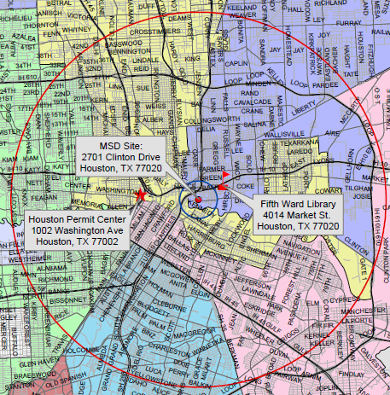
MSD Notice Letters
Property Owners
First-Class Mail
½-Mile Radius
City Requirement
Water Well Owners
Certified Mail
5-Mile Radius
State Requirement

Slide 9
Contact Information
Mark A. Wooten Jr.
Program Coordinator
Public Works & Engineering
City of Houston,
1002 Washington, 3rd Floor
Houston, Texas 77002
msd@houstontx.gov
(832) 394-9005

