Slide 1

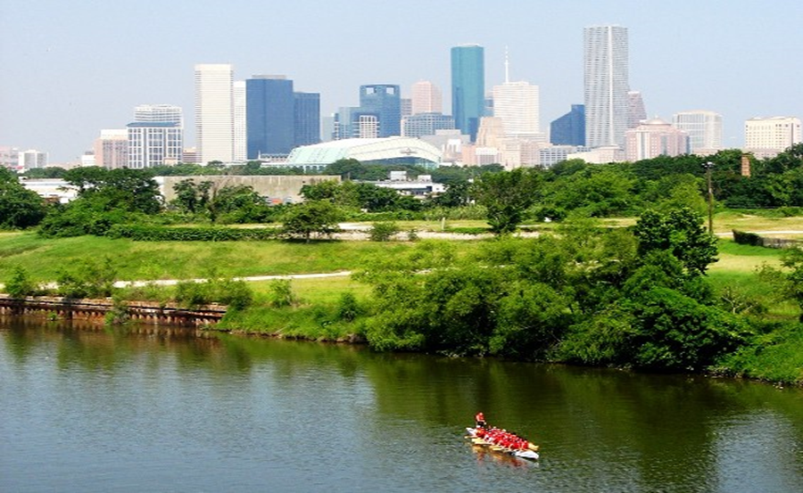

Municipal Setting Designations
Jennifer Clancey
Program Manager

Slide 2
What is an MSD?
A voluntary deed restriction that prohibits the use of impaired groundwater as potable water
    A tool property owners can use to address environmental impairments to groundwater
    Allows reinvestment and redevelopment of impaired properties
A public health protection

Slide 3
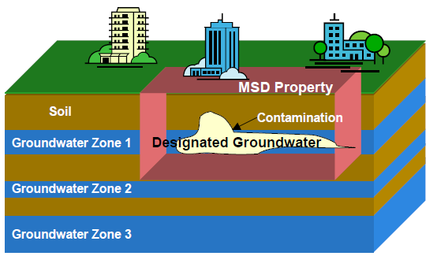
MSD Depiction

Slide 4
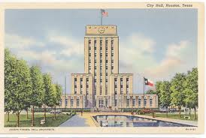
What is an MSD?
It is a State Program
    Administered by the Texas Commission on Environmental Quality (TCEQ)
    Requires Local Support
Article 13 of Chapter 47
    Public Hearing Required

Slide 5
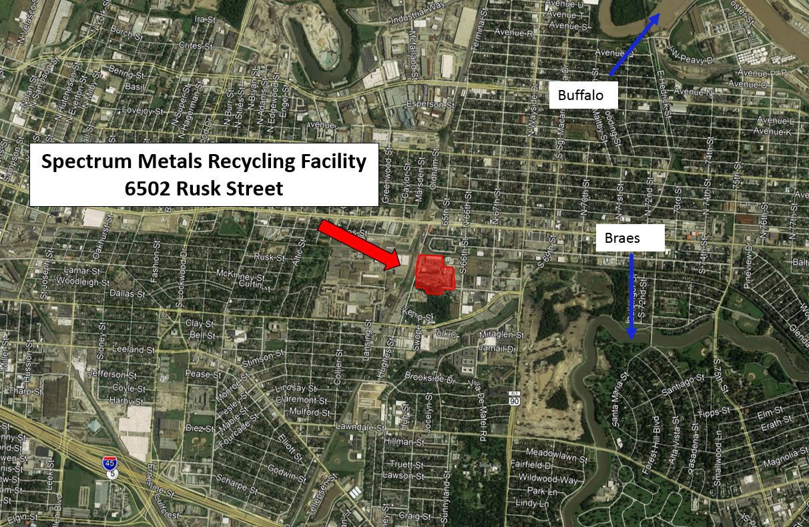
6502 Rusk Street

Slide 6
GMY LTD
Amend MSD Ordinance 2012-345
  (308 & 320 Hughes Street) 9.9574-acres
  Incorporate 1.7789 acres of 6502 Rusk Street
Site Has Long Industrial History (circa 1960’s)
2013: GMY Ltd. dba Spectrum Metals Recycling (GMY) purchases 6502 Rusk Street property
2014: enters state Voluntary Cleanup Program (VCP)

Slide 7
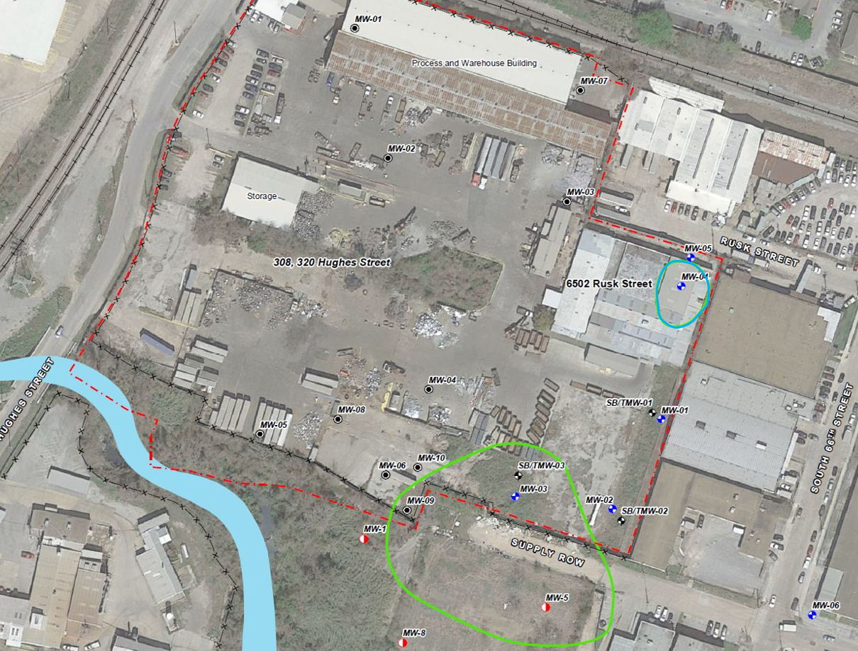
Groundwater Impacts

Slide 8
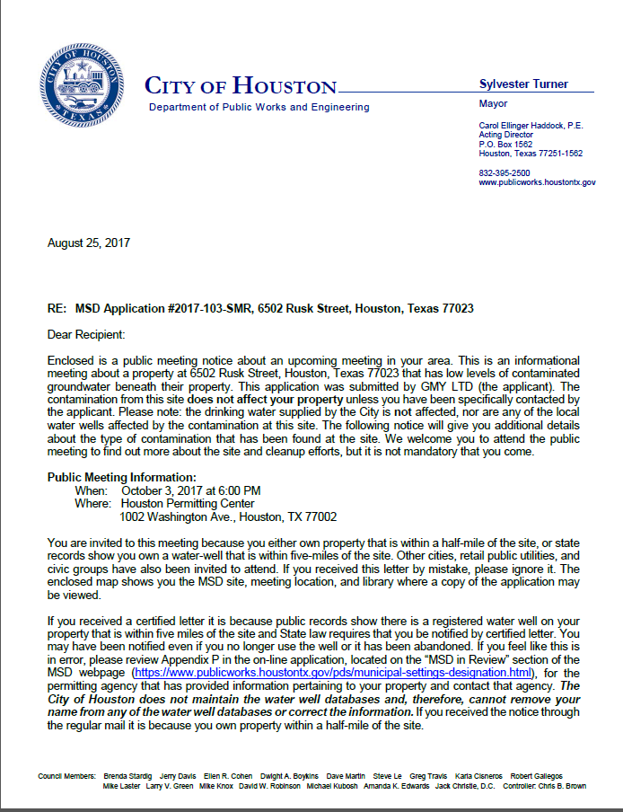
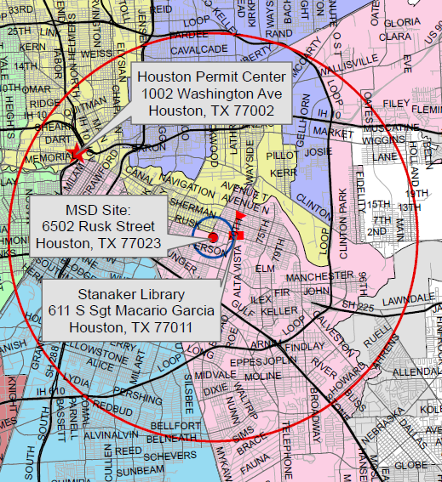
MSD Notice Letters
Property Owners
First-Class Mail
½-Mile Radius
City Requirement
Water Well Owners
Certified Mail
5-Mile Radius
State Requirement

Slide 9
Contact Information
Jennifer Clancey
Program Manager
Public Works & Engineering
City of Houston,
1002 Washington, 3rd Floor
Houston, Texas 77002
msd@houstontx.gov
(832) 394-9005

