Slide 1

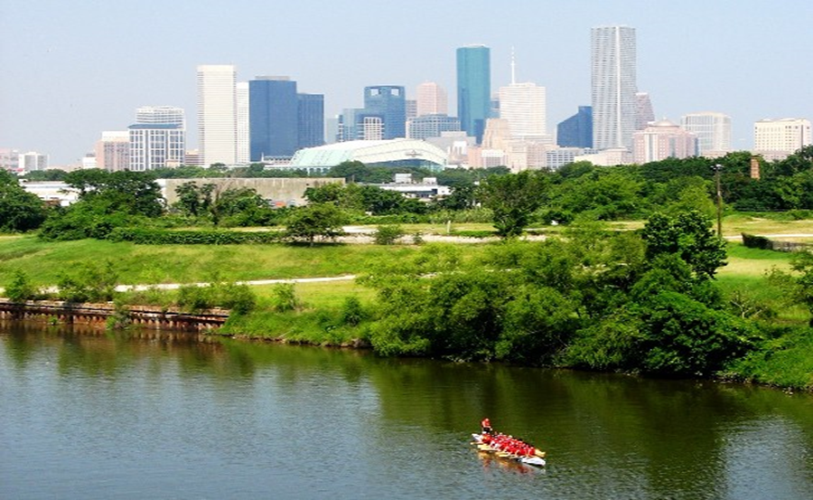

Municipal Setting Designations
Mark A. Wooten Jr.
Program Coordinator

Slide 2
What is an MSD?
A voluntary deed restriction that prohibits the use of impaired groundwater as potable water
    A tool property owners can use to address environmental impairments to groundwater
    Allows reinvestment and redevelopment of impaired properties
A public health protection

Slide 3
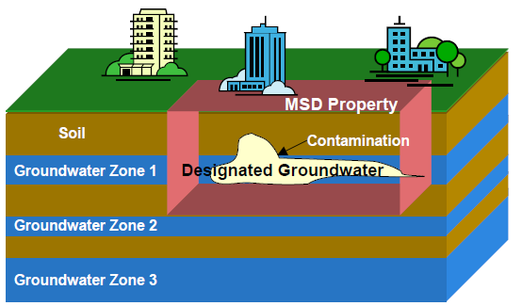
MSD Depiction

Slide 4
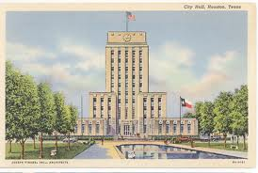
What is an MSD?
It is a State Program
    Administered by the Texas Commission on Environmental Quality (TCEQ)
    Requires Local Support
Article 13 of Chapter 47
    Public Hearing Required

Slide 5
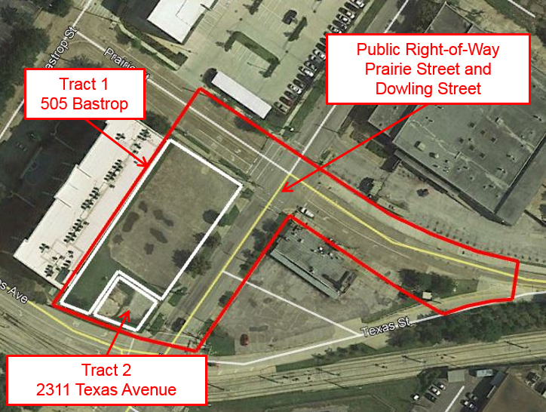
505 Bastrop St. & 2311 Texas Ave

Slide 6
Texas Bastrop, LLC
Approximately 1.8653 acres
1940s to 1990s: Maloney Precision Products
  Manufactured rubber, plastic and metal products
  Tract 1 – paved parking lot
  Tract 2 – vacant property currently undeveloped
TCEQ Voluntary Cleanup Program
  Tract 1 enrolled 2011 (VCP No. 2439)
  Tract 2 enrolled 2016 (VCP No. 2855)

Slide 7
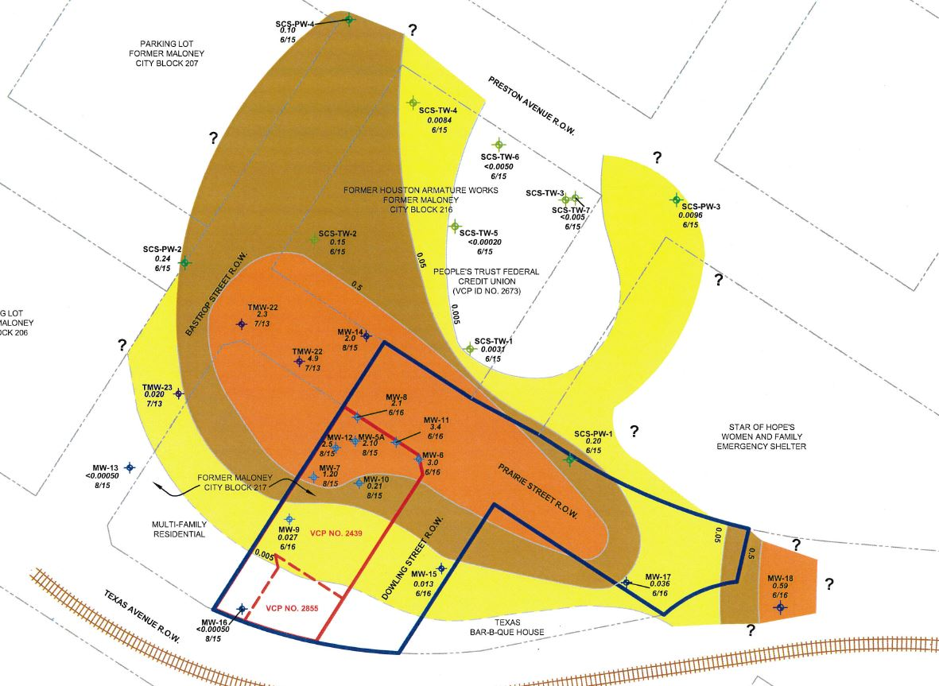
Groundwater Impacts

Slide 8
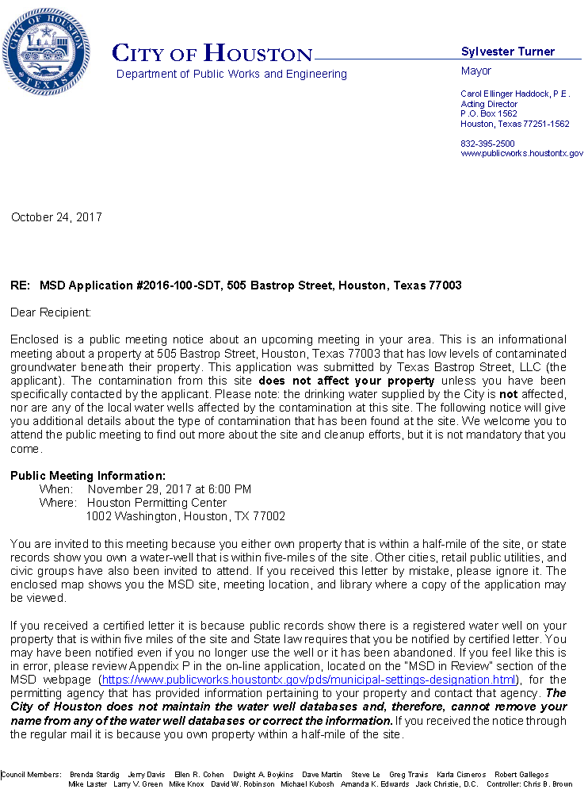
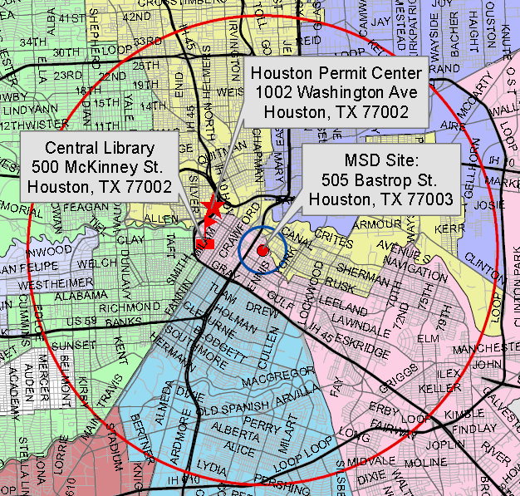
MSD Notice Letters
Property Owners
First-Class Mail
½-Mile Radius
City Requirement
Water Well Owners
Certified Mail
5-Mile Radius
State Requirement

Slide 9
Contact Information
Mark A. Wooten Jr.
Program Coordinator
Public Works & Engineering
City of Houston,
1002 Washington, 3rd Floor
Houston, Texas 77002
msd@houstontx.gov
(832) 394-9005

