Slide 1

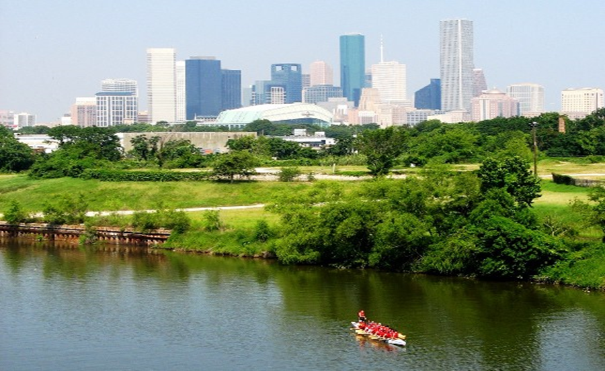

Municipal Setting Designations
Mark A. Wooten Jr.
Program Coordinator

Slide 2
What is an MSD?
A voluntary deed restriction that prohibits the use of impaired groundwater as potable water
    A tool property owners can use to address environmental impairments to groundwater
    Allows reinvestment and redevelopment of impaired properties
A public health protection

Slide 3
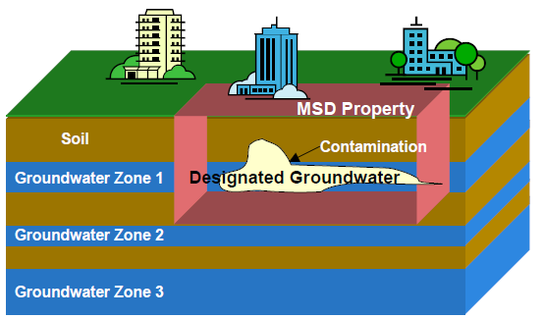
MSD Depiction

Slide 4
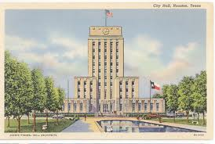
What is an MSD?
It is a State Program
    Administered by the Texas Commission on Environmental Quality (TCEQ)
    Requires Local Support
Article 13 of Chapter 47
    Public Hearing Required

Slide 5
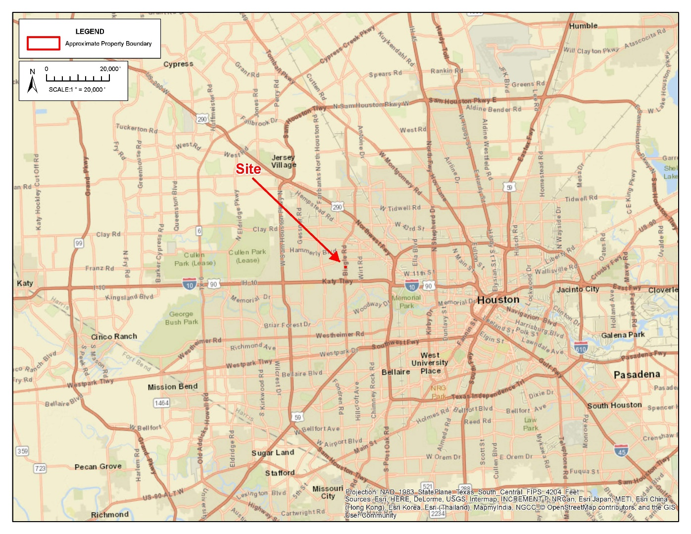
1508 Bingle Road

Slide 6
Bingle Storage, LP.
Approximately 0.922 acres
Three different laundromat tenants operated onsite from 1971 until 1986
  Two included dry-cleaning operations
Generic tire shop operated from 2000 until 2010
Bingle Food Store (convenience store/gas station) operated until 2016
  Two underground storage tanks (USTs) installed in 1974 and removed in 1992
  Three USTs installed in 1994 and removed in 2016
  Voluntary Cleanup Program 2015
Onsite buildings demolished in 2016
Redeveloping as a storage facility; opening in May 2018

Slide 7
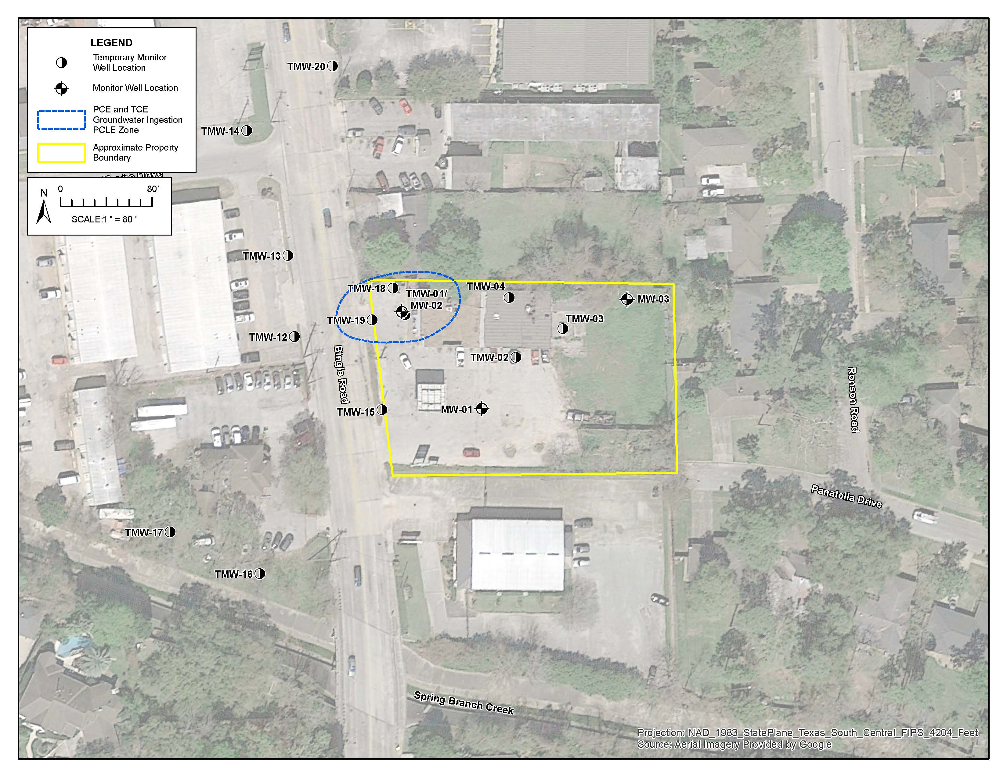
Groundwater Impacts

Slide 8
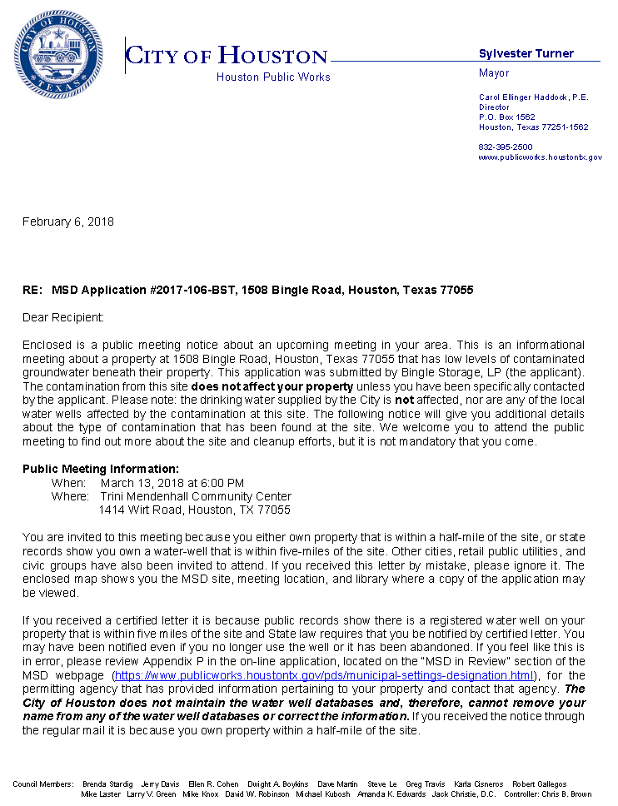
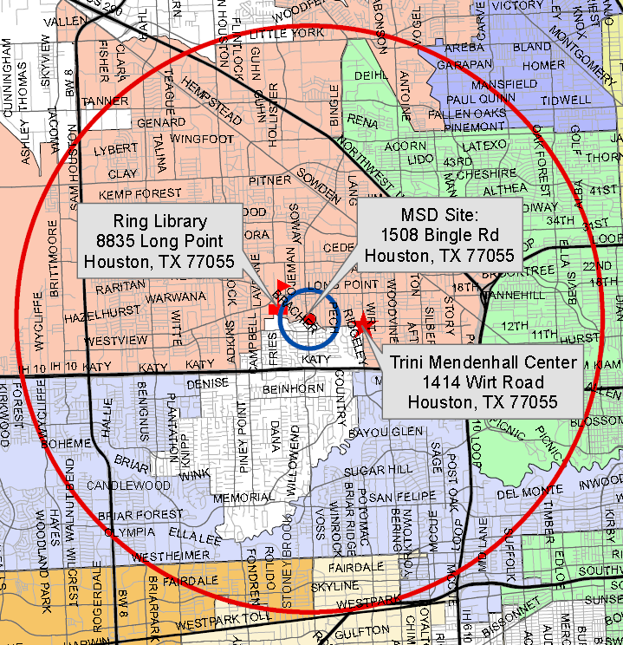
MSD Notice Letters
Property Owners
First-Class Mail
½-Mile Radius
City Requirement
Water Well Owners
Certified Mail
5-Mile Radius
State Requirement

Slide 9
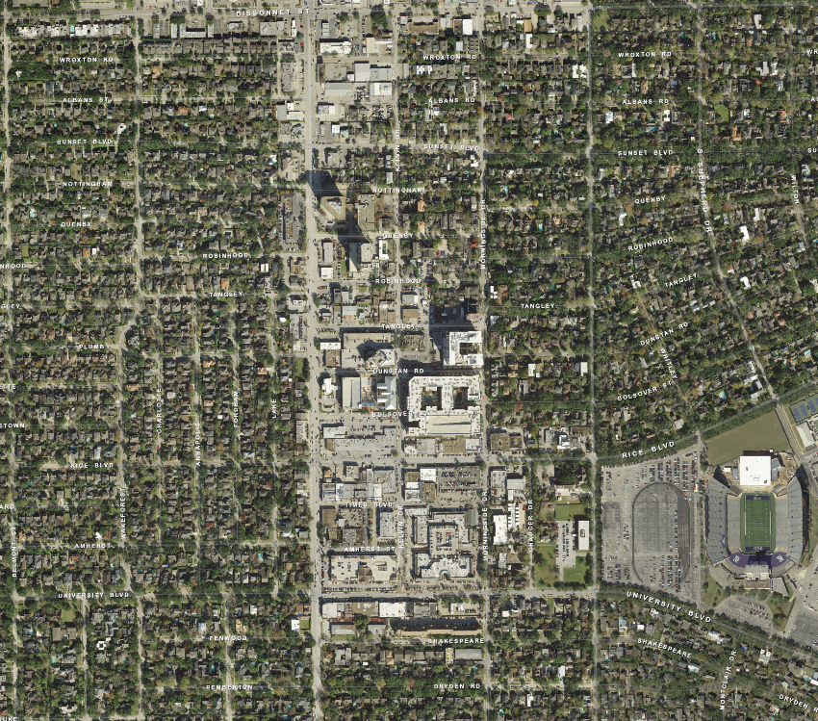
5829 Kirby Drive

Slide 10
Felix Center on Kirby, LTD/Kirby Center Partners, LLC
Approximately 0.8266 acres
LeBon Cleaners operated on site from 1995 until 2017
Discontinued use of Tetrachloroethene (PCE) as dry-cleaning solvent in 2005
Removed all dry-cleaning equipment and became a drop station in 2015
Voluntary Cleanup program 2013
LeBon Cleaners vacated tenant space in September 2017
Site continues to operate as a multitenant shopping center

Slide 11
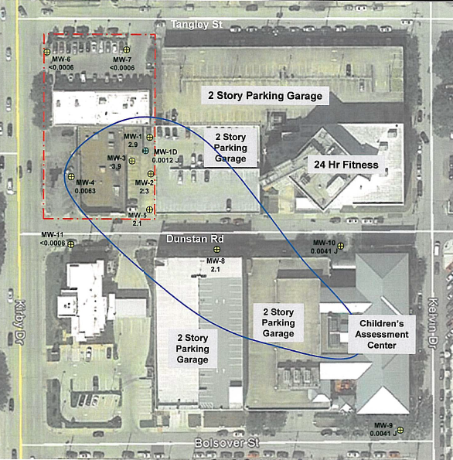
Groundwater Impacts

Slide 12
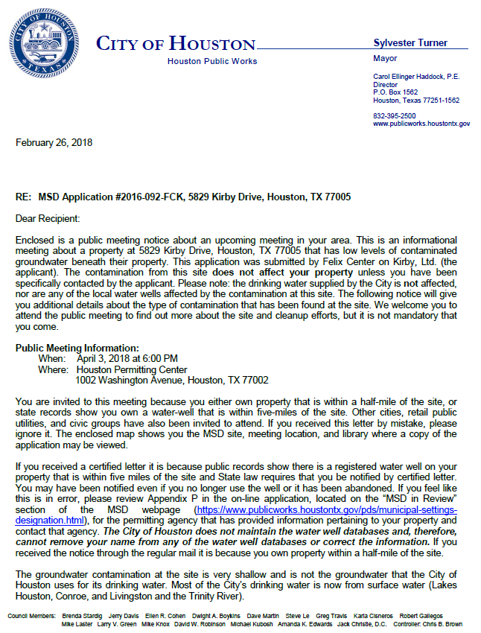
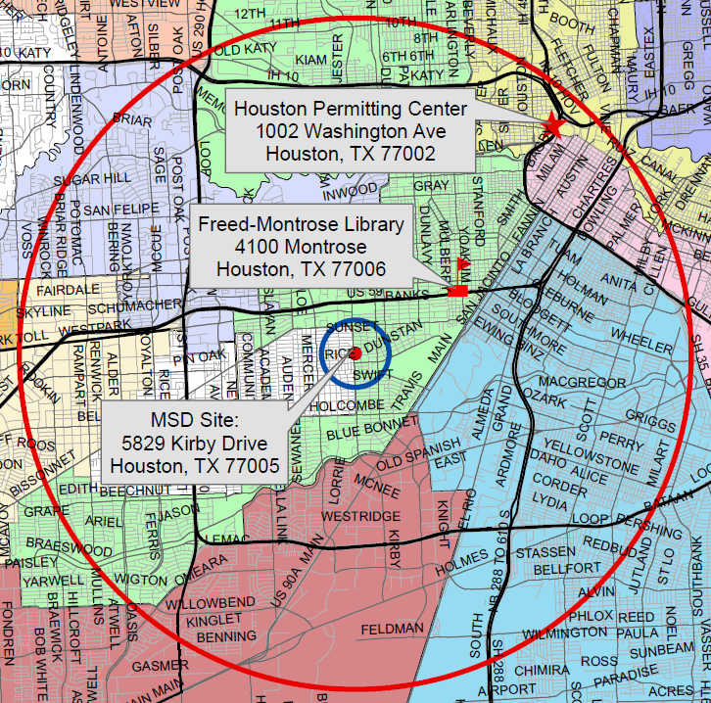
MSD Notice Letters
Property Owners
First-Class Mail
½-Mile Radius
City Requirement
Water Well Owners
Certified Mail
5-Mile Radius
State Requirement

Slide 13
Contact Information
Mark A. Wooten Jr.
Program Coordinator
Houston Public Works
1002 Washington, 3rd Floor
Houston, Texas 77002
msd@houstontx.gov
(832) 394-9005

