Slide 1
NEWPP Expansion
Project Update
TTI Committee Briefing
April 16, 2018

Slide 2
CONTENTS
1 | Project Background
2 | Project Advisor Role:
3 | Delivery ● Scope ● Cost
4 | Request for Council Actions

Slide 3
Project Background

Slide 4
Necessary for Subsidence
Regulations & Growth
Increase in requirement
90
80
70
60
50
40
30
20
10
0
% of Water Demand Supplied by Surface Water
Current
January 2025
January 2035

Slide 5
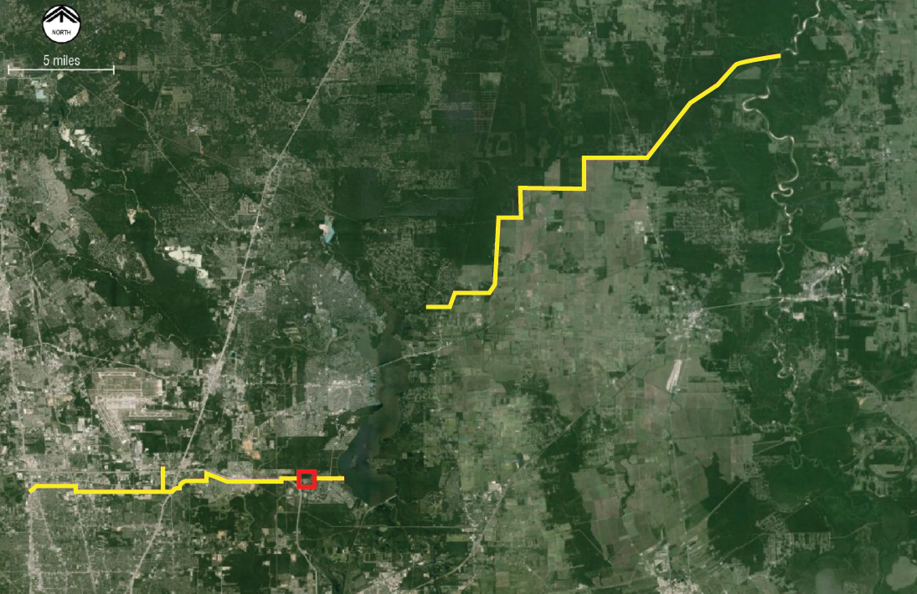
One Component of
Regional Water Supply Plan
Luce Bayou Interbasin
Transfer (CWA Project)
(2019 completion)
Trinity
River
City/NHCRWA/CHCRWA TM
(2021 Completion)
Lake
Houston
New Plant & Intake
(2024 Completion)
WHCRWA/NFBWA TM
(2021 Completion)

Slide 6
Project Partners
Cost Share

Slide 7
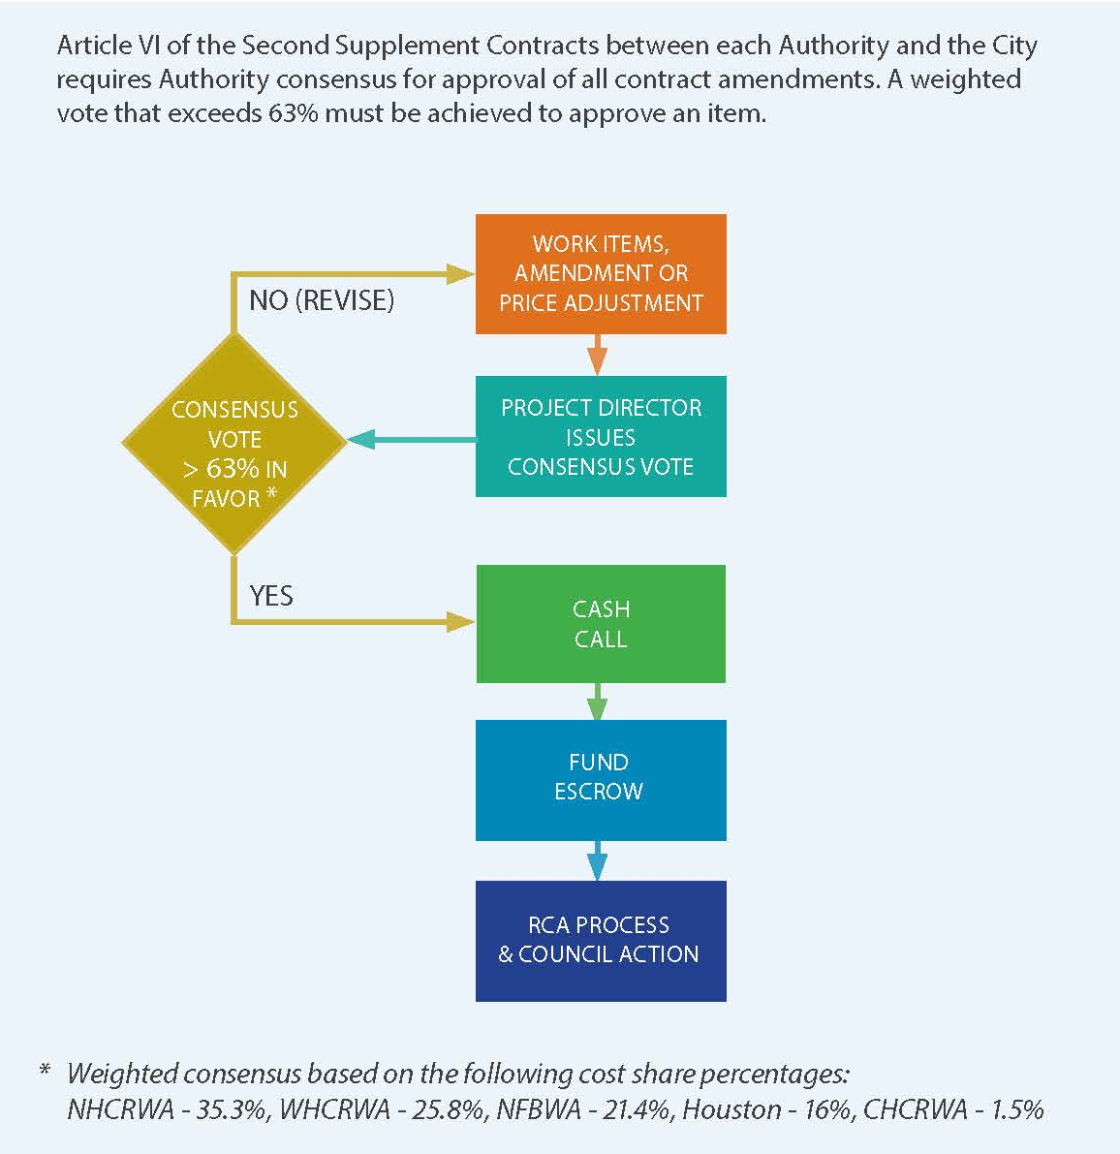
Authority & City Consensus Required to Approve Amendments

Slide 8
Role of the Project Advisor & Technical Consultant

Slide 9









Project Stakeholders
Legal Department
City Contractual Relationship
Public Works Teams
Permitting, Geotechnical, Finance, Transmission Mains, etc.
HOUSTON PUBLIC WORKS
Authority
Partners
Design-Builder
Project Advisor
State/Federal Agencies
USACE, TCEQ, TWDB, etc.
Subconsultants
Subcontractors
Subconsultant
Team members
9
Notes:
9

Slide 10

PATC Roles
Staff Augmentation
Through all Phases
Piloting and Process Confirmation
In association with
Procurement and
Negotiation Support
5Engineering
Aviles Engineering
Capital Project Strategies
CP&Y
EJES Inc.
Gunda Corporation
Gupta & Associates
Hunt & Hunt Engineering
RPH Consulting Group
SES Horizon Consulting Eng
Strong Strategies, LLC
United Engineers
Permitting Support
Project Controls
Technical Collaboration & Review
Construction review & monitoring

Slide 11
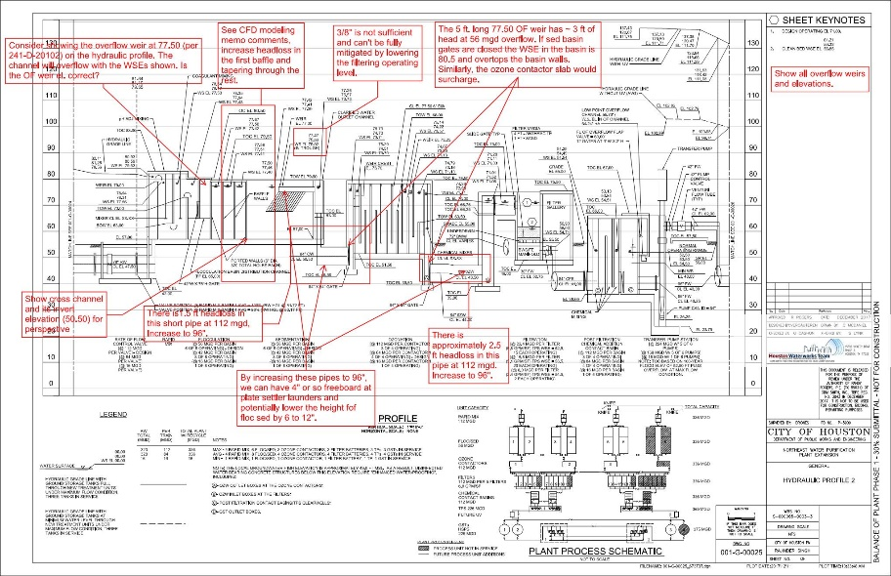
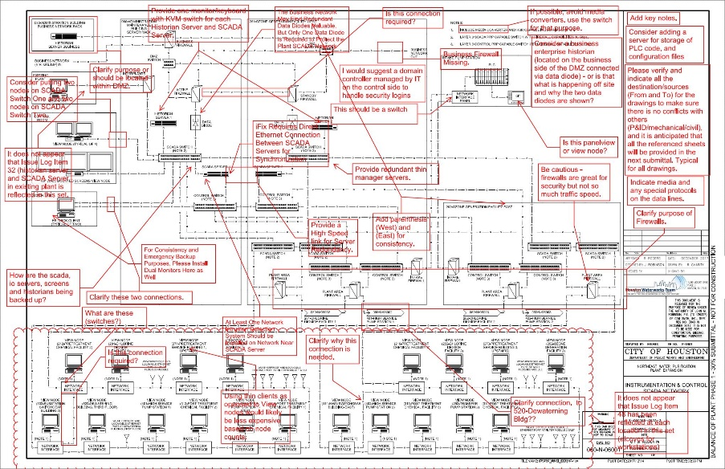
PATC Provides Valuable Oversight
Review all Project documents to make sure the City’s goals & requirements are met
Validate each amendment to HWT’s contract, helping the Project partners save millions

Slide 12
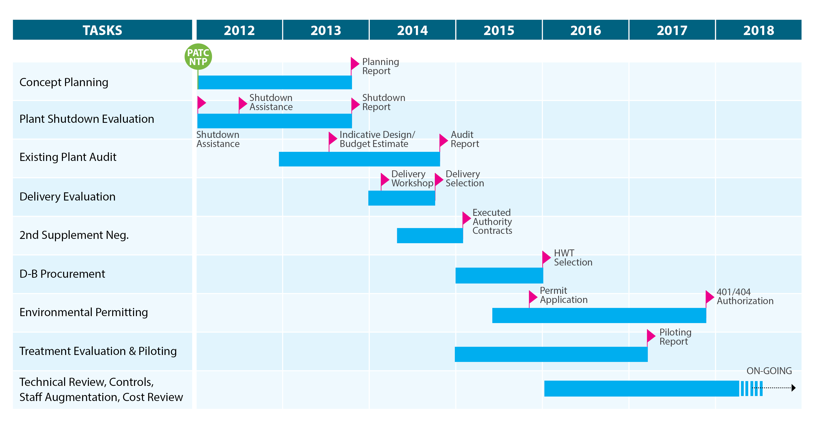
City & PATC Project Progression Timeline

Slide 13
Delivery ● Scope ● Cost

Slide 14
Two-phase (progressive) Design-Build
Lessons learned from DBO delivery of original NEWPP
Owner involvement
Best opportunity to achieve an earlier completion milestone
Earlier cost knowledge
Better ability to adapt to market conditions
Reduces interface risk - “one throat to choke”
PDB
DBB
Houston
Houston
Designer/Builder
Designer
Contractor

Slide 15
Progressive design-build (PDB) allows for ongoing scope and cost refinements
Preliminary Services
Final Design & Construction Services
Basis of
Design
GMP
Proposal
Final
Completion
City & HWT jointly develop scope
HWT estimates costs
City independently validates costs
Scope refinements/ value engineering incorporated
GMP submitted & negotiated
Price, Scope, Schedule
Contractually Agreed-to
Final Cost =
GMP + Approved Changes – Shared Savings Rebate
Guaranteed Maximum
Price (GMP) late 2018
Final Acceptance
late 2024
Contract
Award
& NTP
Approval of
Amendments

Slide 16
Progressive Design-Build allows ongoing scope and cost refinements
Preliminary Services
Final Design & Construction Services
Basis of
Design
GMP
Proposal
Final
Completion
Amendments:
Contract amendments are a planned part of the delivery
They are NOT change orders
They are used to authorize early work
City & HWT jointly develop scope
HWT estimates costs
City independently validates costs
Scope refinements/ value engineering incorporated
GMP submitted & negotiated
Price, Scope, Schedule
Contractually Agreed-to
Final Cost =
GMP + Approved Changes – Shared Savings Rebate
Guaranteed Maximum
Price (GMP) late 2018
Final Acceptance
late 2024
Contract
Award
& NTP
Approval of
Amendments

Slide 17
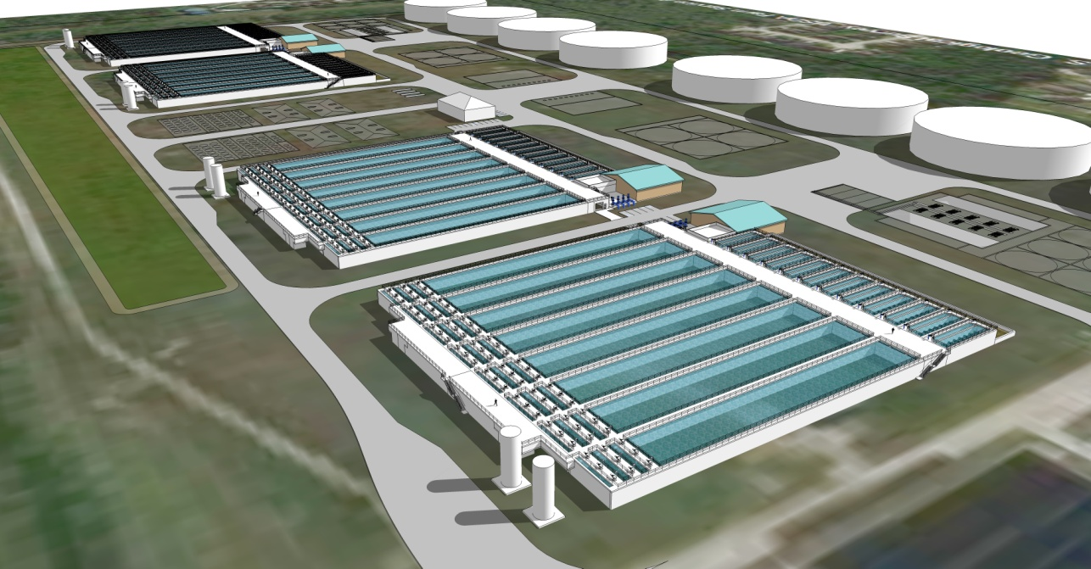
Preliminary budget based on Indicative Design prepared by PATC (Aug 2013)
Belt press dewatering
NO ozone or chlorine dioxide
Design-bid-build
On-shore raw water intake
Conventional WTP, no high-rating
PATC Estimated Design + Construction Cost: $1,167,000,000

Slide 18
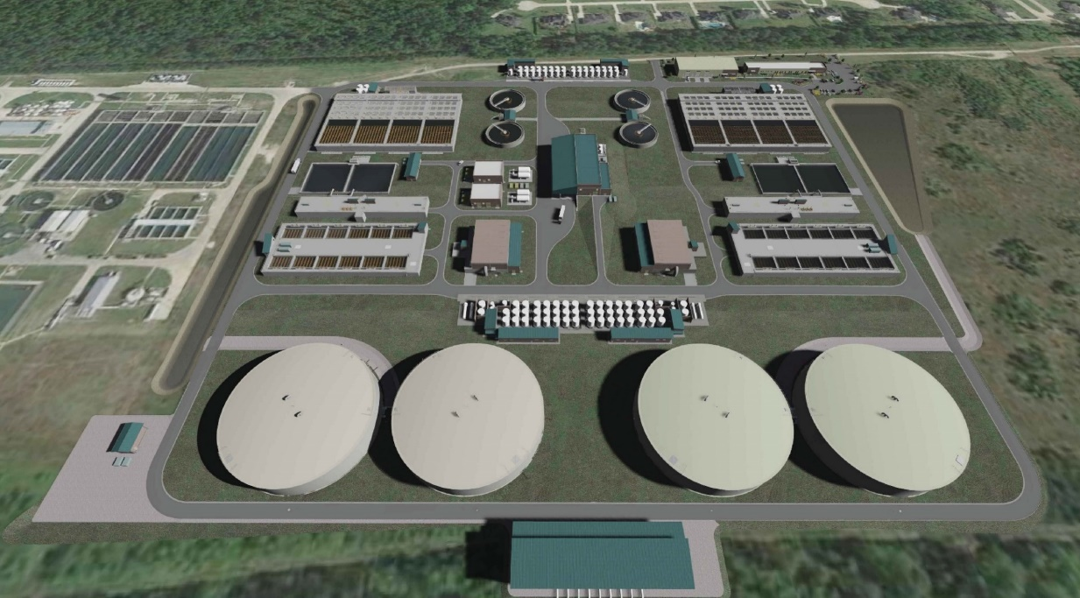
Conceptual campus layout per
HWT Proposal (Oct 2015)
Separate, single-story Admin & Maint Bldgs
Higher rate settling
(0.3 gpm/esf)
Single-story
Dewatering Bldg
(3 centrifuges)
Higher rate filtration
(8.0 gpm/sf)
Off-shore raw water intake
Ozone
Chlorine dioxide
NO recycle treatment
2 treatment modules
Estimated HWT Design-Build Cost: $893,000,000

Slide 19
Design enhancements help treat challenging raw water quality
Challenging raw water quality has led to previous plant shut-downs.
New facilities are designed to prevent this from occurring in future.
Additional thickeners & centrifuges help handle more solids produced from storms
Plant Shutdown
Lower filter and sedimentation rates help treat flashy water
Chemical enhancements help handle drops in alkalinity
More ozone capacity helps oxidize high organics, color, & improve filtration

Slide 20
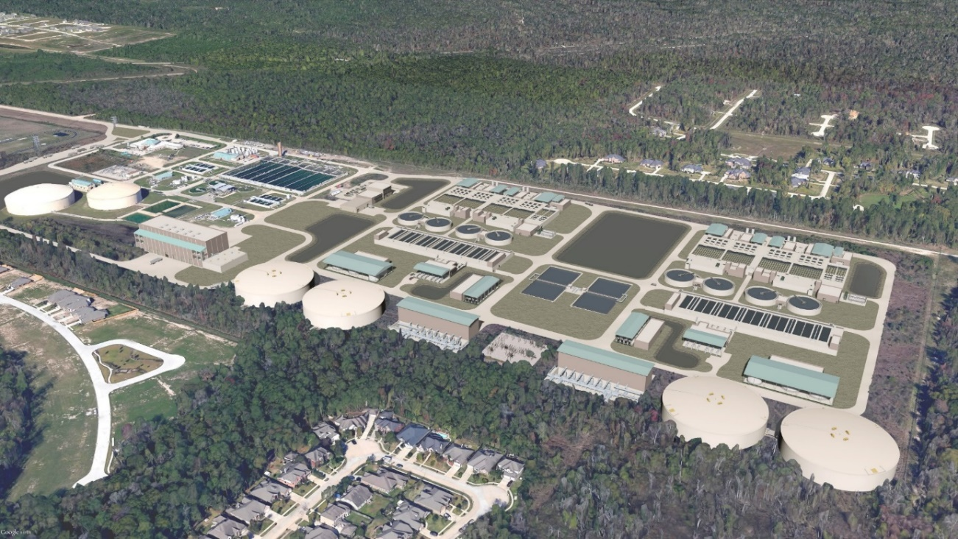
HWT – Final BODR Addendum Estimate
(June 2017)
Off-shore raw water intake
Ozone
Chlorine dioxide
With recycle treatment
2 treatment modules
Reduced rate settling
(0.2 gpm/esf)
Single, Multi-story
Admin/Maint Bldg
Multi-story
Dewatering Bldg
(5 centrifuges)
Lower rate filtration
(5.1 gpm/sf)
Estimated HWT Design-Build Cost: $1,335,000,000

Slide 21


HWT – 30% Design Estimate (Jan 2018)
Reduced rate settling
(0.2 gpm/esf)
Off-shore raw water intake
Ozone
Chlorine dioxide
With recycle treatment
2 treatment modules
Incorporates recent market data
Impacts larger site area (90 acres)
Larger
Single, Multi-story
Admin/Maint Bldg
More stormwater ponds
Multi-story
Dewatering Bldg
(5 centrifuges)
Lower rate filtration
(5.1 gpm/sf)
Estimated HWT Design-Build Cost: $1,684,000,000

Slide 22
Collaborative design process led to facility changes that increased cost estimates
 | Indicative Design Estimate | HWT Proposal Price | BODR Addendum Cost Estimate | 30% Design Cost Estimate
Estimated Non-oversized Cost | $1.167B | $893M | $1.335B | $1.684B
Incorporates Facility Enhancements*
Ability to operate intermittently at higher production (up to 425 mgd)
Traditional filter & pretreatment loading rates**
* Project elements added to increase reliability, redundancy, and robustness (e.g., additional dewatering centrifuges to handle large solids loadings during storm events). ** Reduced rates for settling and filtration at 320 MGD to account for challenging raw water quality events.

Slide 23
Estimated costs changed in response to scope and market conditions
HWT
Proposal
Final BODR
Addendum
30%
Design
Original Budget
Estimate
$1,167
M
$893
M
$1,335
M
$1,684
M
NON-OVERSIZED ESTIMATES
2015
2017
Aug
Nov
Aug
Apr
Jan
June
Oct
June
2013
2016
2018
$1,410
M
$1,755
M
OVERSIZED ESTIMATES
*Estimates are DB costs for HWT and do not include City administration, PATC, legal, and reserves.

Slide 24
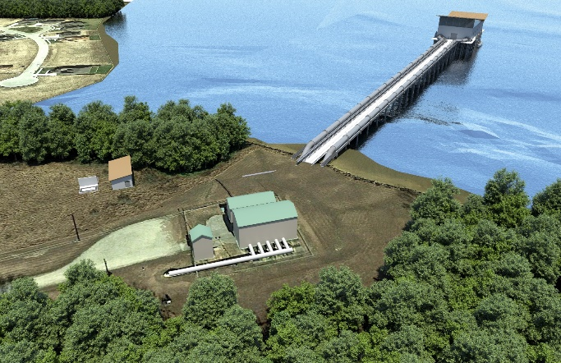
Over-sized* facilities allow for future capacity increases
IPS: Larger building, extra pump cans
RW Pipelines:
2 @ 108” vs.
2 @ 96”
GST: Larger capacity
(x4 tanks)
HSPS: Larger buildings, extra pump cans (x2 stations)
*Extra capacity beyond 320 MGD, paid for by City, but Authorities can elect
to participate by paying for costs proportional to their participation amount.

Slide 25
Filter Loading Rates Impact Cost

Slide 26
EWP Pricing Confirmed BODR Addendum Cost Estimates
*Some adjustments made to allow for comparison on a direct scope basis.

Slide 27
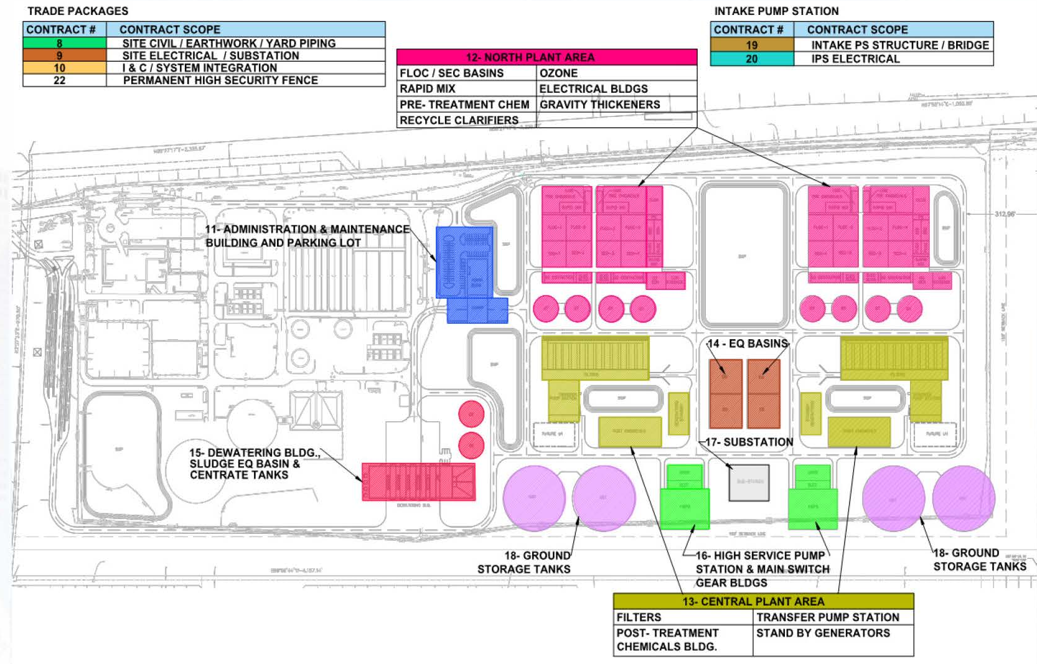
Final pricing based on competitively bid pkgs.

Slide 28
Cost modeling summary
Project costs are estimates, NOT actual costs until a Guaranteed Maximum Price (GMP) is negotiated
Ability to adjust project scope relative to the budget
Opportunities to incorporate market-based information
Value engineering to reduce costs
Negotiations to adjust price
Under a traditional delivery, cost changes would not be known until bid day, with little ability to change

Slide 29
Progress to Date

Slide 30
Project is midway through the Preliminary Services phase
Preliminary Services
Final Design & Construction Services
Basis of
Design
GMP
Proposal
Phase 1
(80 mgd)
milestone
Phase 2
(240 mgd)
milestone
Final
Completion
Component 1
6/30/22
(current estimate)
6/27/24
(current estimate)
Component 2*
Early Work Packages
NEWPP Construction
We are Here
Transition & Warranty Services
Final
Acceptance
Contract
Award
& NTP
Amendments
Approval
Guaranteed Maximum
Price Approval
* Design & pre-construction services

Slide 31

Design nearing 60% completion milestone

Slide 32
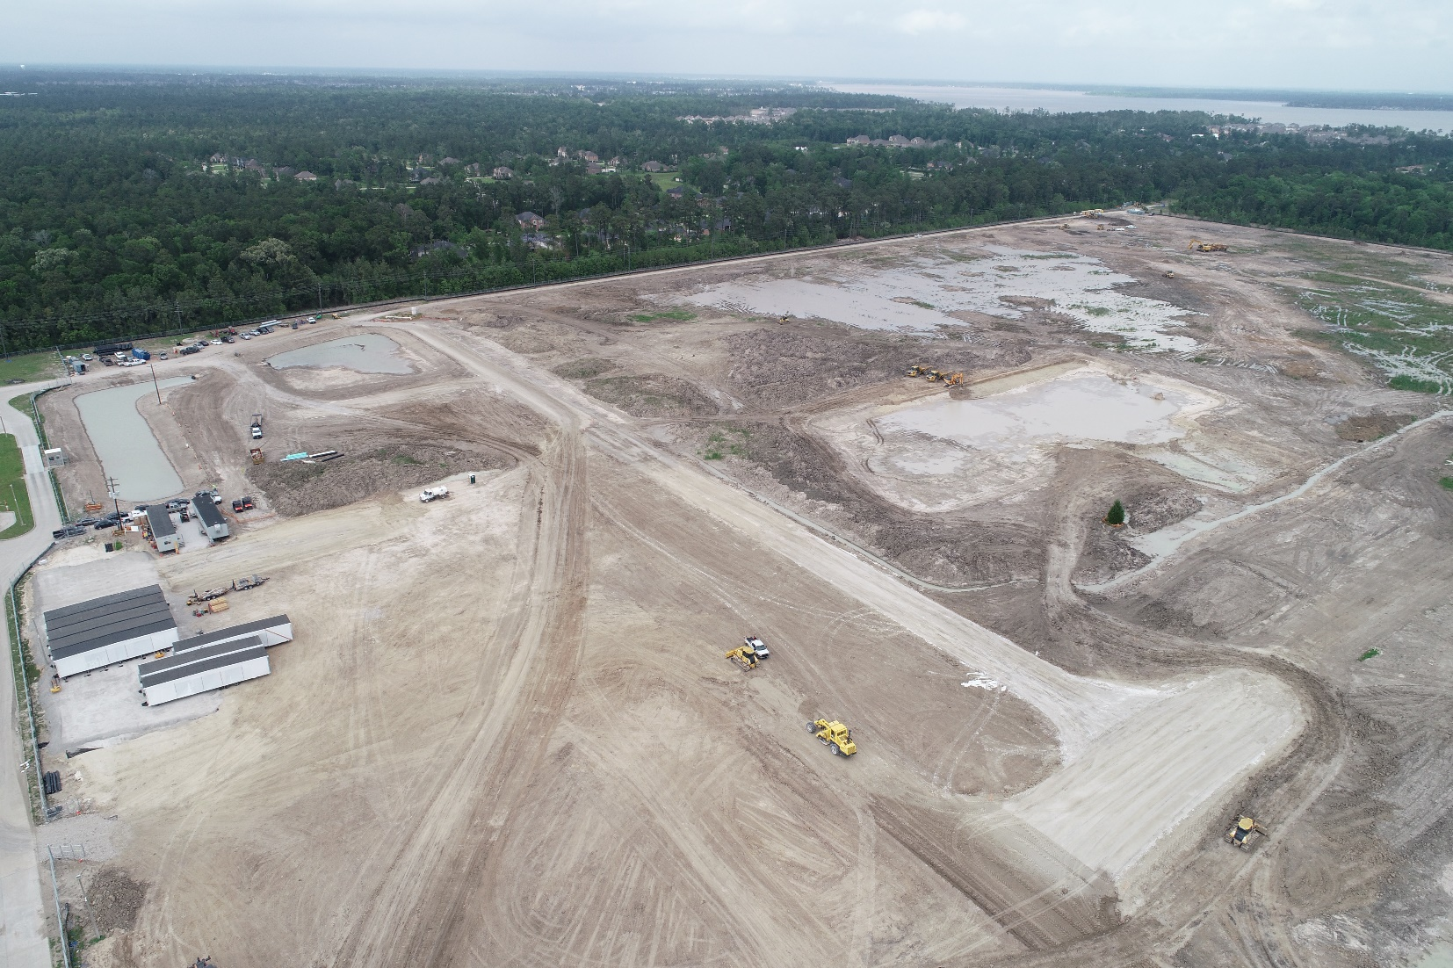
EWP Construction Activities

Slide 33
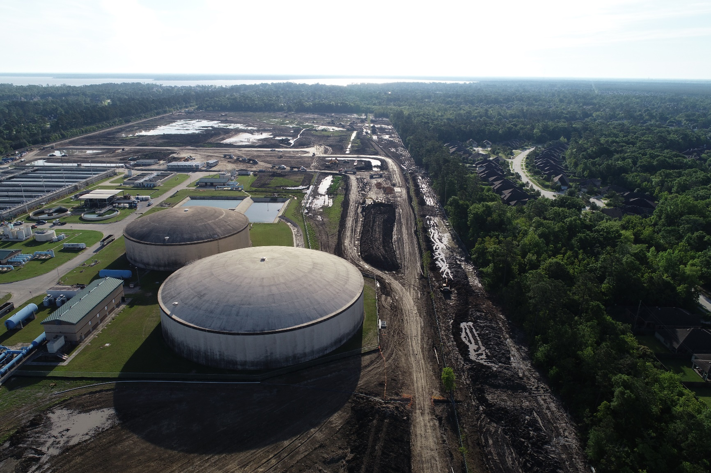
EWP Construction Activities

Slide 34
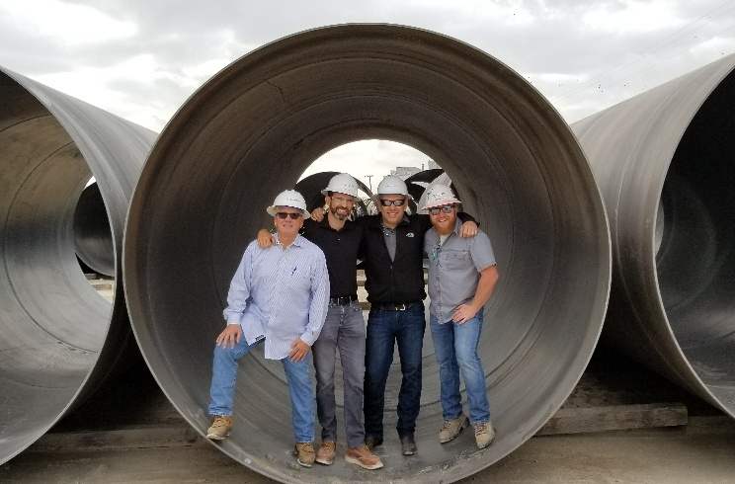
108-inch raw water pipe is ready for delivery

Slide 35
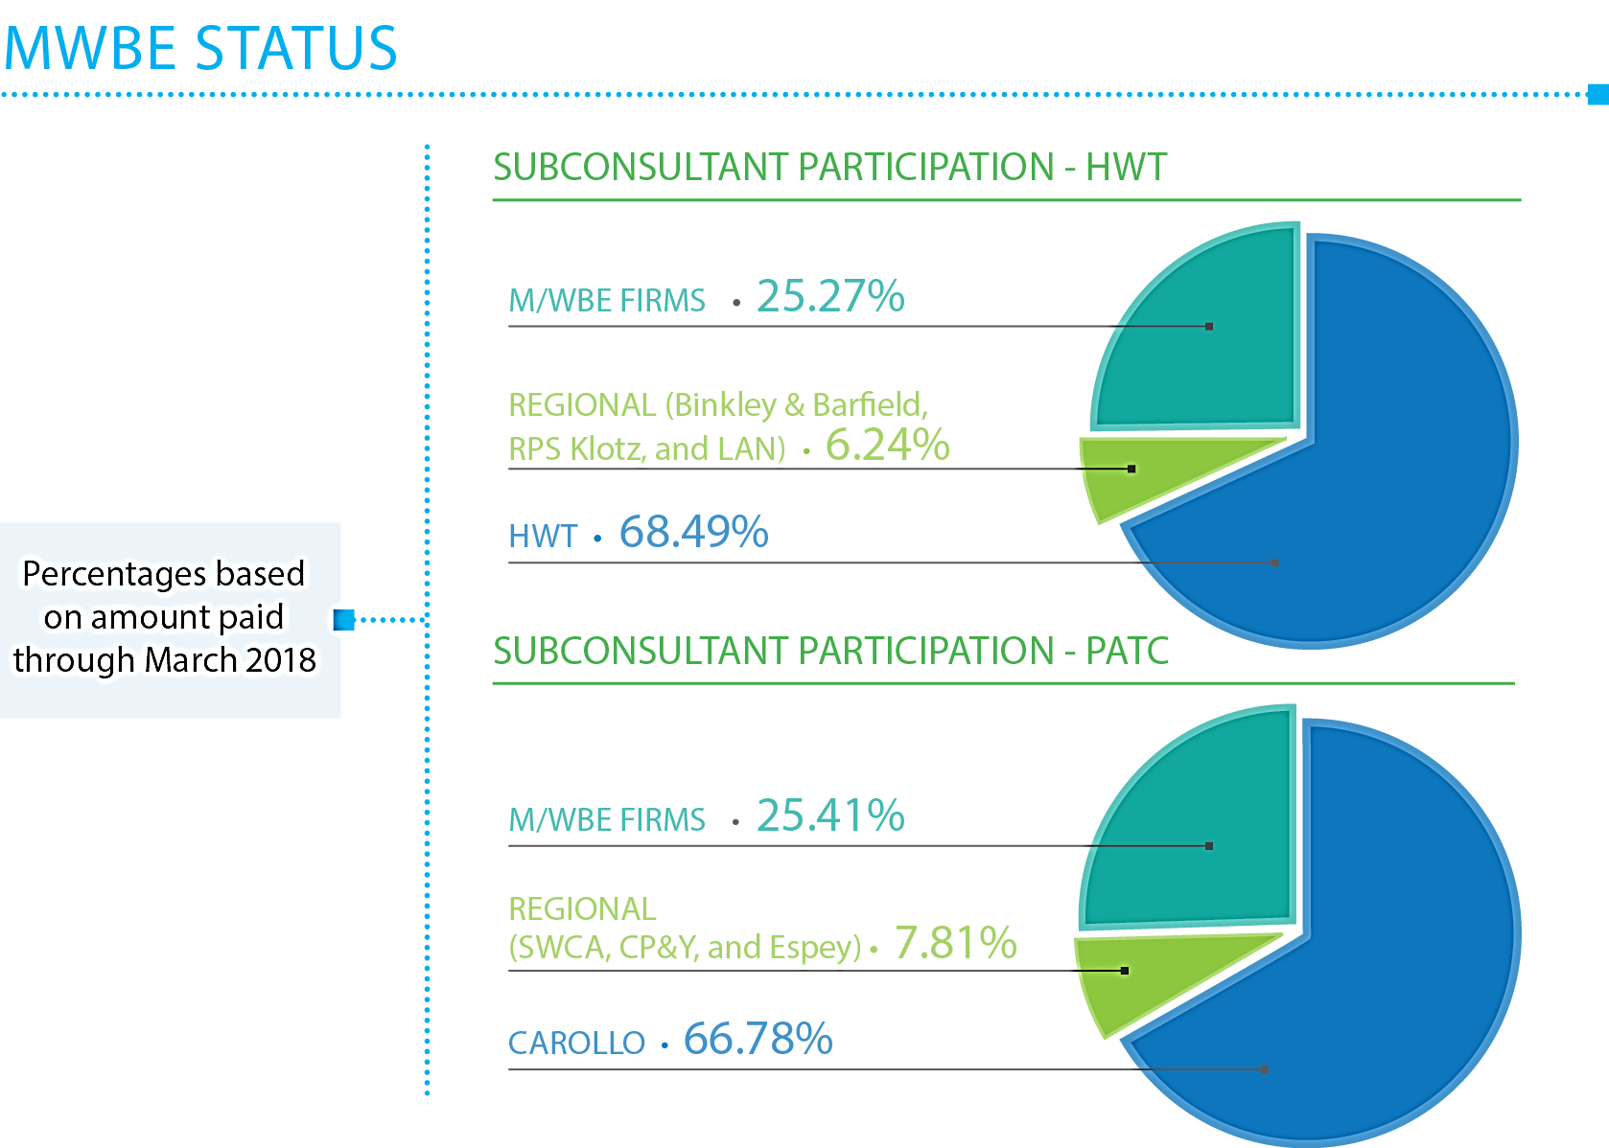
MWBE Engagement Overview - Design

Slide 36
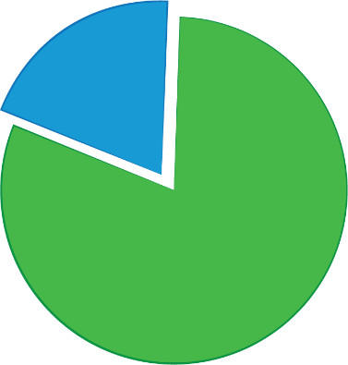
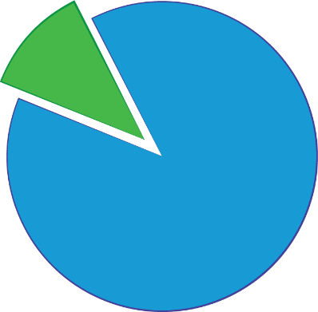
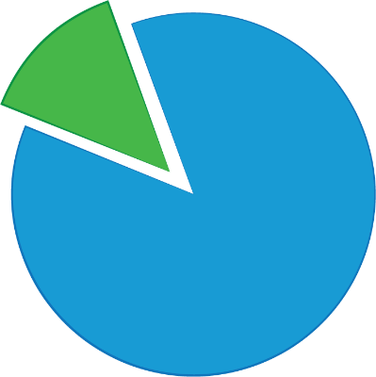
MWSBE Participation – EWP Construction
MWSBE Participation for
EWP 1 ($13.8M of $17.18M direct construction cost)
MWSBE Participation for
EWP 2 ($3.8M of $35.5M direct construction cost)
MWSBE Participation for
EWP 4 ($4.3M of $32.2M direct construction cost)
19.7%
11.55%
13.4%
80.3%
88.45%
86.6%
Balance of Work
Balance of Work
Balance of Work
M/WBE Firms include Landtech, Fence Master, Lazer and Emerald
M/WBE Firms include Rebar Reinforcement Placers, Cohen Industrial Supply, and C&B Waterworks, Inc.
M/WBE Firms include Republic Traffic Safety, J. Simmons, Fierro Group, Z Logistics, M&D Foundation, AGS Consultants, All Steel

Slide 37
Community Outreach
Website – greaterhoustonwater.com
Phone hotline – (281) 520-3777
Two public meetings held:
  October 25, 2017
  November 15, 2017
Construction notifications distributed
Upcoming public meeting (May 1)
Weekly coordination meetings – construction & outreach teams
Over 70 contractor outreach events between February 2017 & April 2018, including:
  National Association of Minority Contractors
  PWE Contracts in 5
  Greater Houston Black Chamber of Commerce
  Greater Houston Business Procurement Forum
  Women Contractor’s Association
  Houston Contractor’s Association

Slide 38
Requests for Council Action

Slide 39
Upcoming Requests for Council Action
Action | Approx. Date | Amount
Approve HWT Amendment 6 – EWP #2A | April 2018 | $45.5M
Approve HWT Amendment 7 – EWP #5 | Spring 2018 | TBD
Approve HWT Amendment 8 – EWP #6 | Summer 2018 | TBD
Approve HWT Amendment 9 – EWP #7 (tentative) | Summer 2018 | TBD
Approve HWT Amendment – GMP for Balance of Plant | Late 2018 | TBD
Approve PATC Amendment | Mid-Late 2018 | TBD

Slide 40
NEWPP Expansion
Project Update
TTI Committee Briefing
April 16, 2018

