Slide 1
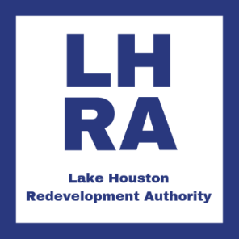
Northpark Drive Overpass Project
Open House
February 6, 2020
Kingwood Community Center

Slide 2
Project Overview – The Western Sector
The Lake Houston Redevelopment Authority (LHRA) in conjunction with Tax Increment Reinvestment Zone No. 10 (TIRZ 10) and the City of Houston are leading the reconstruction of Northpark Drive.
The Authority commissioned the Kingwood Area Mobility study in 2013, at the request of the Public Works Department of the City of Houston and needed to take a comprehensive analysis of mobility needs in general for the greater Kingwood area. The study included extensive public input and Northpark Drive was identified by the community as the number one priority mobility project needed for the Kingwood area.
The project will reduce congestion, decrease traffic delays and travel time, improve mobility, and enhance pedestrian safety.

Slide 3
Project Benefits
  Expansion of Northpark Drive from four to six lanes between I-69 (US Highway 59) to Russell Palmer Road.
  Construction of an overpass to route traffic over the Union Pacific Railroad tracks and Texas State Loop 494.
  Decrease delays/travel time.
  Elevate Northpark Drive over the 500-year floodplain.
  Storm water and flood mitigation improvements

Slide 4
Project Details
Funding
  The Western Sector of the Project (T-1013) has a total budget of $39,913,000 with the City of Houston contributing $15,455,000, and the Lake Houston Redevelopment Authority contributing $24,458,000. The Authority will fund any overages.

Slide 5
Project Timeline
Open House
February 6, 2020
Open House
Construction Contract Awarded
Project Begins

Slide 6
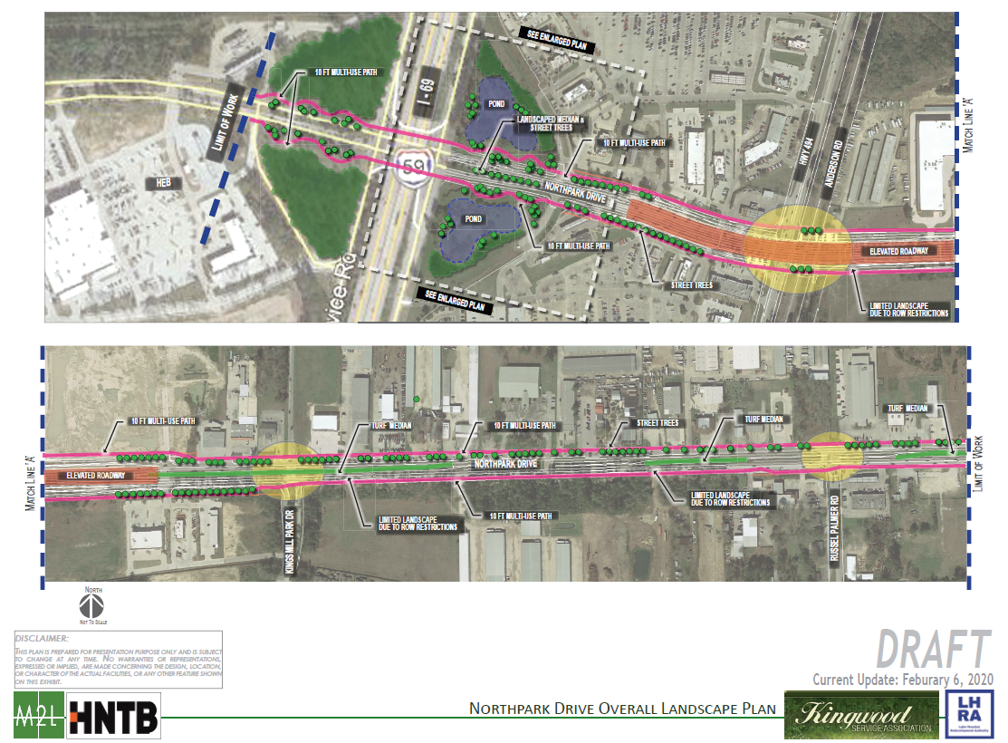
Proposed Northpark Drive Landscape Plan

Slide 7
Contact Us
Lake Houston Redevelopment Authority & TIRZ 10
c/o Allen Boone Humphries Robinson LLP
3200 Southwest Freeway, Suite 2600
Houston, Texas 77027
Please direct all questions and information requests to NorthparkDrive@elmorepr.com

