Slide 1
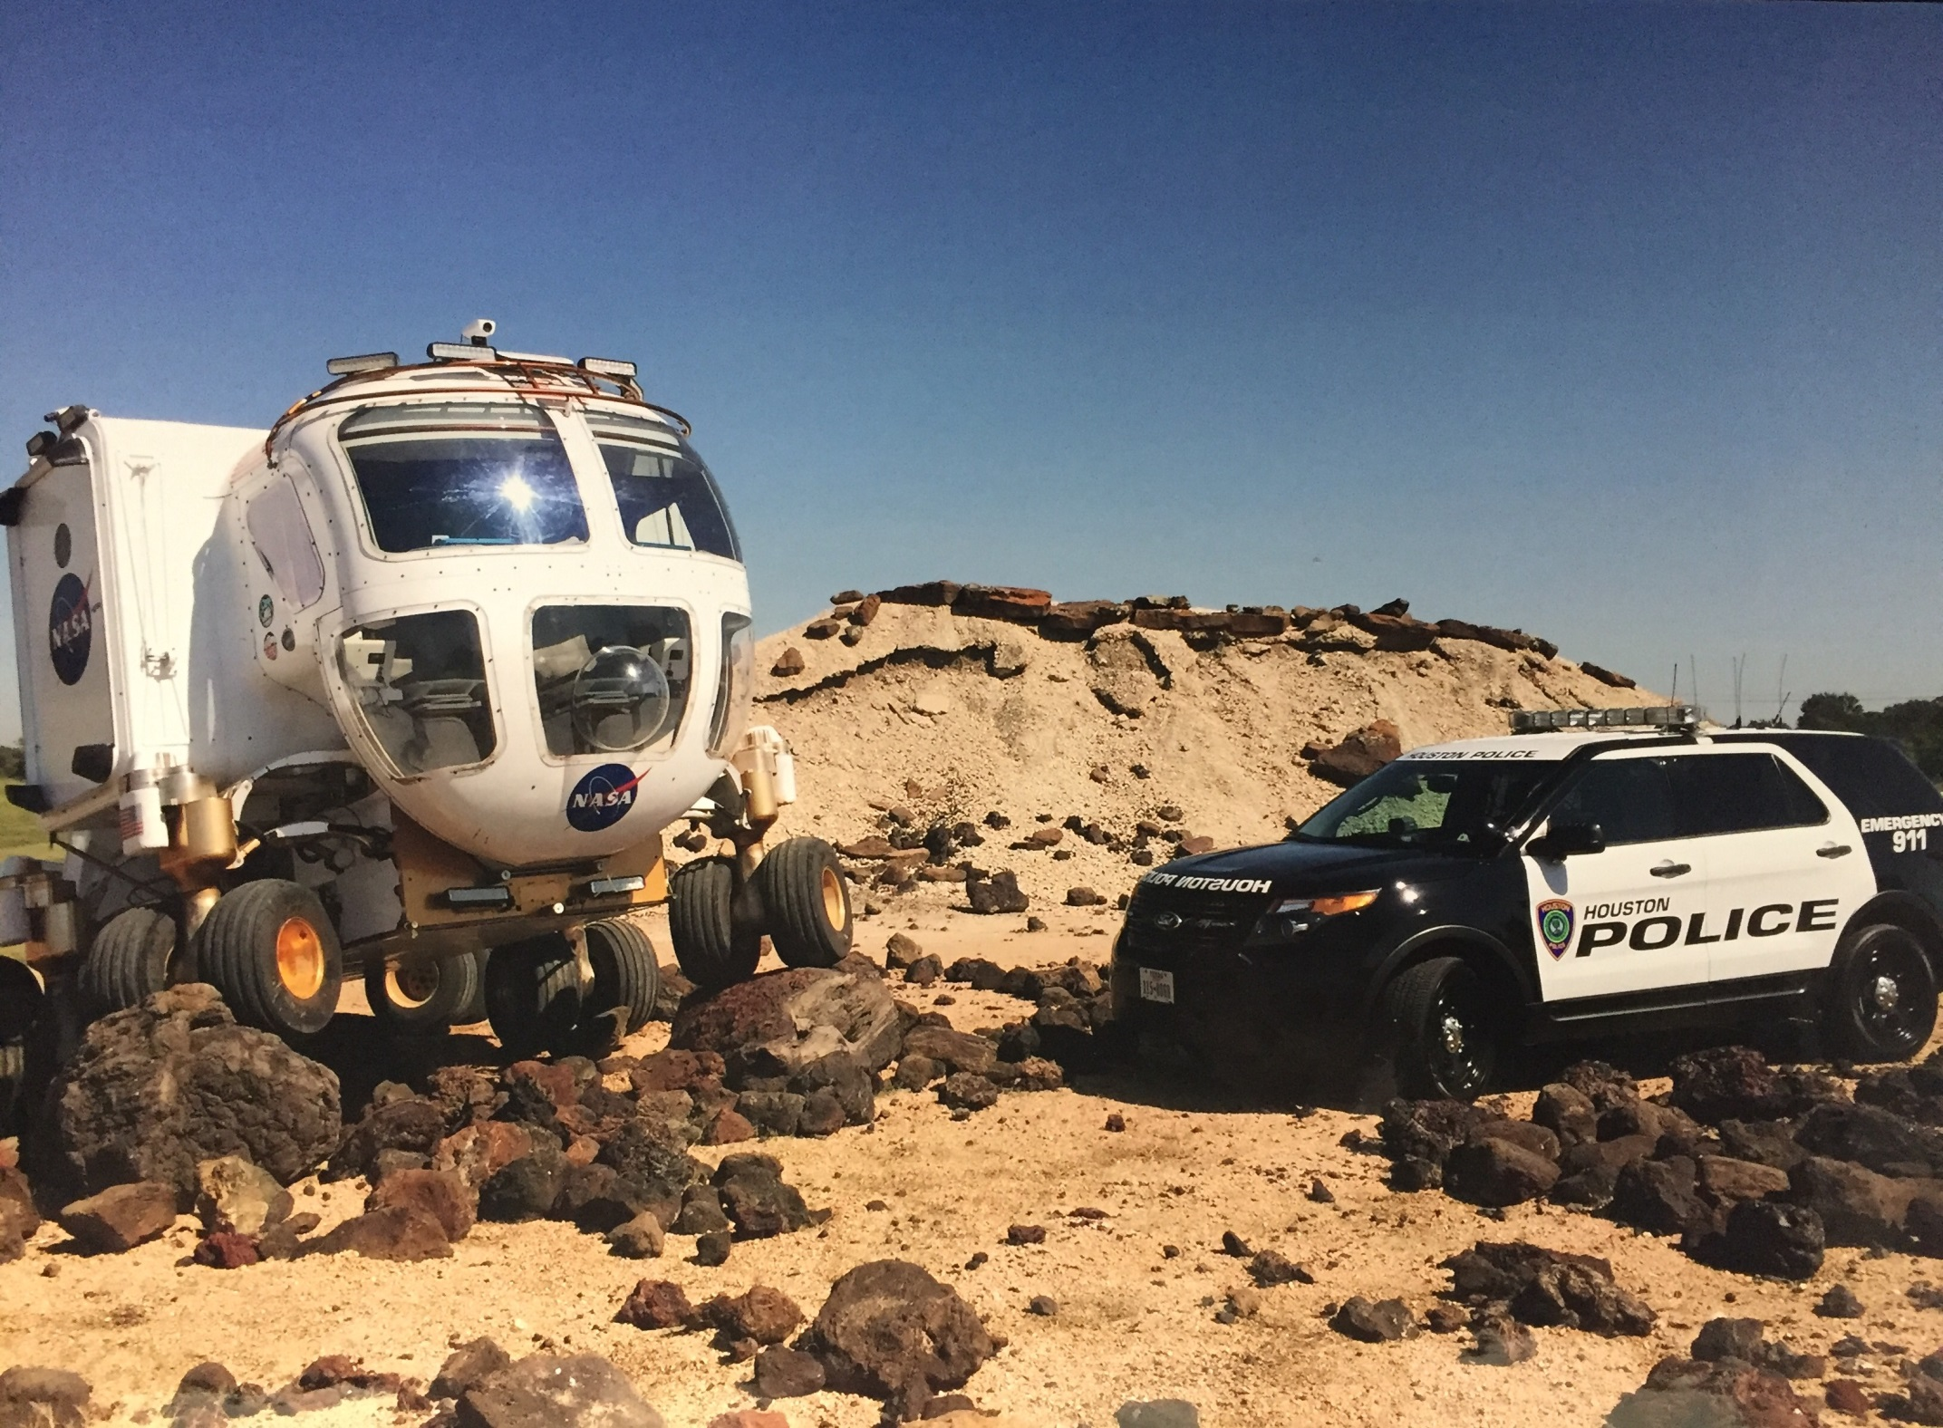

Houston Police Department
Clear Lake Division
Captain J. C. Stevens

Slide 2
Clear Lake Division
 | 2015 | 2016 | Change
Murder | 7 | 7 | 0%
Sexual Assault (RAPE) | 43 | 37 | -14.0%
Robbery | 382 | 383 | 0.3%
Aggravated Assault | 308 | 414 | 34.4%
Violent Crime | 740 | 851 | 15.0%
Burglary Habitation | 736 | 533 | -27.6%
Burglary Building | 259 | 245 | -5.4%
Burglary Motor Vehicle (BMV) | 1758 | 1671 | -4.9%
Theft (Except BMV and Auto) | 2255 | 2333 | 3.5%
Auto Theft | 974 | 980 | 0.6%
Non Violent | 5982 | 5762 | -3.7%
Part-1 Crime | 6722 | 6613 | -1.6%
January 1, 2015 - December 31, 2015
January 1, 2016 – December 31, 2016
Notes:
Jan 1 – Dec 27
CFS Totals-
2014- 49732
2015- 48673
2016 -48036

Slide 3
Texas Local Govt. Code 215.031
“Hawkers, peddlers, and pawnbrokers.”
Faulkner case - Cities have the authority to prohibit peddlers and solicitors from conducting business in public places.
However, free speech concerns may likely limit any canvasser regulation to a minimum.
This type of regulation invokes fundamental personal rights, i.e., freedom of speech, equal protection.
Notes:
SE contacted Clear lake DGU warrant for suspect in 12 District Involved in Crime 12, 13, 14….. Several Robberies, Purse Snatchings, Thefts and Sliders offenses…

Slide 4
U. S. Supreme Court
Reed v. Town of Gilbert
Reed case involving temporary signs for a church held that content-based laws are “presumptively unconstitutional.”
Springfield, Illinois enacted an ordinance that banned panhandling in their downtown historic district. It was challenged, and although unrelated to panhandling, the Reed case ruling controls content-based laws and resulted in Springfield’s ordinance being ruled unconstitutional in 2015.
Notes:
VIOLENT CRIME PROGRAM:
Bulletin is of Red Chrysler 200 with 2X B/M and 1 B/F suspects, possible involved in Sliders and Purse Snatchings…

