Slide 1
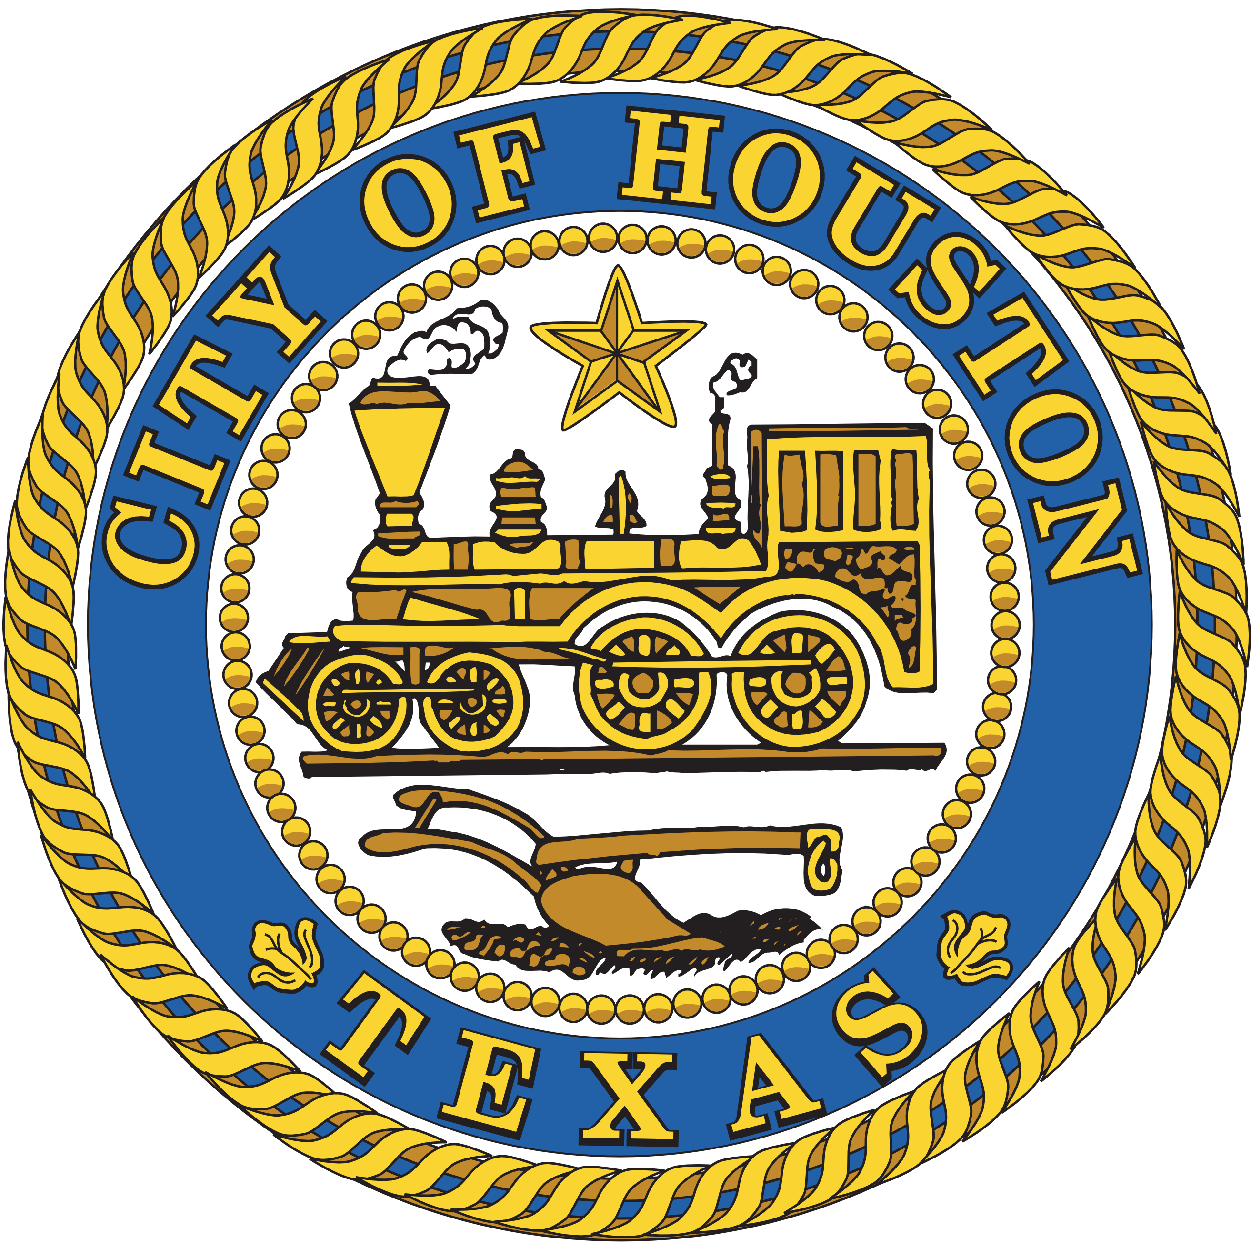

COUNCIL DISTRICT E
CAPITAL IMPROVEMENT PLAN MEETING | 2017
CAROL ELLINGER HADDOCK, P.E.
Notes:
Good evening, My name is Carol Haddock and I am I’m here to talk with you about the on-going and upcoming Capital Projects that are being or will be constructed by the Department of Public Works and Engineering in the upcoming years.
Each spring your City Council member invites members of the various departments into the community to provide an update on where we are in the current projects and talk about new projects that are recommended for the upcoming Capital Improvement Plan.

Slide 2
WHAT’S A CIP?
Capital Improvement Plan
    ● City Council Adopted
         Identifies Planned Budgets - Capital Projects & Capital Programs
         Five Year Rolling Period
Notes:
Being that you are here tonight, you are obviously interested in the City’s Capital Improvement Plan or CIP. So what is a CIP? The City’s CIP is a Plan. This plan includes specific Capital Projects or Capital Programs and the funding the City of Houston intends to spend on each of them and what year that spending will occur. It covers a 5-year period that “rolls” each year and this new plan is adopted by City Council.

Slide 3
What we DO
REPAIR
RECONSTRUCT
REHABILITATE
Notes:
The life cycle of the city infrastructure is first we repair, then we rehabilitate and then finally we reconstruct.
The CIP does not include Repairs are budgeted and performed by our Operations Divisions – Public Utilities, Street & Drainage and Traffic Operations. We ask that you use 3-1-1 year round to request these repairs.
This meeting is specifically about the CIP. The CIP includes Capital Projects and Capital Programs.
Capital Programs include - Rehabilitation or, as many of my colleagues in other departments, Renovations.
Capital Projects include - New Construction, Reconstructing or even Purchasing Major Equipment.
Today’s meeting is specifically about the CIP. The CIP includes Capital Projects and Capital Programs. Let’s delve into these two areas a little bit more.

Slide 4
REHABILITATE
Capital Programs
CONCRETE
PANELS
ASPHALT
OVERLAYS
DRAINAGE
Notes:
When a piece of infrastructure or an asset is beyond repair, the first line of defense is to rehabilitate. Each year in the CIP, approximately 25% of the funds are for Capital Programs.
Capital Programs are what we use to perform this rehabilitation citywide. They are shown with funding in the CIP, but not in a specific location.
Rehabilitation includes work that will extend the life of the infrastructure – as it was originally design and built with only minimal improvements. When we look at pavement, filling a pothole would be a repair, but replacing a full panel of concrete or putting an new layer of asphalt over any entire road would be a rehabilitation. This work will make the road last longer.

Slide 5
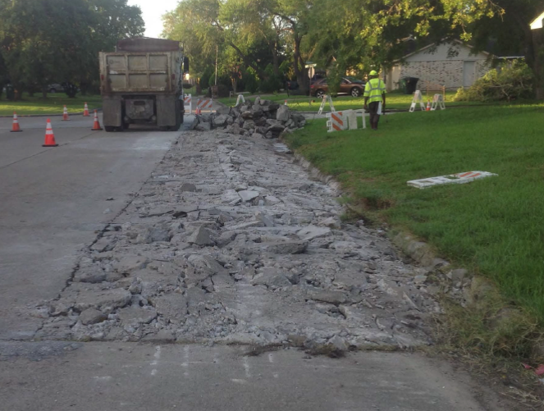
REHABILITATE
Concrete Panels
  ● Limited Problem Area
  ● Shorter Timeframe
  ● Extends Asset Life
Notes:
Here’s an example of a concrete panel replacement. For example, when the majority of the street is okay, but there are several areas that the concrete is broken our Concrete Panel Replacement Program can cut out the bad area and place new concrete. Performing this rehabilitation will make the entire street last longer. This also doesn’t require waiting the 5-10 years it can take to get a full reconstruction.
The Programs include annual funding with the full program. Generally, this funding is used to complete many smaller projects each year. The list for the first year in the CIP is available on the ReBuild Houston viewer. These programs are the implemented Citywide and are used to address infrastructure that needed more than repair.

Slide 6
RECONSTRUCT
Capital Projects
WATER
WASTE
WATER
TRAFFIC &
STREET
STORMWATER
& DRAINAGE
Public Utilities
ReBuild Houston
Notes:
Capital Projects include things like building streets and storm drainage, a wastewater treatment plant, a traffic signal, parks, libraries, community centers, and fire and police stations. You can think of Capital Projects like building a house. It’s a long term investment that you expect to last for decades.
For the Department of Public Works and Engineering, these projects are funded by the Public Utility for water and wastewater and ReBuild Houston for streets and storm drainage.
Reconstruction can happen anywhere – on our thoroughfares or collectors, on our local streets, on storm drainage, water or wastewater in our neighborhoods. Capital Projects can also include improvements such as adding turn lanes at intersections, another lane, or sidewalks or paths for pedestrians and bicyclists.
When we reconstruct, we work to implement the infrastructure that will serve as the foundation of complete communities – including sidewalks, street lights and access to schools, parks and transit.
These projects are generally listed individually in the CIP. A little later, I’ll show you how to find out more details on-line through our interactive viewer.

Slide 7
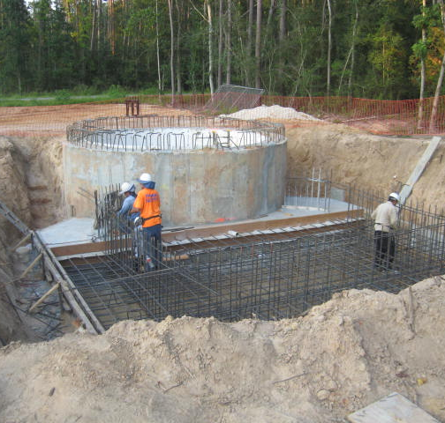
DISTRICT E
Kingwood Area
Magnolia Point
  ● Lift Station Project
    - Wastewater
Notes:
Capital Projects include things like building streets and storm drainage, a wastewater treatment plant, a traffic signal, parks, libraries, community centers, and fire and police stations. You can think of Capital Projects like building a house. It’s a long term investment that you expect to last for decades.
This photo is of the Magnolia Point lift station project. In addition to providing better infrastructure to support wastewater, it also allows 548 lots to move from septic systems to a wastewater main system.

Slide 8
CIP PROCESS
identify
need
engage
community
finalize
design
hire
contractors
begin
construction
Notes:
I often get asked why we can’t construct something this coming year when we know there’s a problem today. That is why we are hear tonight. There are several reasons – The first is that The CIP is the City’s commitment to the Community on what we intend to build. This commitment shows both what we are going to do and when we are going to do it. The Projects are listed one by one so people can see the schedule and cost for each of those. As I discussed earlier, the CIP is a “Rolling” 5-year plan. That means that in order to meet the existing commitment to the community, that new Capital Projects can be scheduled for construction in year 5. Years 1 through 4 are the continuing commitment of last year’s update.
This is good though, because it really does take several years to perform a good design. In the recent past, PWE has worked hard to improve our relationship with neighborhoods by coming out to understand the problems you experience everyday – early in the process and not when the construction equipment shows up. Using this information, we develop a proposed solution and then seek community consensus. Consensus is tricky because we work to balance the desires of the community with the City’s design criteria for this replacement infrastructure and citywide needs like mobility. Sometimes that may require changes that people don’t like – such as removing an opening in a median, or wider sidewalks. I’ve heard people express concern about “more concrete” because of wider sidewalks. We have recently narrowed our design criteria on both local streets and thoroughfares – by a foot. When you consider this across around 16,000 lane-miles of street, that starts to add up quickly.
This criteria also brings good things – street lights in neighborhoods that currently don’t have them or a protected left turn lane where there isn’t one today.

Slide 9
AVAILABLE FUNDING
Annual CIP Limits
Notes:
The second reason is that the CIP also has to follow a budget. There is only a certain amount of money available each year to design and construct projects. The steps to come out and understand the community needs and develop good plans well before construction helps us put the right amount in the CIP for the right year.

Slide 10
$1,285,215,000
BOTTOM LINE
We’ve got LOTS planned from 2018-2022
Notes:
The good news is that over the five years of this CIP, that nearly $1.3 billion planned for improvements (assuming the revenue cap is repealed).

Slide 11
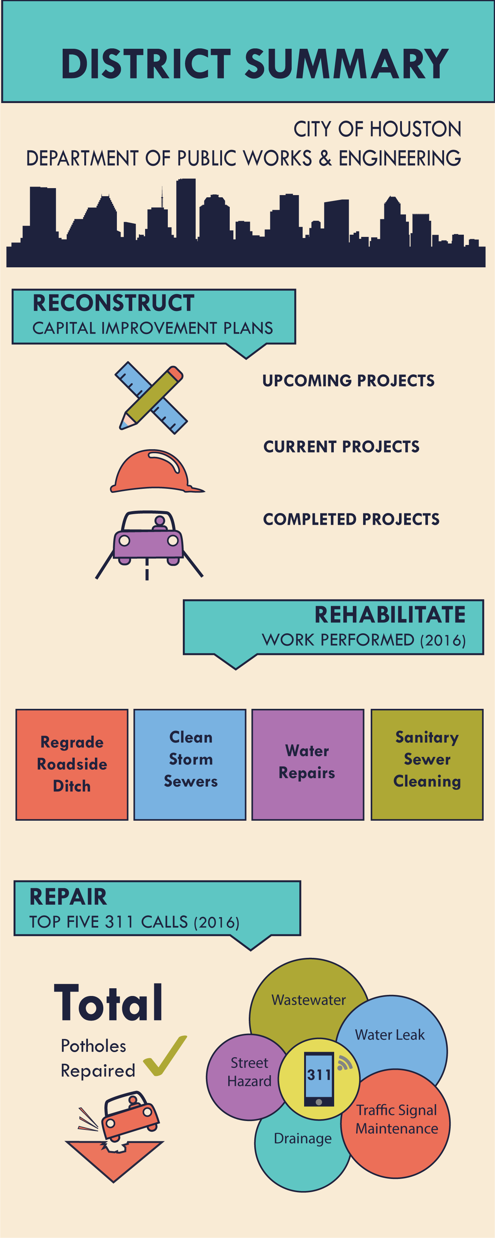
DISTRICT
Infographic
  ● Upcoming Projects
  ● Work Performed
  ● Potholes Repaired
  ● Top 311 Calls
Notes:
We want to keep you informed of what is happening in your district. If you don’t already have one, please visit our Public Works & Engineering table to pick up a District Summary card that shows what CIP projects are upcoming this year, the district specific work we performed in 2016, the total number of potholes repaired in your district and the number of 311 calls for specific requests from Jan-Dec 2016. This is kind of like our report card to you from 2016 and a preview of what to expect moving forward.

Slide 12
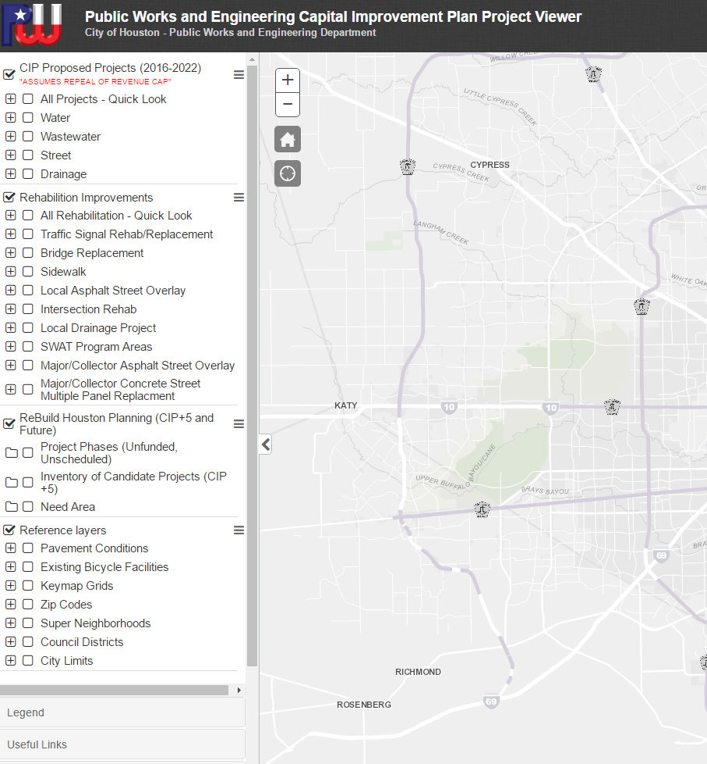
REBUILD HOUSTON
Viewer
● Project Specific Information
● Reconstruct & Rehabilitate
www.ReBuildHouston.org
Notes:
This year we’ve deployed an updated viewer and ReBuild Houston website. This viewer is now easier to use on your tablets and cell phones. Before the meeting and throughout the evening, we’ve had our Public Works and Engineering Community Outreach team available here with tablets to help you look at specific projects. They are here tonight to help you get your questions answered. When we get to the Q&A portion later tonight, they will be a big part of the response to questions.

Slide 13
THANK YOU
questions?
Email: PWECIP@Houstontx.gov
Call: 832-395-2090
Follow: @HoustonPWE (Facebook + Twitter)
Notes:
Stay in touch with us…like us on Facebook, follow us on Twitter, visit our website, email or call!

