Slide 1
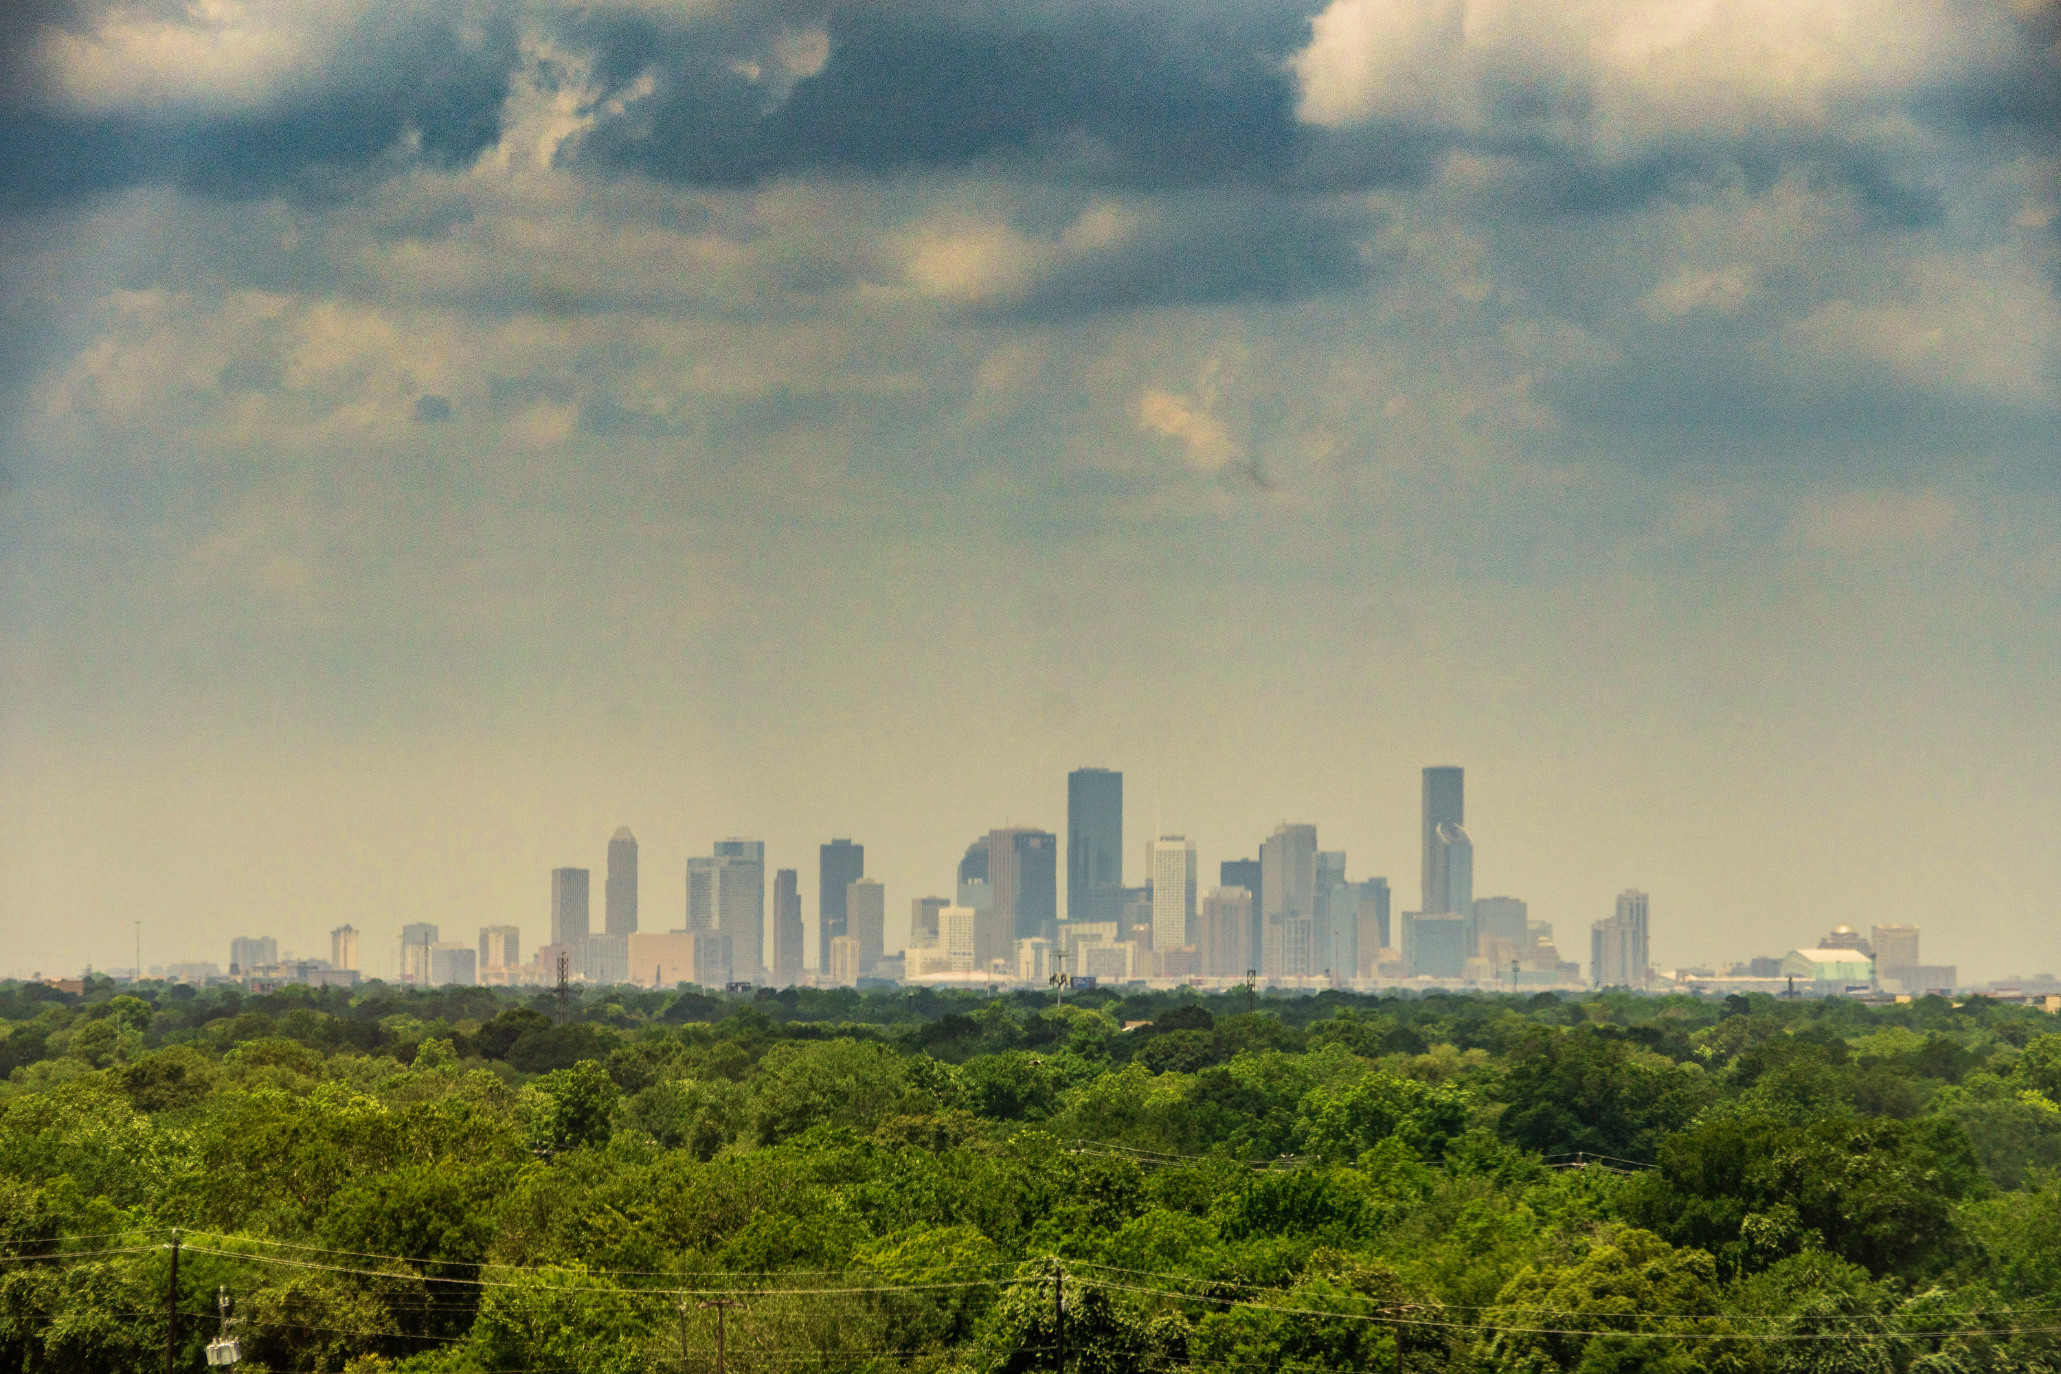



















Welcome to the Faith & Affordable Housing Summit

Slide 2

opening remarks

Slide 3
City of houston
housing & community
development department

Slide 4
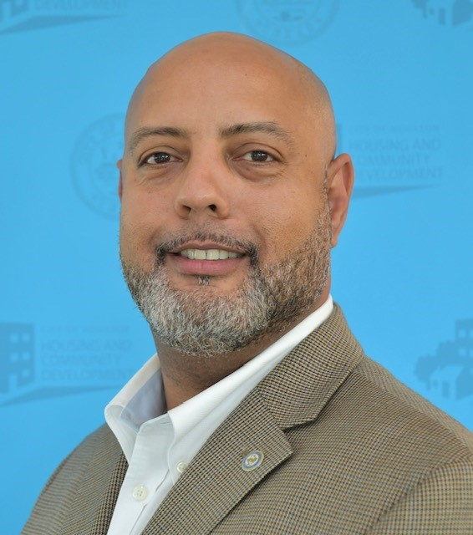
Cedrick LaSane, Housing & Community Development Department
Cedrick.LaSane@houstontx.gov, (832) 394-6200

Slide 5
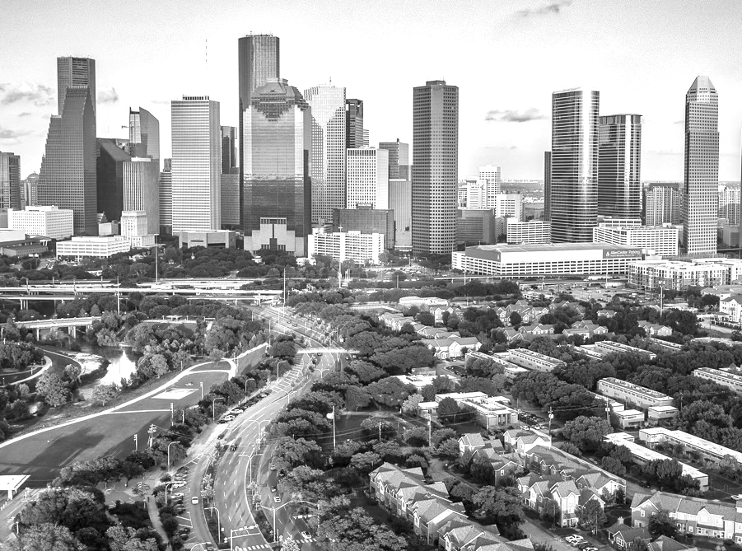


Housing
Programs
Housing & Community Development
Michael C. Nichols
Director
Cedrick LaSane – Assistant Director
Ryan Bibbs – Division Manager
Derek Sellers – Deputy Director

Slide 6
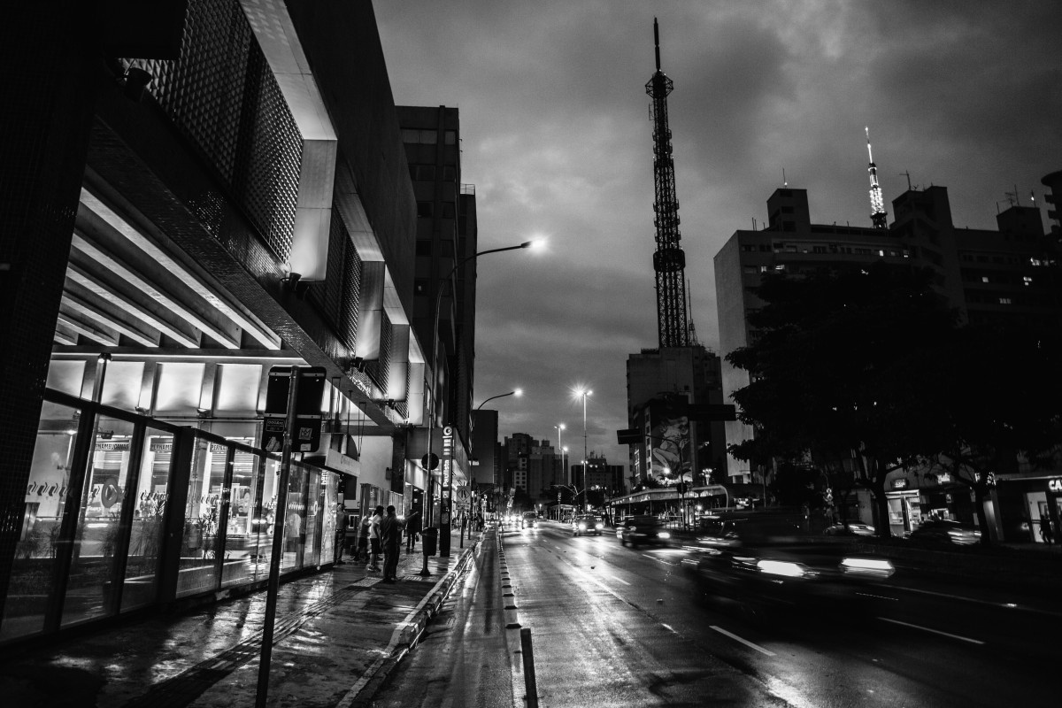

Homebuyer Programs
CITY OF HOUSTON ⋆ HOUSING AND COMMUNITY DEVELOPMENT DEPARTMENT
Page ‹#›

Slide 7
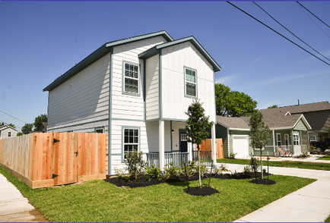
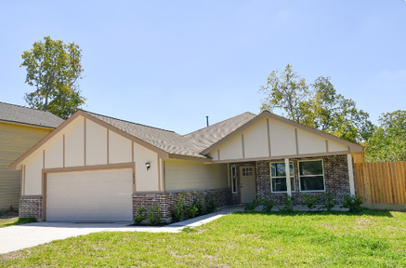







Affordable Home Development Program (AHDP)
  Funding Source: Uptown TIRZ Bond
  Award funds to for-profit and non-profit
  Single-Family Home Communities
    120% AMI Homebuyers
  Sales prices vary based on the development
  Affordability Period - 5 Years
CITY OF HOUSTON ⋆ HOUSING AND COMMUNITY DEVELOPMENT DEPARTMENT
Page ‹#›
3

Slide 8

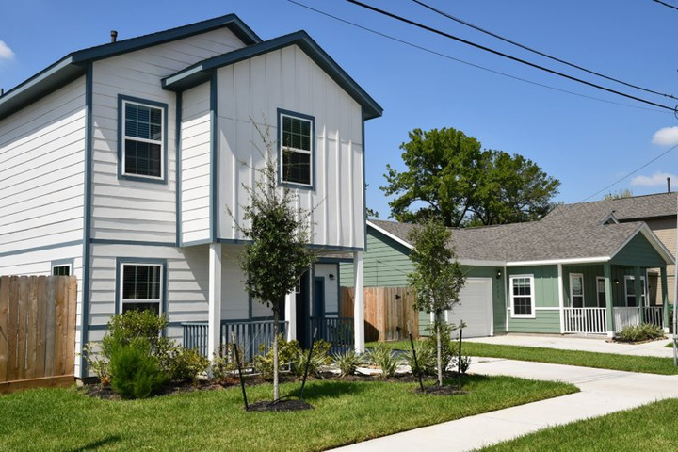
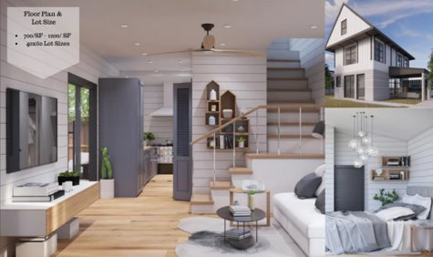
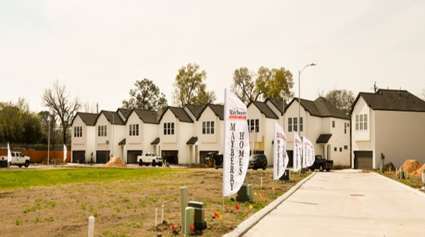
CITY OF HOUSTON ⋆ HOUSING AND COMMUNITY DEVELOPMENT DEPARTMENT
Page ‹#›
4

Slide 9
New Home Development Program (NHDP)
  Funding Sources
    Uptown TIRZ Bond
    TIRZ-Affordable Housing Set Aside
  HCD works with construction contractors and the Houston Land Bank for the development of affordable single-family homes to be sold to families earning up to 80% of AMI
  Sales prices range from $207,000 to $225,000 with up to $50,000 in subsidy to the buyer
  Affordability Period varies from 2.5 years to 15 years based on amount of subsidy for the buyer
CITY OF HOUSTON ⋆ HOUSING AND COMMUNITY DEVELOPMENT DEPARTMENT
Page ‹#›
5

Slide 10
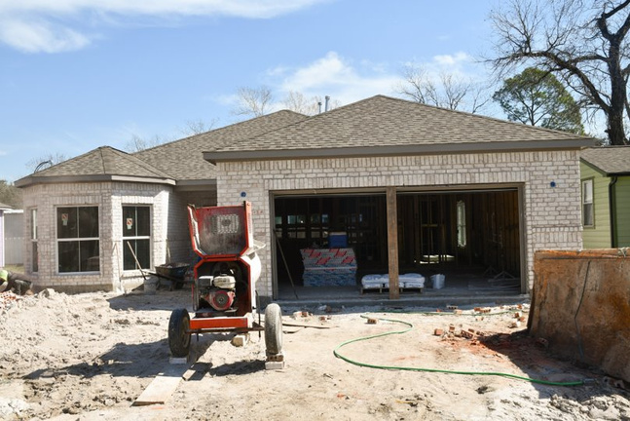
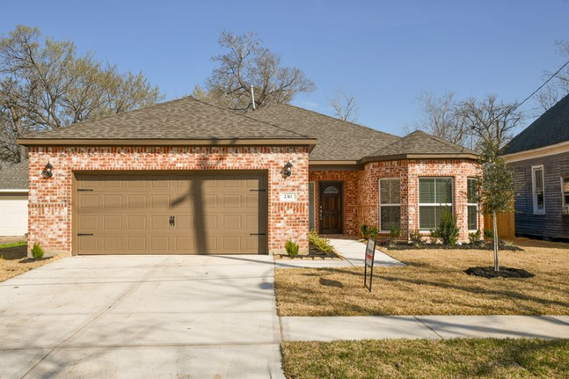
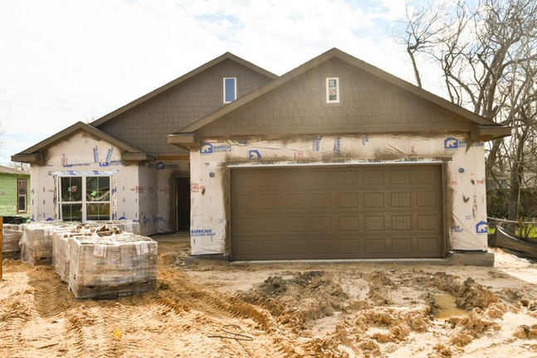
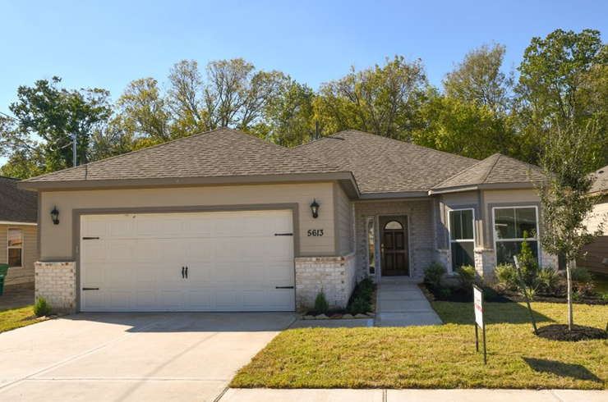
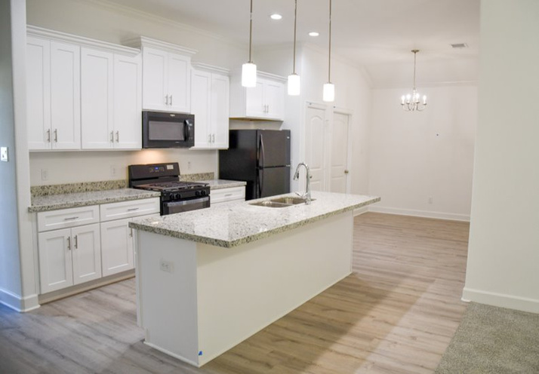
CITY OF HOUSTON ⋆ HOUSING AND COMMUNITY DEVELOPMENT DEPARTMENT
Page ‹#›

Slide 11
Community Housing Development Organization (CHDO) Program
  Funding Source
    HOME Investment Partnerships Grant
  Awards funds to community-based non-profit developers for the development of single-family homes to be sold to families earning up to 80% AMI
  Sales prices range from $212,000 to $228,000
  Affordability Period - Varies from 5 years to 15 years based on amount of subsidy for the buyer
CITY OF HOUSTON ⋆ HOUSING AND COMMUNITY DEVELOPMENT DEPARTMENT
Page ‹#›

Slide 12
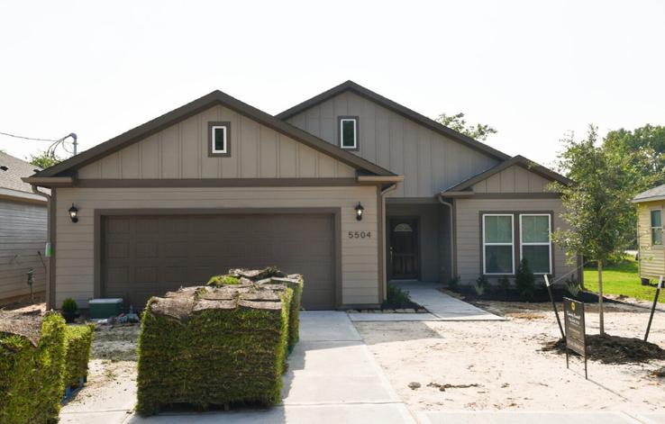
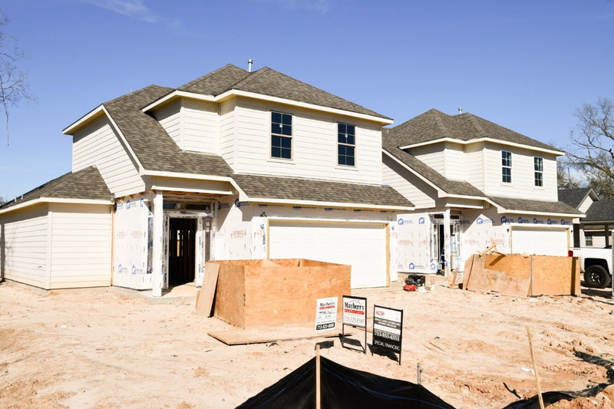
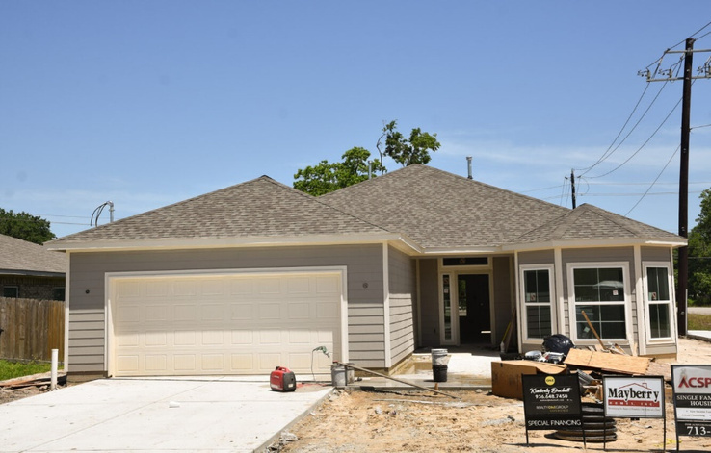
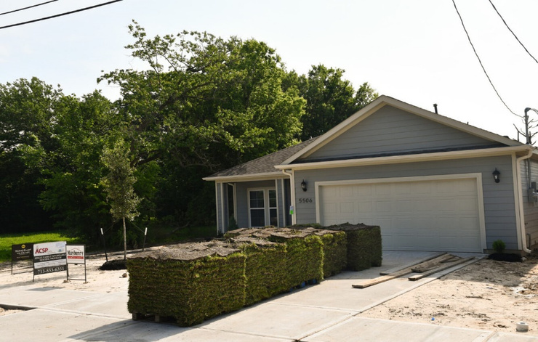
CITY OF HOUSTON ⋆ HOUSING AND COMMUNITY DEVELOPMENT DEPARTMENT
Page ‹#›
8

Slide 13
Downpayment Assistance
  Funding Source(s)
    Community Development Block Grant (CDBG)
    TIRZ – Affordable Housing Set Aside
  Awards up to $50,000 to first-time homebuyers at or below 80% AMI towards the purchase of a home by offering assistance with down payment, closing costs, principal reduction, and/or subsidizing interest rates
  Affordability Period – 5 years
CITY OF HOUSTON ⋆ HOUSING AND COMMUNITY DEVELOPMENT DEPARTMENT
Page ‹#›
9

Slide 14




Single Family
Home Repair Program
  Overall Funding - $40M
    Timeline – 5 years
      Assist Households below 80% AMI
      Priority Assistances Elderly and Disable
    Reimbursement Program- $1.6M
      Max Award - $6K per/household
      Low-to Moderate Urgent Need
    Rehabilitation and Reconstruction - $38.4M
      Approx. 128 Households to be Served
      Rehabilitation and Reconstruction Compliance Period – 3 years
      Rehabilitation Max Award - $100K
      Reconstruction Max Award - $300K
        Reconstruction Budget - $250K
        Resilience Budget - $50K
CITY OF HOUSTON ⋆ HOUSING AND COMMUNITY DEVELOPMENT DEPARTMENT
Page ‹#›

Slide 15


2100 Travis Street, 9th floor
Houston, TX 77002
832-394-6200
www.houstontx.gov/housing
CITY OF HOUSTON ⋆ HOUSING AND COMMUNITY DEVELOPMENT DEPARTMENT

Slide 16
Q&A

Slide 17
affordable housing financing panel

Slide 18
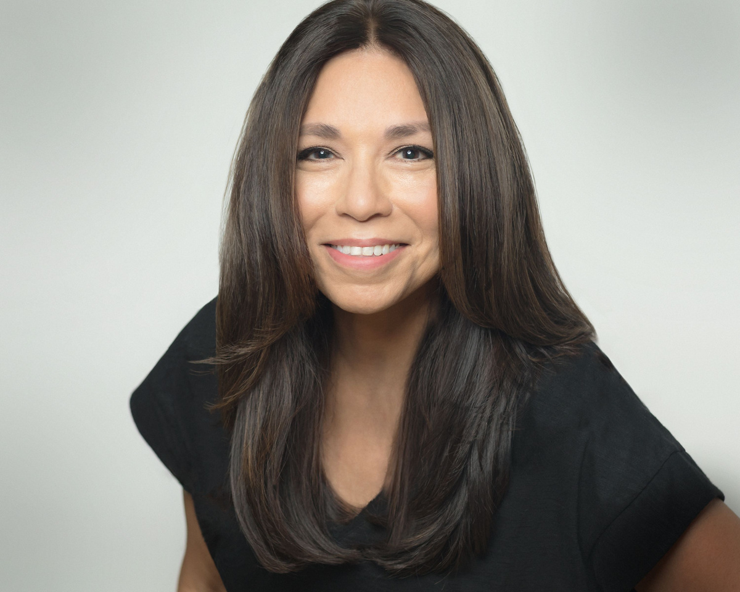
Moderator: Laura Jaramillo, LISC
ljaramillo@lisc.org, (713) 417-8038

Slide 19
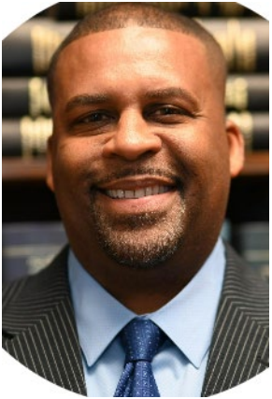
Richard Mudd, Sr., Houston Housing Financing Corporation
rmudd@houstonhfc.com, (713) 461-2749

Slide 20
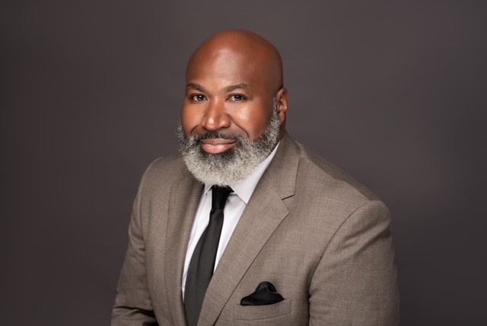
David Northern, Sr., Houston Housing Authority
DNorthern@housingforhouston.com, (713) 260-0822

Slide 21

Jeffrey Powell, Wells Fargo
jeffrey.d.powell@wellsfargo.com, (713) 319-1588

Slide 22
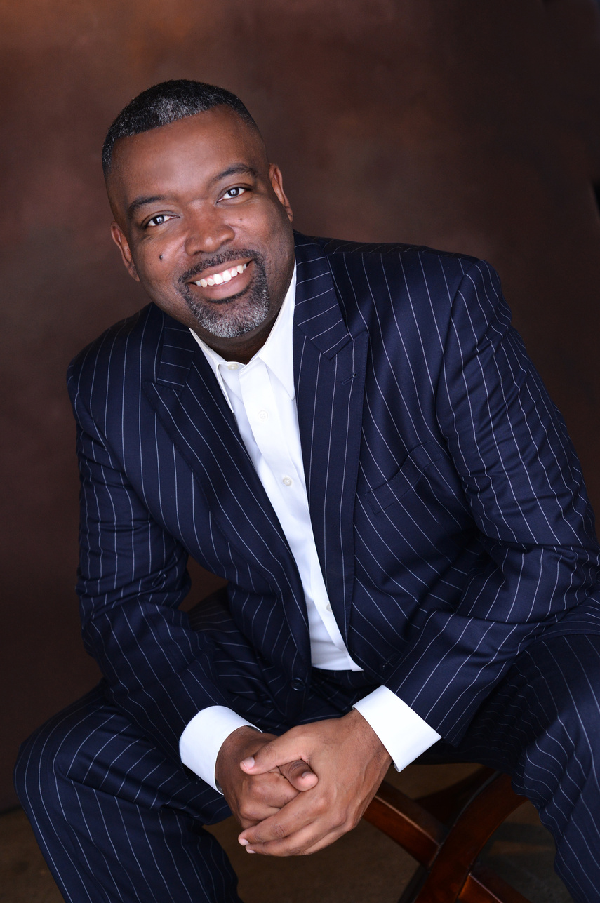
Kevin Riles, Commercial Real Estate Expert
kevin@kevinrilescommercial.com, (281) 403-3700

Slide 23
Q&A

Slide 24

LUNCH

Slide 25
affordable housing partnerships panel

Slide 26
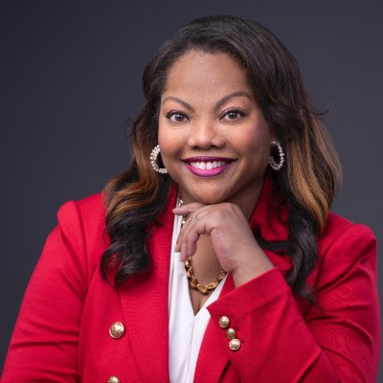
Moderator: Amber Burton
Amber.burton@har.com

Slide 27

Ashely Allen, Houston Community Land Trust
ashley@houstonclt.orgc, (832) 638-6763

Slide 28
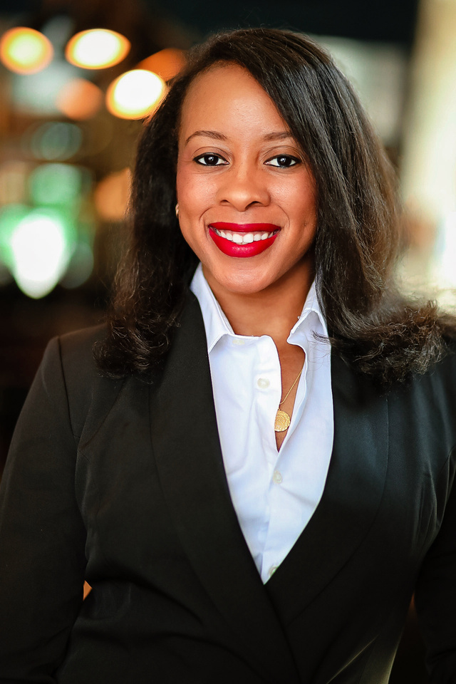
Janel A. Young, Houston Habitat for Humanity
jyoung@houstonhabitat.org

Slide 29
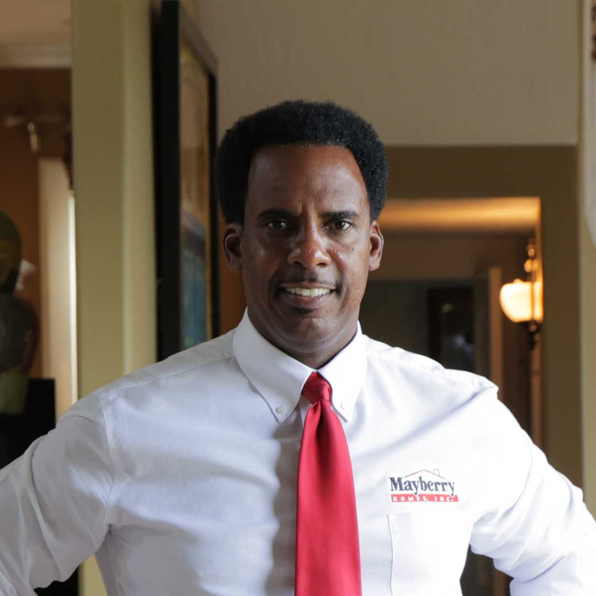
Sharone Mayberry, Mayberry Homes, Inc.
sharone@mayberryhomes.net, (713) 523-8585

Slide 30

Christa Stoneham, Houston Land Bank
info@houstonlandbank.org, (281) 655-4600

Slide 31
Q&A

Slide 32
closing remarks

Slide 33
thank you!

