Slide 1
MWSBE
Technical Assistance
Training for Contractors
AA
April 23, 2025 - 8:30AM – 12:30PM

Slide 2


Division Contact Information
Kennisha London
Deputy Director
Chrystal Boyce Division Manager
2100 Travis, 9th Floor, Houston, TX 77002
www.houstontx.gov/housing
Notes:
I would like to take this opportunity to introduce our team, first we have Kennisha London the Deputy Director and Chrystal Boyce is our Division Manager for Contract Compliance.
Chrystal oversees Pre-Award Services and leads a team of professionals who administer Affordable Rental Housing Compliance, Section 3, Pay or Play, and the Minority Women Owned Small Business Enterprise (MWSBE) programs.

Slide 3



MWSBE Team Members
Felecia Burrell
Contract Administrator
Andres Melgoza
Contract Administrator
Carolyn Seals
Contract Administrator
Notes:
I am one of three Contract Administrators for MWSBE, City of Houston Housing and Community Development Department. The MWSBE Team consist of Carolyn Seals, Andres Melgoza, and myself. I will be going over the MWSBE requirements.
This presentation is being recorded for training purposes.
For any questions regarding MWSBE compliance you are welcome to contact either one of us. Our contact information will be entered in the chat box.
Also, at the end of the presentation, please, take a moment to complete the survey. The link is provided in the chat box.

Slide 4
Discussion Topics
Contract Agreements
Compliance Forms Packet
Deviation Request
Contractor Performance
Close-Out Evaluation
MWSBE Policy Overview
MWSBE Certification Benefits
Commonly Used MWSBE Terms
B2GNow Participation/Payment Tracker
LCP Tracker Document Submission Portal
Notes:
Discussion topics I will cover today are as well as

Slide 5

Benefits of MWSBE Certification
Office of Business Opportunity www.houston.mwdbe.com
Advantage in procurement selection process;
Receives regular alerts of networking and contracting opportunities;
Company profile is listed in the City’s MWDBE/SBE/PDBE online directory;
Opportunity to bid on goal- oriented contracts.
Covered under City of Houston Chapter 15 Ordinance;
Adds trust to services offered;
Other Texas certification agencies accept City of Houston MWDBE/SBE/PDBE certifications.
Notes:
There are benefits for being certified with the City of Houston. You have the advantage in the procurement selection process, you will receive alerts of networking events and contracting opportunities; opportunity to bid on goal-oriented contracts and other Texas certification agencies are reciprocal to the City of Houston's MWSBE certification.

Slide 6



MWSBE Policy Overview
It is the policy of the City of Houston to strengthen Minority, Women-Owned, Small Business Enterprises (or MWSBE) participation during all phases of contracts. The objective is to ensure local firms are afforded equal opportunities that promote utilization and eliminate discrimination.
HCDD contracts must comply with federal procurement regulations, which mandates contracts to include all necessary affirmative steps to ensure Minority, Women-Owned, Small Business Enterprises are utilized to maximum capacity.
As a result, HCDD contracts must adhere to local and federal requirements as it relates to Minority, Women-Owned, Small Business Enterprises.

Slide 7
COMMONLY USED MWSBE TERMS
Notes:
Throughout this training I will utilize a few of commonly used MSWBE Terms such as

Slide 8
Commonly Used MWSBE Terms
General Contractor or Prime Contractor: The main contractor responsible for the overall coordination of a project that includes communication with all involved parties concerning site activity, change orders, subcontractor participation, etc.
Subcontractor: a contractor hired to perform portions of work on contract of a General Contractor.
Supplier: A company that supplies product.
Lower Tier Sub: A firm or individual that received work under another subcontractor that sublets a part of their contract.
Good Faith Efforts: Steps taken that demonstrate efforts to meet MWSBE goal requirements.
MWSBE: Minority, Women-Owned Small Business Enterprise
Goal Oriented Project: A competitively bid project with a MWSBE goal requirement.
SOW: Start of Work
TOW: Termination of Work

Slide 9
POST AWARD COMPLIANCE REQUIREMENTS

Slide 10
Goal Achievement
After a Prime Contractor is awarded a project on a goal-oriented project, compliance can only be achieved by (1) meeting goal requirements or (2) demonstrating acceptable Good Faith Efforts in an attempt to meet the goal. For more information on acceptable Good Faith Efforts, visit: http://www.houstontx.gov/obo/docsandforms/goodfaithefforts.pdf
Only firms certified through the City of Houston, Office of Business Opportunity participation can be credited towards participation goals. For more information regarding the City of Houston MWSBE certification process, visit: http://www.houstontx.gov/obo/certificationoverview.html
MBE & WBE goals are separate and must be met individually!
25.00% MBE & 10.00% WBE = 35.00% Overall Goal
Notes:
Only firms certified through the Office of Business Opportunity program can be credited towards participation goals. For more information regarding Good Faith Efforts and MWSBE certification process visit the City of Houston's Office of Business Opportunity website page.

Slide 11

LCP Tracker
Following a Pre-Construction and/or Kick Off Meeting, a Compliance Monitor will create the project profile and assign the Prime Contractor as the Prime Approver.
The Prime Contractor will be responsible for assigning each subcontractor and supplier to the project in the LCP Tracker.
The Prime will also have the capability to review each document submitted by contractors for approval.
The information required to set up a contractor assignment would be found on the Compliance Forms Packet Cover Sheet.
Each contractor must be assigned to a project in order to submit required compliance documents.
Notes:
Following a Pre-Construction Meeting, your assigned Contract Administrator will create the project profile and assign the Prime Contractor as the Prime Approver in LCP Tracker.
The Prime Contractor is responsible for adding each subcontractor and supplier to their project, this includes certified and non certified subcontractors. Subcontractors must be assigned to the project in order to upload documents.

Slide 12
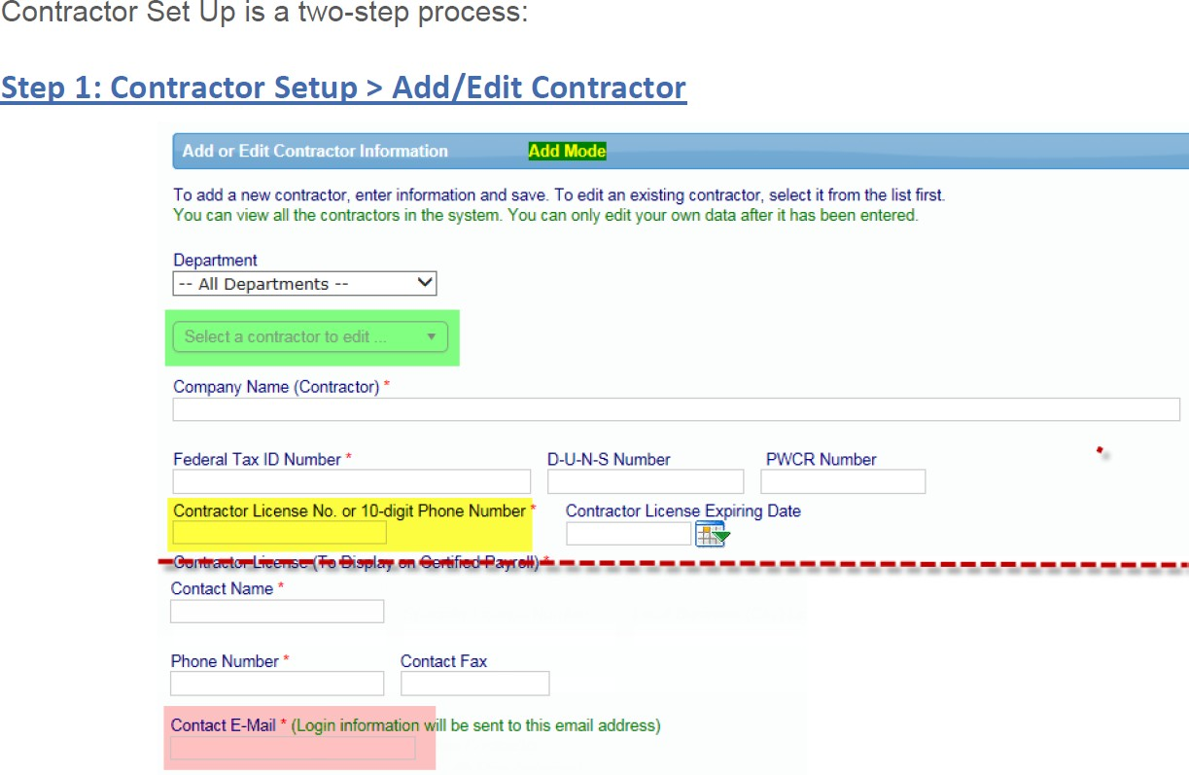
Contractor Set Up is a two-step process
BBB Construction
11-1111111
888-888-8888
Jane Doe
888-888-8888
jane@bbbconstruction.com
Notes:
Setting up a contractor is a 2 step process, once you log into LCP Tracker you will select the Set up tab Contractor Setup and then Add/Edit Contractor. This screen will appear. Have your contractor coversheet available for your entries. Note: Make sure the company isn't already in the database. Enter all company data correctly and click save.
Following the Pre-construction meeting,

Slide 13
Step 2: Prime Contractor Steps to Assign a Contractor to Project
Step 1
Step 2
Step 3
Step 4
Step 5
Step 6
Log in https://prod.lcptracker.net/WebForms/Login.aspx
Select “Set Up” from the toolbar tab. Then, click Add/Edit Contractors.
To add a “New” contractor, enter the contractor information and click save. If the contractor already has an account, and you have difficulty locating the contractor profile, add the contractor and enter the “Contractor ID” as shown on the contractor cover sheet.
Go to “Set Up” and click “Contractor Assignment”
Click “Add New Assignment”, select project and contractor adding.
Select project, enter field information and press save.
Notes:
The next process is to assign contractors to the project – go to the set up tab and click on Contractor Assignment. Click Add new assignment select the project and add the contractor. Always be sure press save.

Slide 14
Steps to Upload Documents
Step 1
Step 2
Step 3
Step 4
Have document available on your computer. The document can be almost any type that can be viewed by internet browser: txt, pdf, xls, doc, tif, etc.
Go to Set Up and select Add/Edit Document
Enter Required Fields
Upload Document under appropriate file name
Notes:
After completing your compliance documents, save them in a file on your computer. Then go to Set Up then Add/Edit Document, enter required field and upload the document under the correct file name. If forms are incorrectly uploaded, those documents will be rejected. And you will be asked to resubmit the document in the appropriate section with the correct file name.
Please note, MWSBE forms cannot be uploaded as an Section 3 form and visa versa.

Slide 15
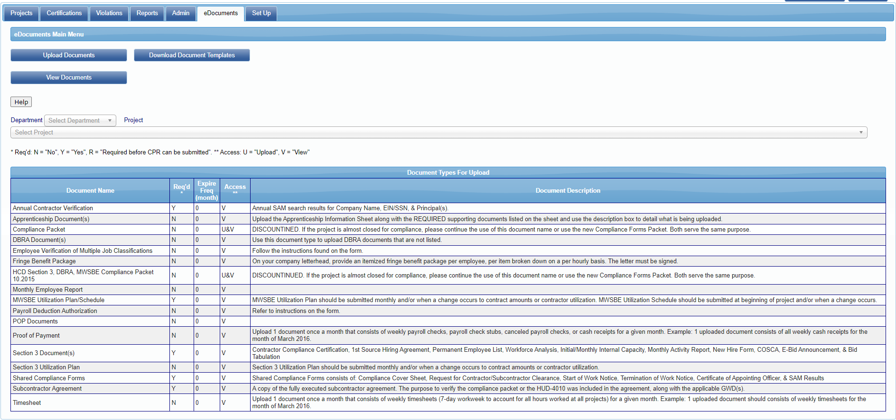
Steps to Upload Documents
On the header tab, Click eDocuments
Click upload documents
Notes:
This screen allows you to see how to upload documents. On the menu bar, you will select the eDocuments tab, then click upload documents.

Slide 16
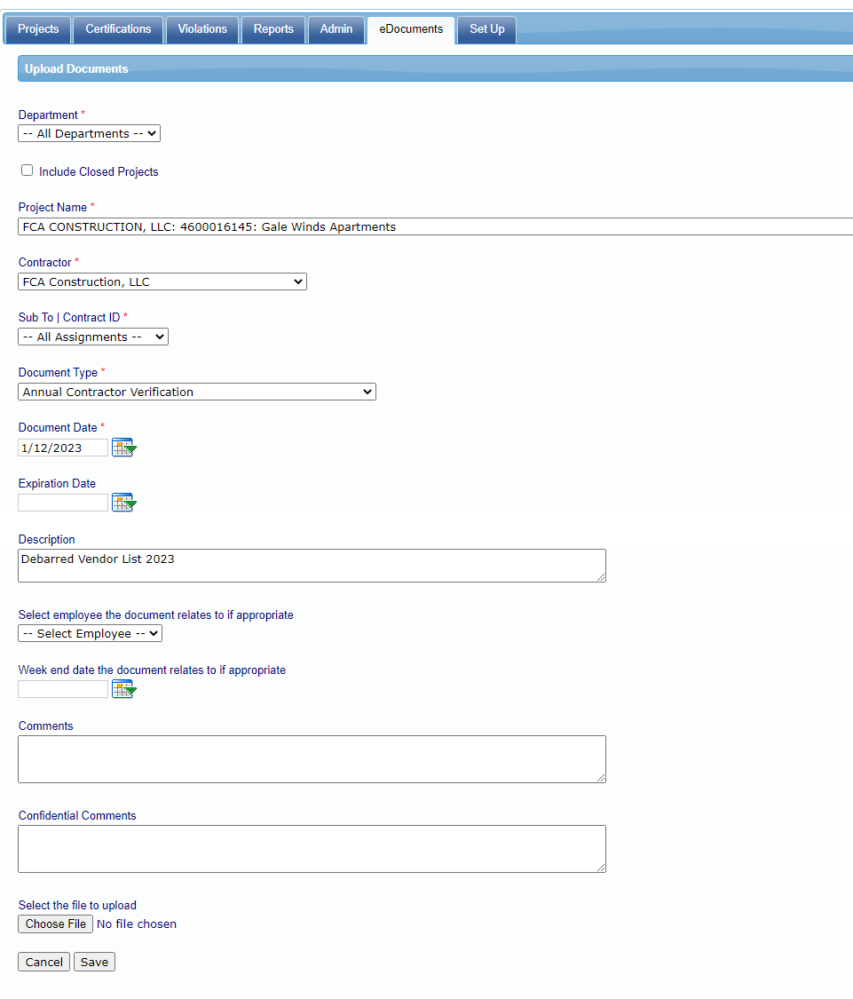
Steps to Upload Documents
Notes:
Select the project name, then select the subcontractor, documents name type, upload the document and don't forget to press save.

Slide 17
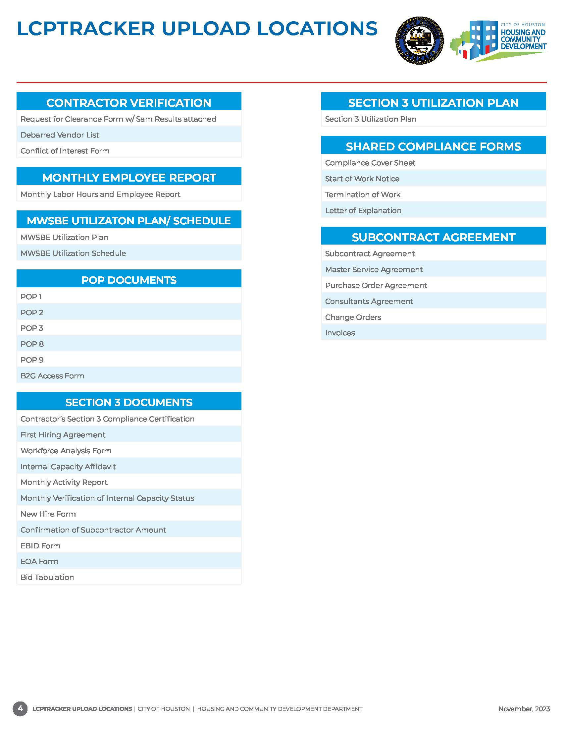
Document Upload Locations
Documents uploaded in the wrong location will be rejected and considered non-compliant.
Notes:
The LCPTracker Upload Locations document is a reference tool you can use when uploading our required compliance documents. MWSBE uses four of the eight locations: Contractor Verification, MWSBE Utilization Plan/Schedule,
Shared Compliance Forms, and the Subcontract Agreement section. As a reminder, documents uploaded in the wrong location will be rejected.

Slide 18
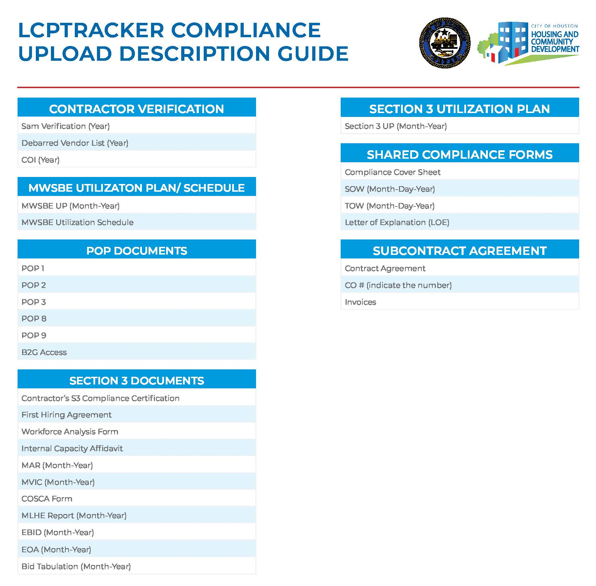
Document Description Guide
Notes:
You can see here how documents are to be properly labeled.
The Sam's Verification, Debarred Vendor List, and Conflict of Interest are annual form and must include the year.
The forms under Annual Contractor Verification, MWSBE Utilization Plan/Schedule, Shared Compliance Forms and Subcontract Agreements are applicable to MWSBE only.

Slide 19
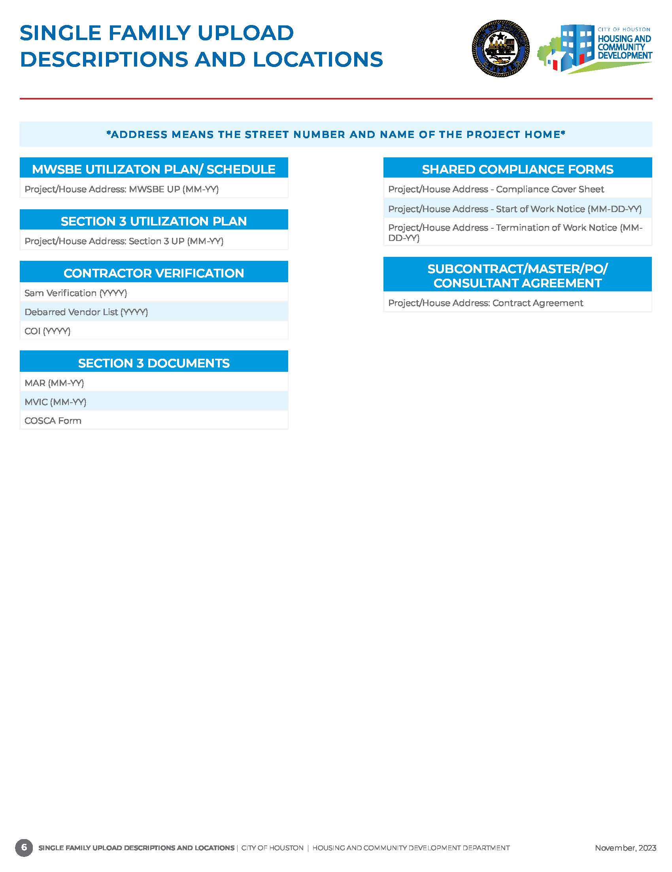
Document Description Guide
SINGLE-FAMILY ONLY
All Compliance Documents must include Address
Notes:
We, also, have a guide specifically for Single Family Home projects, all these documents must include the address. It is imperative that the house address is listed first, then the name of the document.
Once, again, please ensure all documents are properly labeled. The document descriptions and locations can be found in the MWSBE Compliance packet.

Slide 20
B2GNow Payment Reporting &
MWSBE Participation Tracker
After a project is awarded, a profile is set-up in B2Gnow for payment and participation tracking of certified and non-certified firms.
The assigned MWSBE Coordinator will be responsible for adding contractors to B2GNow.
The Prime Contractor is required to enter payments to subcontractors and suppliers within 5 days of payment receipt from the City.
Subcontractors, suppliers and professional service providers are required to confirm payments entered by the Prime.
Notes:
Now, let's discuss the B2GNow system. After the project is awarded, there is a profile in B2GNow which is used for payment and participation tracking of certified and non-certified firms. It is important to know that MWSBE compliance forms are required for all companies working on your project. So, that means certified and non-certified firms. For example, if there are 100 firms working on a project, yet only 10 are certified, you must complete and upload documents for 90 non-certified firms as well. Because these projects are goal-oriented projects.
Your assigned MWSBE Coordinator is responsible for adding contractors into B2GNow.
The Prime Contractor is required to enter subcontractors and suppliers payments within 5 days of payment receipt from the City.
Subcontractors, suppliers, and professional service providers are required to confirm payments entered by the Prime.

Slide 21
Automated Compliance Audit Process
SAP populates payments made Prime Contractor
Prime is notified of payment via email
Prime enters payment
data for subs
Subcontractor is notified via email
Subcontractor confirms or rejects payment
If the Subcontractor rejects a payment, the Subcontractor and Prime are notified via email of the discrepancy.
Compliance Audit Complete
Notes:
Here you see the Automated Compliance Audit Process.
All emails are system generated
The prime is required to resolve discrepancies by providing proof of payment

Slide 22
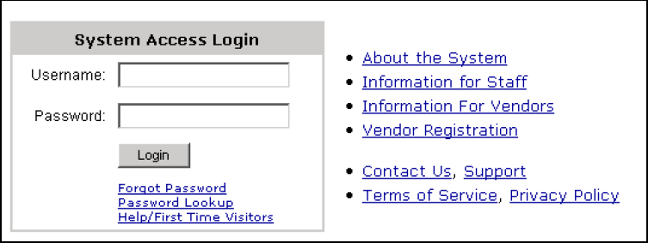
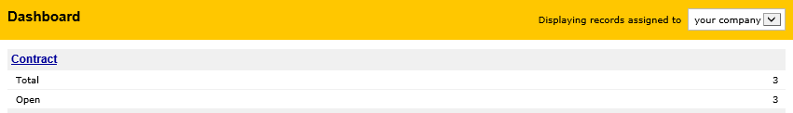
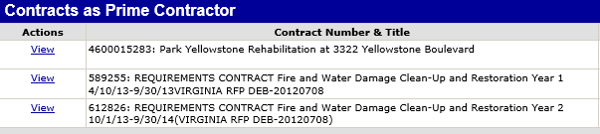
Access to Contracts in B2GNow
Step 1
Step 2
Step 3
Login to B2G with your company
Credentials.
Under Dashboard, click “Contract”.
A list of all active projects will appear. To access a project, click “view”
Notes:
All subs entered in B2G Now on your project will be notified and given access and on a monthly basis to check and confirm their payments.

Slide 23
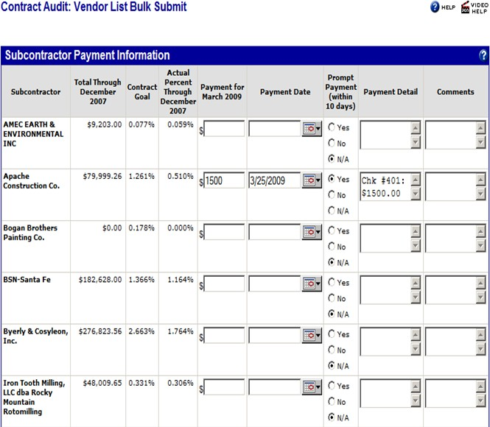
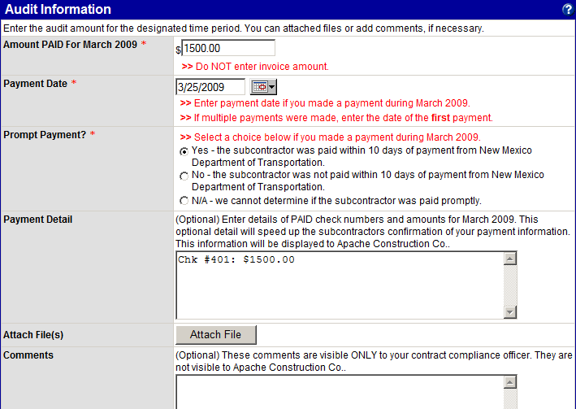
Prime Contractor Payment Process
The prime can report individual payments or subcontractor payments all at once
Notes:
The prime can report payments individually or enter payments all at once. If the project is large, you may want to enter payments all at once to save time.
If payments are not confirmed, then the subcontractor will received monthly letters asking them to confirm.

Slide 24
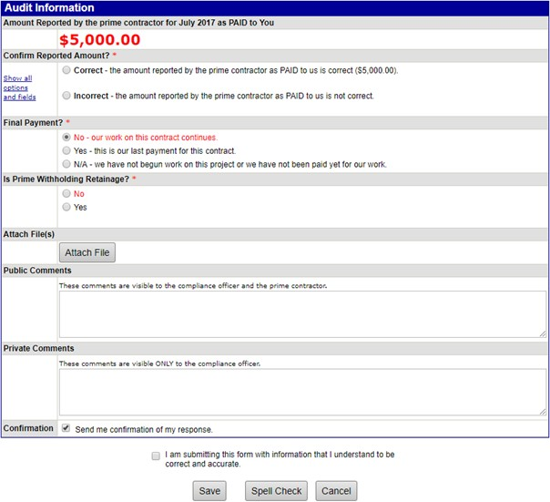
Subcontractor Payment Confirmation Process
Notes:
Once the payment is entered by the prime the subcontractor will be prompted to confirm payment. Select if the payment is correct or incorrect, if the payment is incorrect enter comment and press save. The prime and contract administrator will be notified. As mentioned previously it is the responsibility of the prime to address payment discrepancies by providing check number, amount of check and the date the check cleared.

Slide 25
COMPLIANCE FORMS PACKET
Notes:
As promised lets talk about the compliance forms!!!!

Slide 26
MWSBE Compliance Packet for Certified & Non-certified firms
One-Time/ Initial Documents
Recurring Document
MWSBE Utilization Plan
Request for Contractor Clearance Form
Start of Work
Termination of Work
Executed Contract Agreements
SAM Verification
MWSBE Monthly Utilization Plans (Certified and Non-Certified Firms)
Compliance Cover Sheet
Company Name, Principal Owners & EIN
Mediation Clause
Texas Comptroller Debarred Vendor List
MWSBE Utilization Schedule
Annual Document
  Conflict of Interest Form
  Texas Comptroller Debarred Vendor List
  Request for Contractor Clearance Form
  SAM Verification
    Company Name, Principal Owner(s) & EIN
Notes:
The prime contractor will receive the MWSBE Compliance Packet, the forms are to be utilized by both certified and non-certified firms on the project. Be sure to pass on to all the subcontractors on the project.
Annual Documents are to be submitted once a year for the duration of the project, one time initial forms are submitted once during the life of the project and the only form that needs to uploaded monthly is the MWSBE Utilization Plan

Slide 27
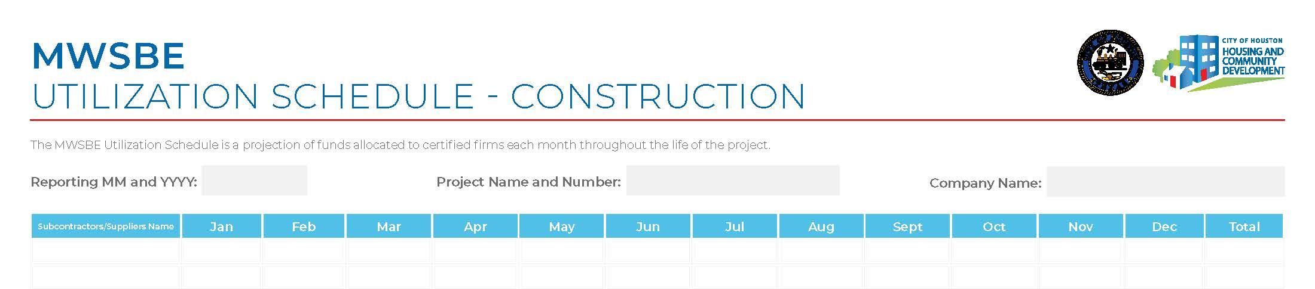
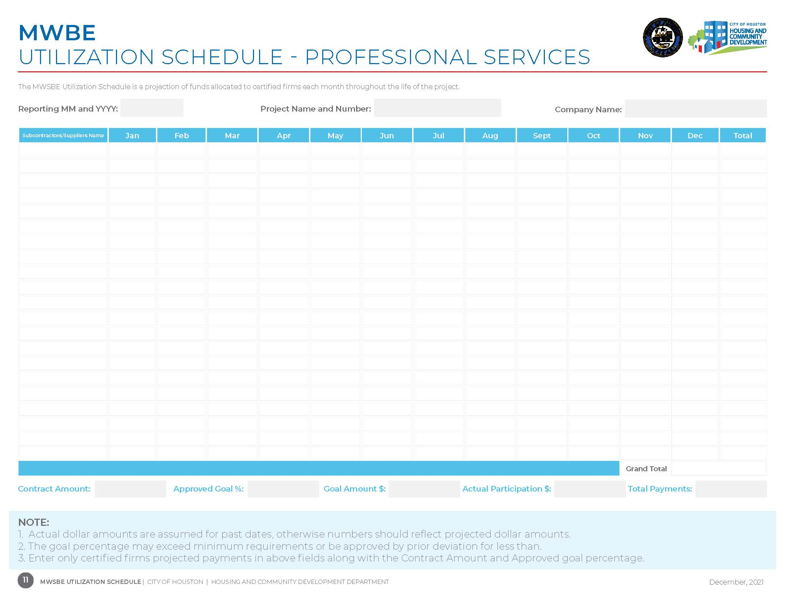
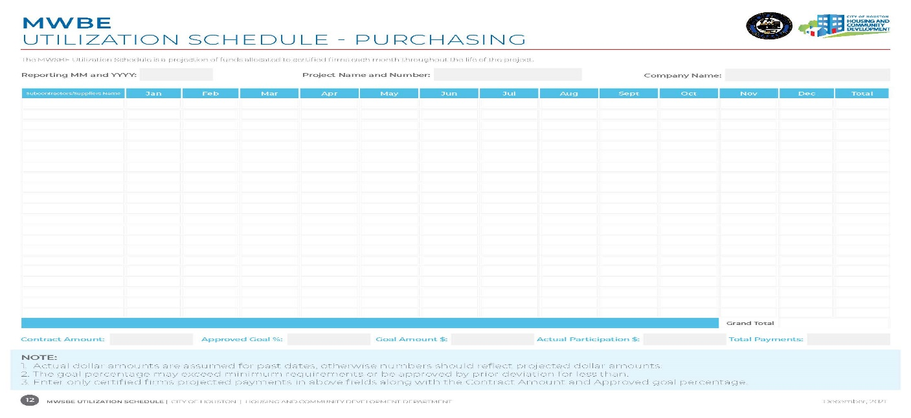
Utilization Schedule
Prime Contractor Only Requirement
The Utilization Schedule is a forecast of your company’s utilization of certified firms to meet the participation goal on this project.
A projection of monies to be allocated to certified firms for each month of the project.
This form must be completed and submitted for review and approval before start of work and each time there is a change to the plan. A new plan must be submitted when submitting a deviation request and responding to a “Not Meeting the Goal” letter.
Notes:
Only the prime contractor will submit the Utilization Schedule, it is a forecast of utilization of certified firms only to meet the goal and a projection of monies to be allocated for each month.
A new schedule must be submitted along with a deviation request and when responding to a Not Meeting the Goal Letter.

Slide 28
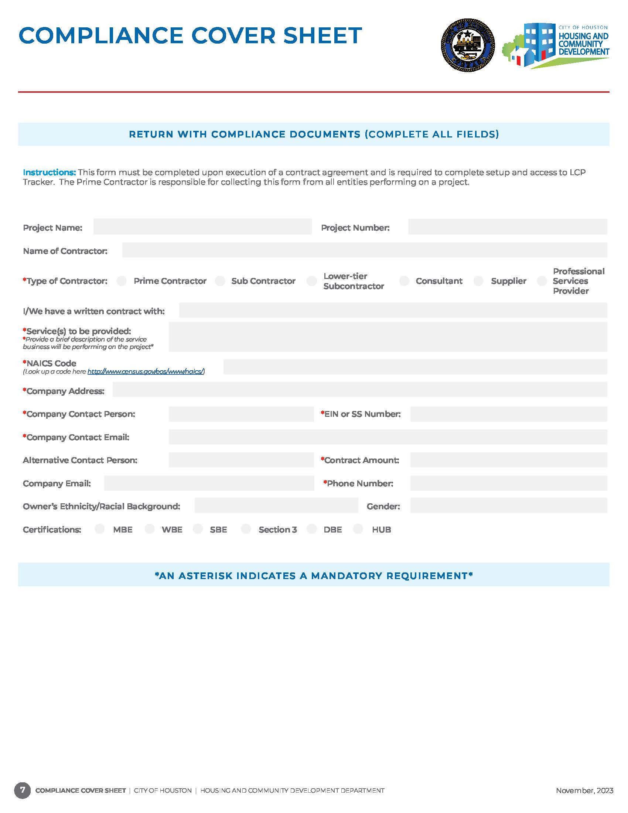



UNACCEPTABLE FORM
Baldwin Lofts
Baldwin Lofts
460001111
BBB Construction
BBB Construction
X
Jones Construction, Inc.
Concrete paving
Concrete paving
238910
111 Avenue K, Houston, TX 11111
11-1111111
111 Avenue K, Houston, TX 11111
Jane Doe
Jane Doe
jane.doe@bbbconstruction.com
ACCEPTABLE
FORM
jane.doe@bbbconstruction.com
N/A
$500,000.00
888-888-8888
888-888-8888
African American
Male
X
Notes:
The unacceptable form has missing data that would be needed to complete entering the subcontractor in both B2G and LCP tracker. This form is uploaded under Shared Compliance Forms.
This is an example of an unacceptable for and an acceptable form.

Slide 29
The Prime Contractor is responsible for collecting this form to complete contractor setup and access to LCP Tracker.
This form must be completed and submitted within five business days upon execution of a contract agreement and/or purchase order by all contractors, suppliers and consulting firms.
All fields are required to be completed except for the following:
Pre-existing LCP Tracker User ID
Fax Number
Certification Type "Complete only if Applicable"
Document must include contractors point of contact information.
If contractors are utilizing a consulting firm, DO NOT add their information on the document.
Notes:
The compliance coversheet is a form that both the contract administrator and the prime contractor will use to enter company info into B2G and LCP Tracker.
This is an one time document and should be uploaded as a Shared Compliance Form.
The Compliance Cover Sheet used by the Contract Administration to enter subcontractor's into B2G. Be sure to complete the form in its entirety.

Slide 30
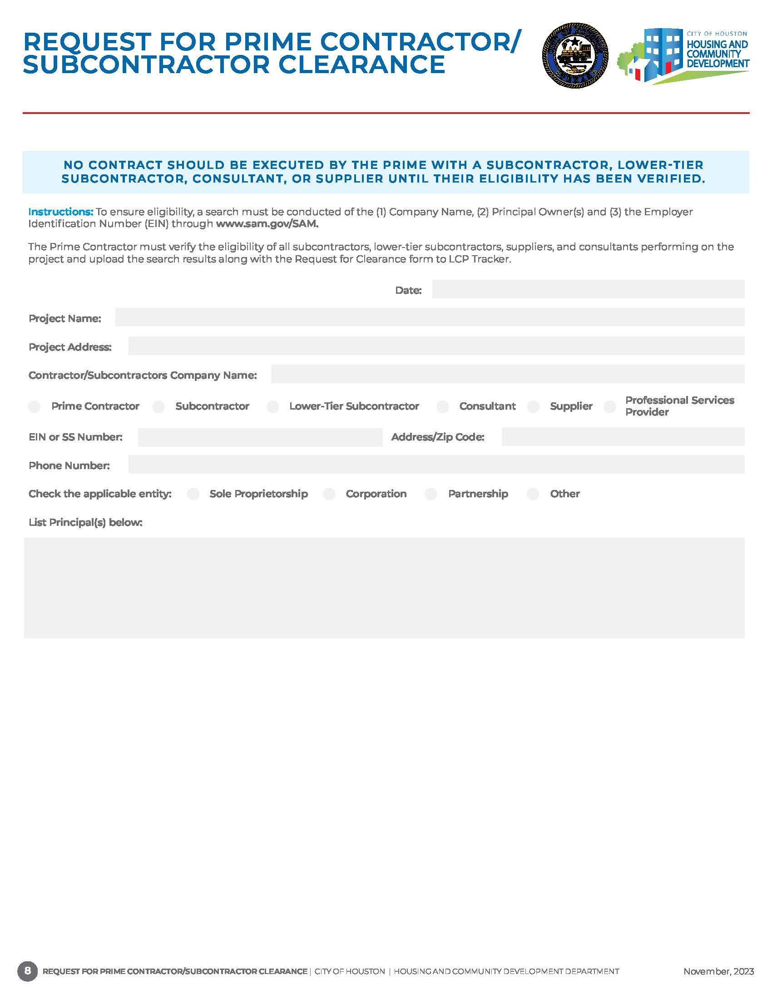
The Prime Contractor must submit a Contractor Clearance form for every contractor, supplier, lower tier subcontractor, consulting firms, etc. intended to perform on a project.
The date must reflect the same year when the Sam verification results was conducted.
The request for clearance form and all generated Sam verification results must be combined in one pdf format.
1/12/2023
Baldwin Lofts
5500 Baldwin Road, Houston, TX 11111
BBB Construction
11-1111111
111 Avenue K, 11111
888-888-8888
x
Ruben Doe
Myles Doe
Notes:
The request for prime contractor/Subcontractor clearance for must be completed by everyone on the project, the date must reflect the same month and year when the sams verification inquiry was conducted. This form must be combined with the sams results and uploaded as an annual contractor verification form. Do not upload this form alone it will be rejected.

Slide 31
SAM Verification
To verify eligibility of a contractor to work on a federally funded project, a search must be conducted on the following credentials: 1) Full Company Name, (2) Principal Owner(s) and (3) the Employer Identification Number through www.sam.gov
Search results and the Request for Clearance form must be uploaded in LCP Tracker for all contractors and suppliers.
No contract should be executed with a Prime Contractor, Subcontractor or Supplier until their eligibility has been verified.
The site now requires the creation of an account to conduct searches. The person conducting the search must be logged into the site, otherwise no search results can be retrieved.
Each search results must include date from the website when search was conducted.
Notes:
SAM Verification form is used to verify eligibility of a contractor to work on a federal funded project. The search must be conducted for the following credentials: Full Company Name, Principal Owners and Employer Identification Number.
Search results and the request for clearance form must be upload together or both forms will be rejected.

Slide 32
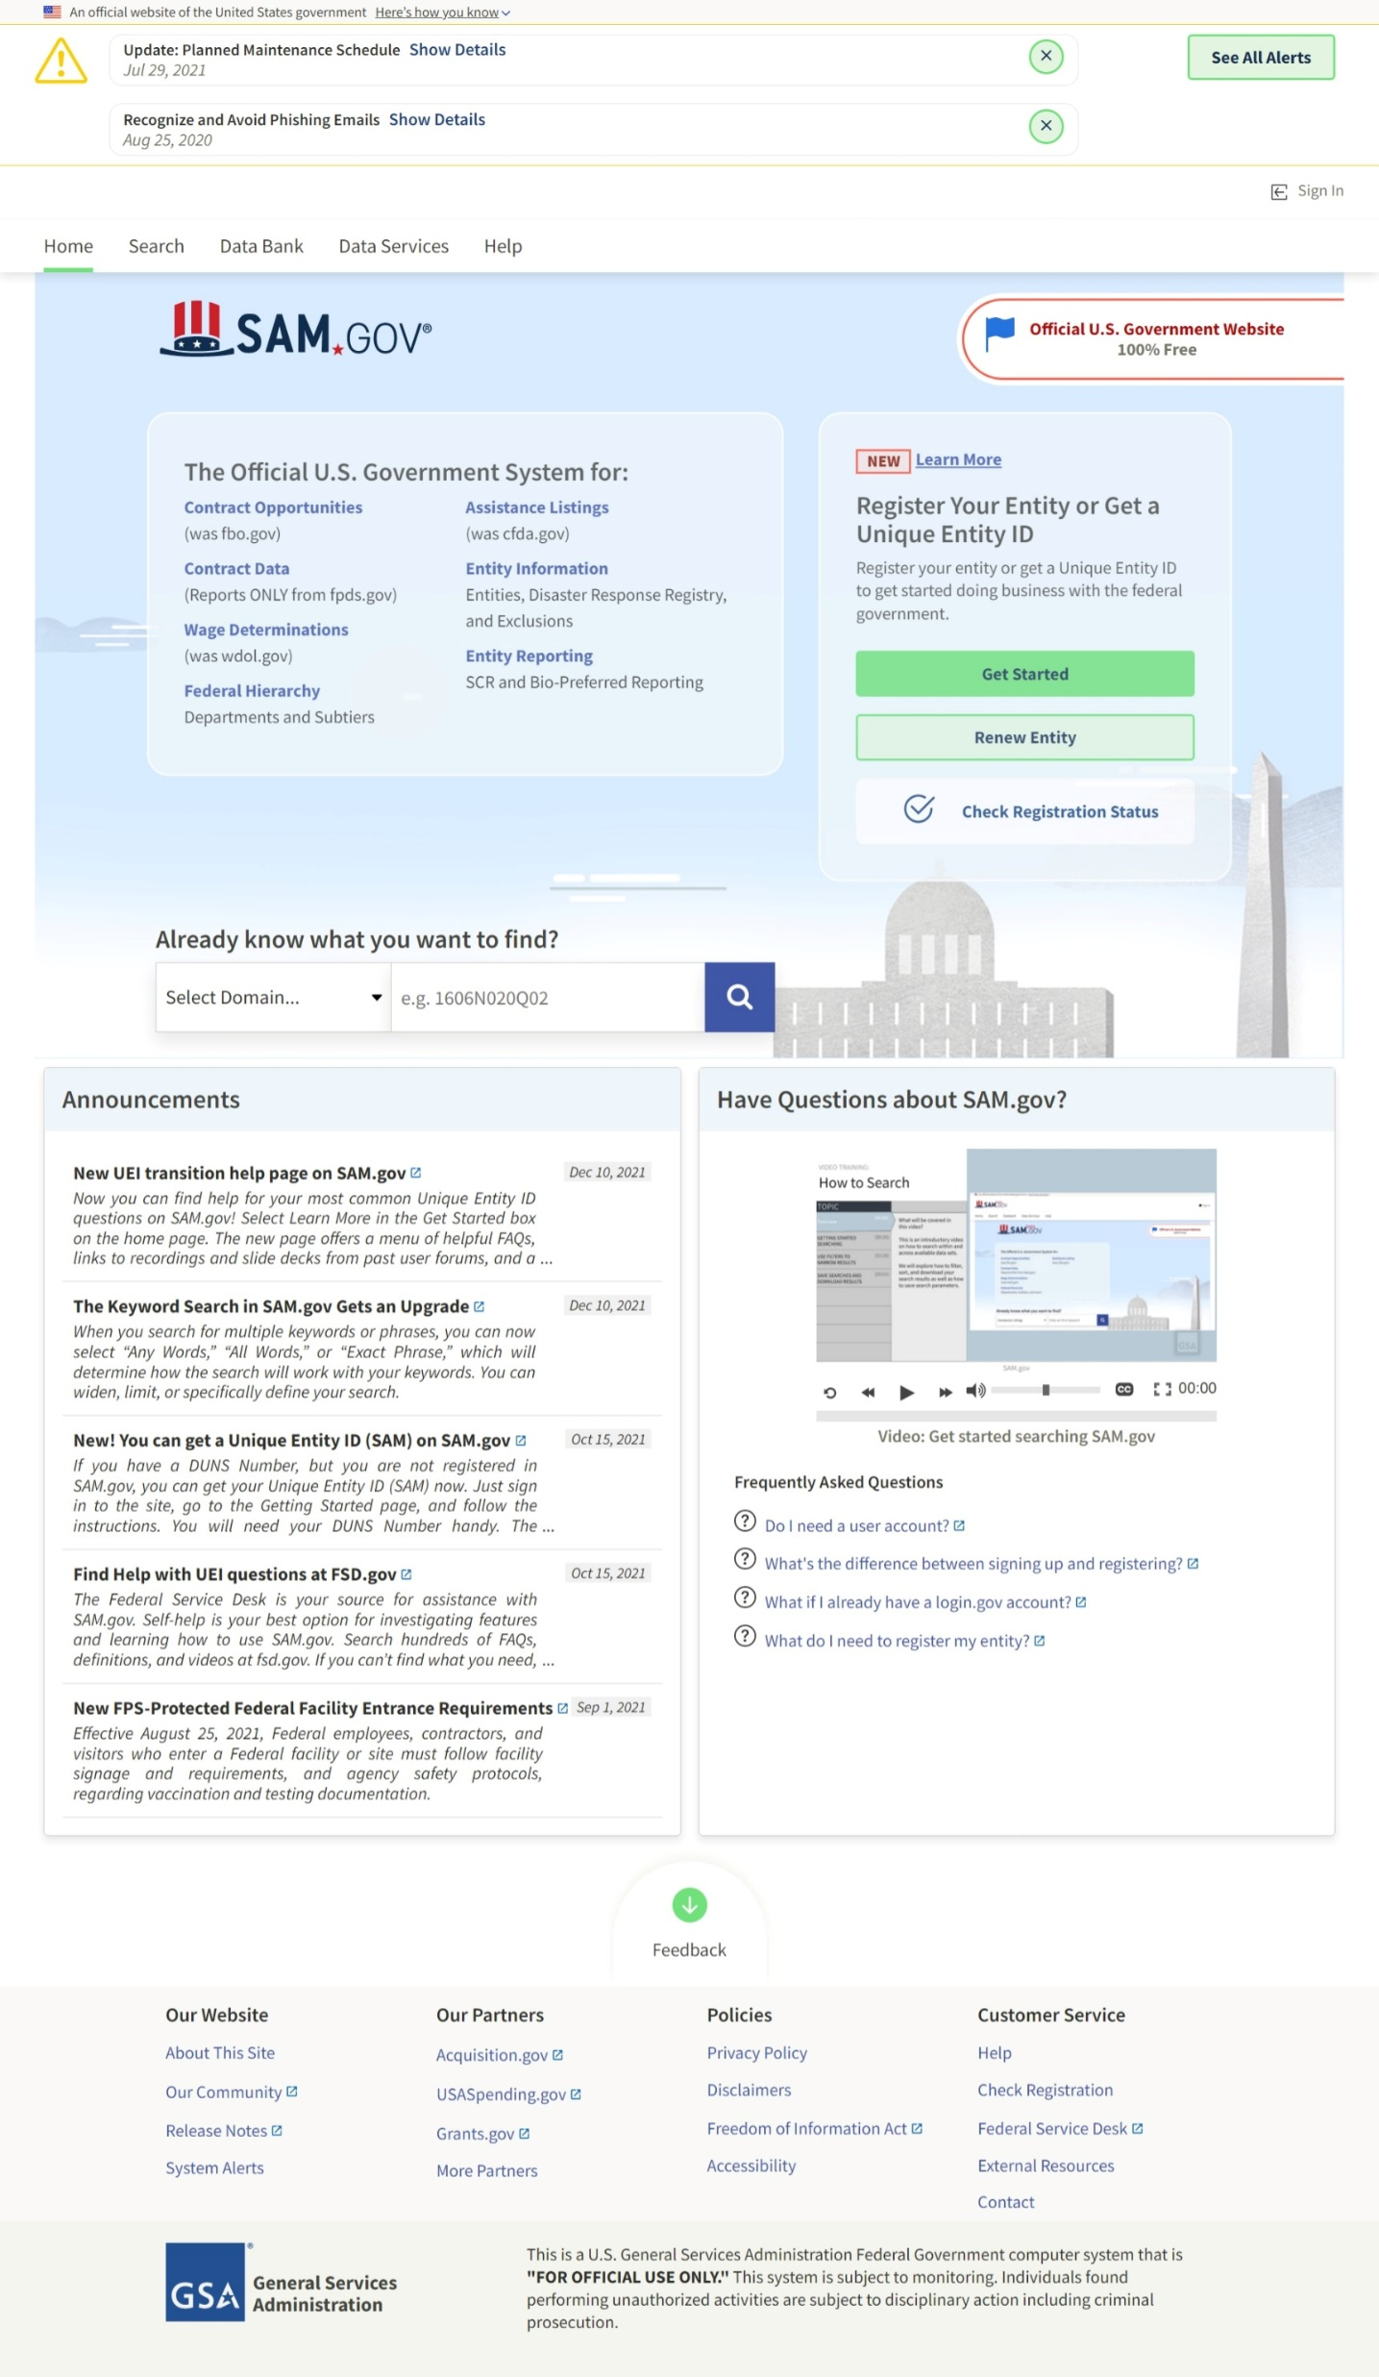
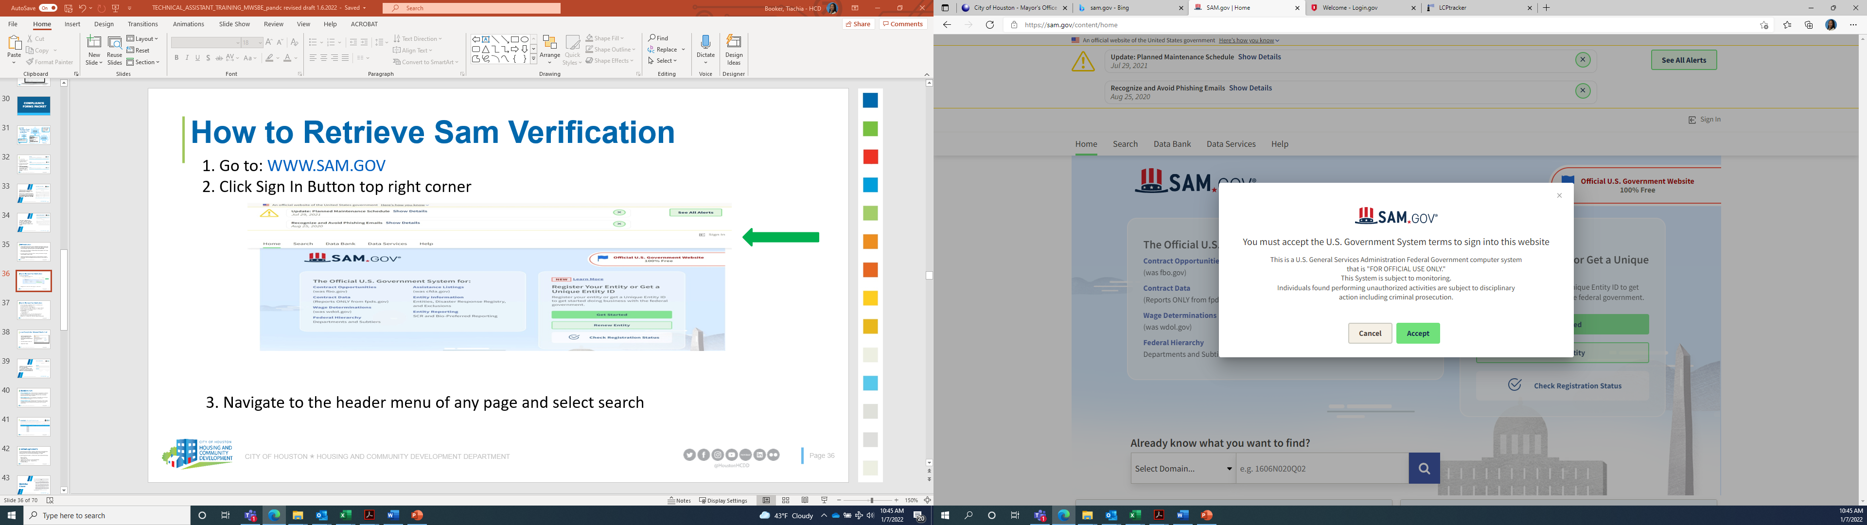
How to Retrieve Sam Verification
1. Go to: WWW.SAM.GOV
2. Click the “Sign In” button on top right corner
Sign In
3. A box will appear, Click “accept.”
Notes:
Go to www.SAM.Gov and sign in, before you can sign in you must create an account. Note: You do not have to register to create an account.

Slide 33
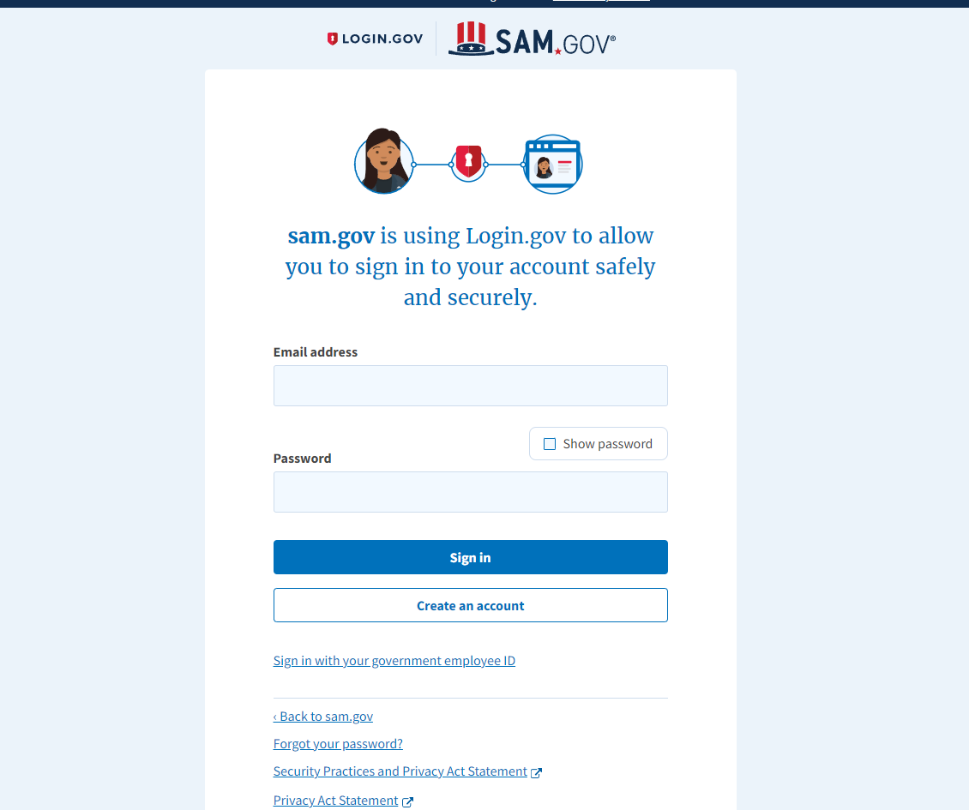
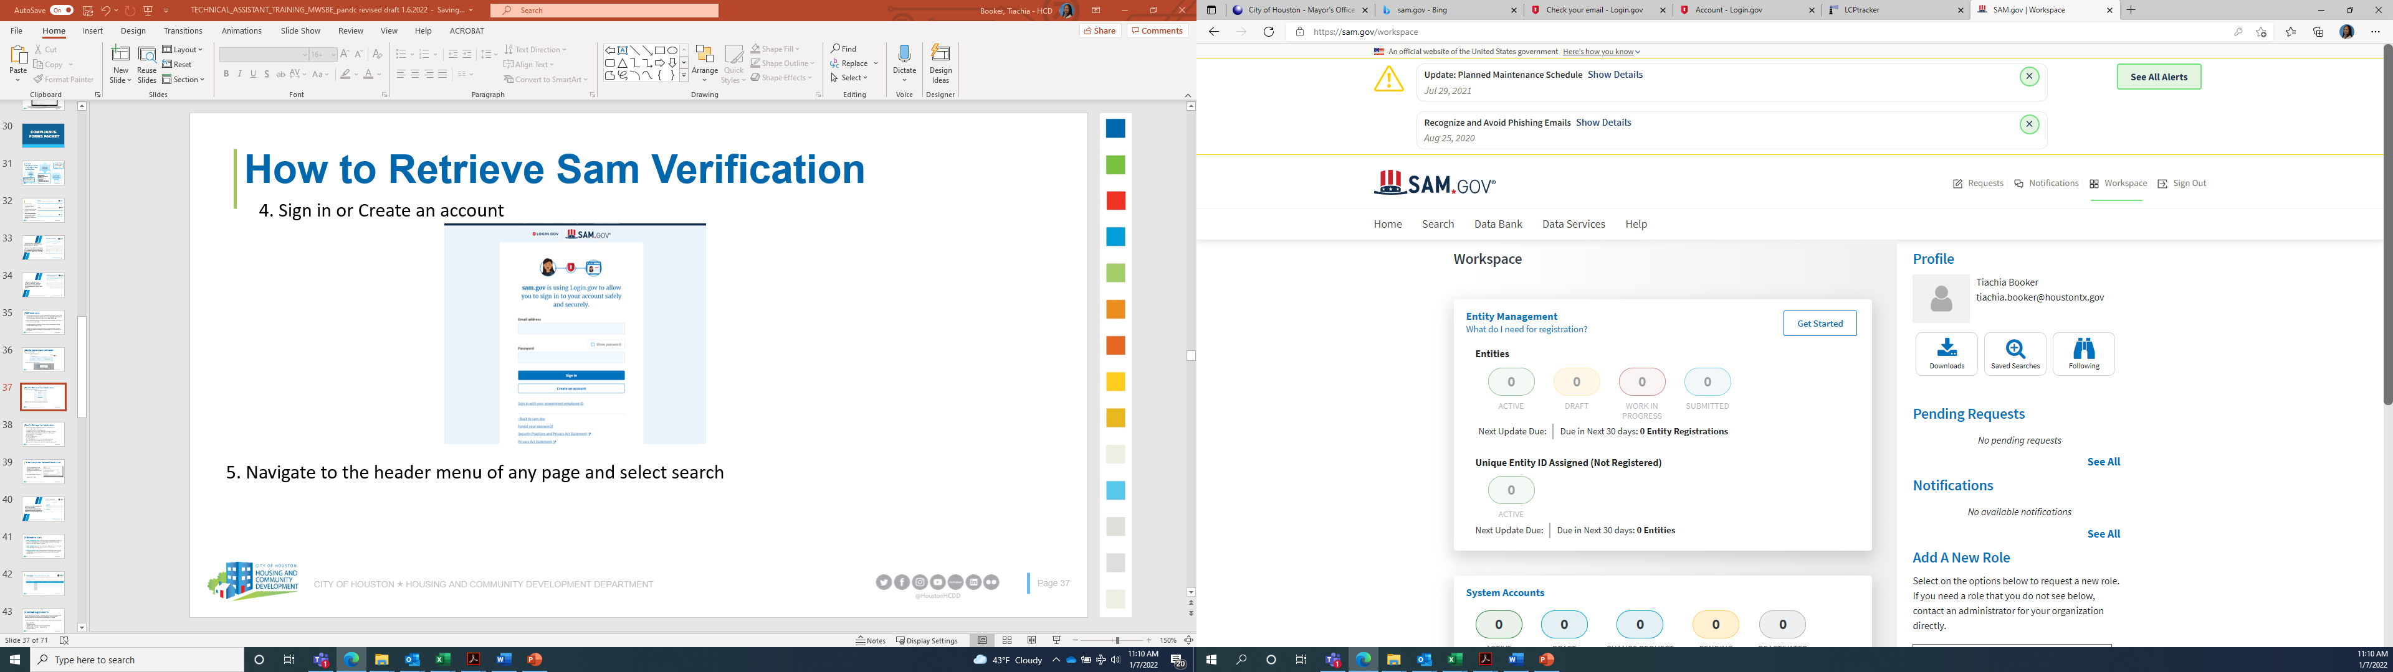
How to Retrieve Sam Verification
4. Sign in or Create an account
5. Navigate to the header menu of any page and select search
Notes:
Sign in and navigate to the header menu and select search

Slide 34
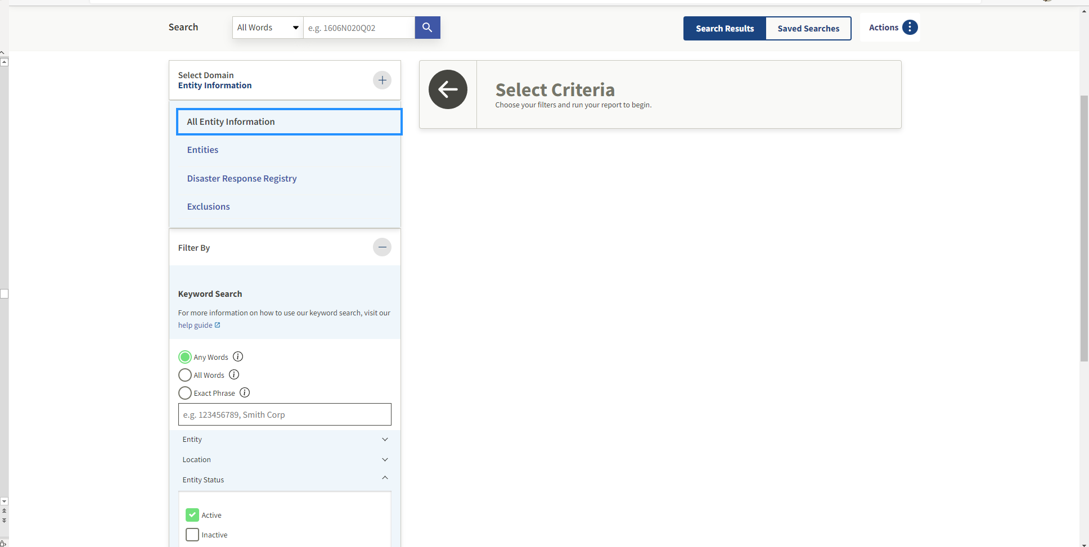
How to Retrieve Sam Verification
6. From the search page, navigate to the left-side bar. Select the “plus” icon to the right of the “select domain.”
Select Entity Information and click all Entity Information
7. Under filter by check the “Any
Words” box
8. Enter the applicable information (Company name, EIN # and principal names) in the Search box and press enter
Select
Select
Check
Enter
Notes:
Check the Any Words box and enter company name, EIN# and principal names in search box and press enter- each search must be done individually

Slide 35
How to Retrieve Sam Verification
9. Print the first 3-4 pages of the search-exclusion matches and ensure that the contractor is not an exact match:

Slide 36
How to Retrieve Sam Verification
10. Upload all results generated (Full Company, EIN#, and Principals) along with the Request for Contractor Clearance form into one document in LCPTracker.
Baldwin Lofts
1/12/2023
5500 Baldwin Road, Houston, TX 11111
x
BBB Construction
11-1111111
111 Avenue K, 11111
888-888-8888
x
Ruben Doe
Myles Doe
NOTE: If any exact match is identified, contractor, subcontractor, or lower-tier subcontractor will not be eligible to conduct any business on federal projects. Any partial matches would need to be verified by HCDD and additional information may be requested.
Notes:
Upload all results along with the request for contractor clearance form into one document. All documents must include the date of your search on the header

Slide 37
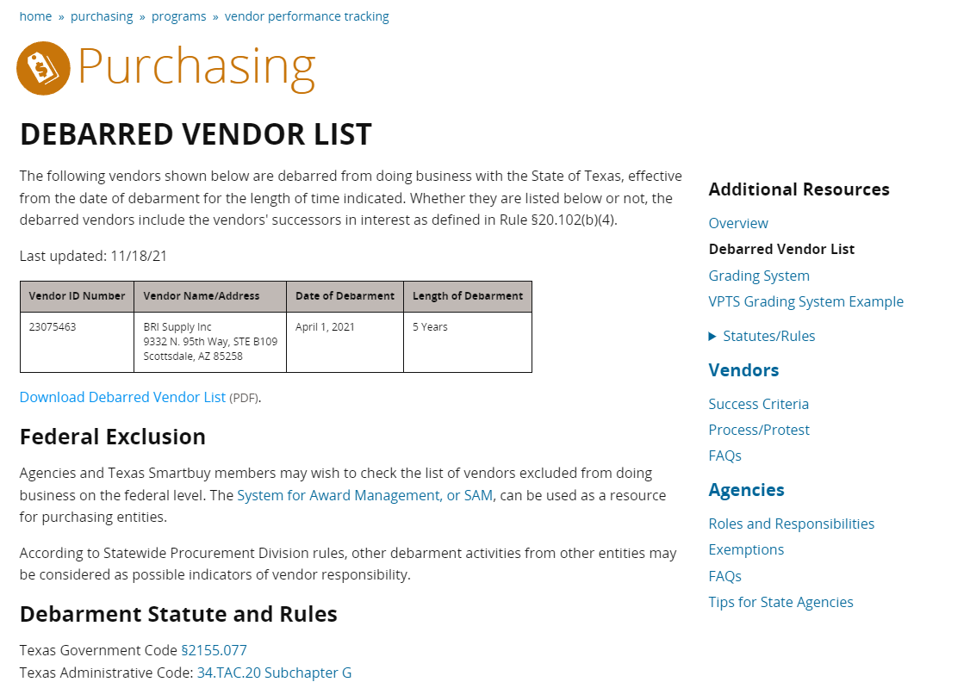
Proof of non-debarment from the state comptroller’s office must be provided by prime contractors, subcontractors, suppliers, consulting firms and lower tiers.
Document must include date from website when search was conducted.
Do not manually write the date on the document
Notes:
Proof of non-debarment from the state comptrollers office must be provided for all contractors working on the project. This document must also include the inquiry date from the website. Please do not manually enter the date, this document will be rejected. Note: the date you conduct your inquiry must also be the month/year you upload the document in LCP Tracker!

Slide 38
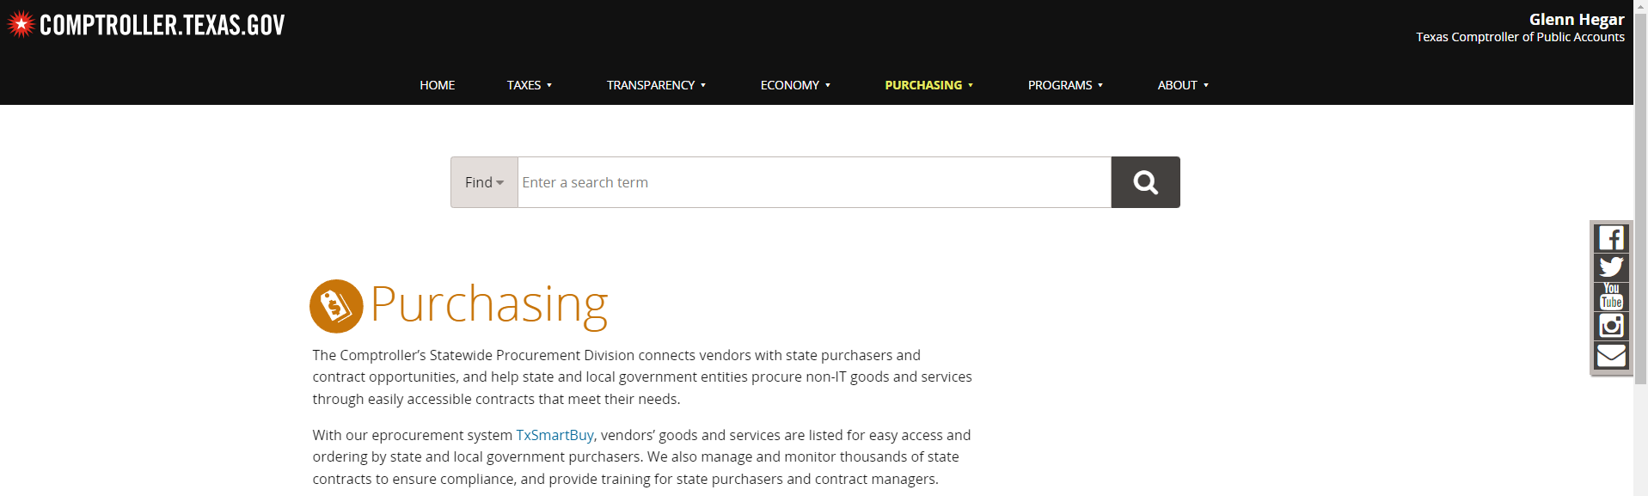
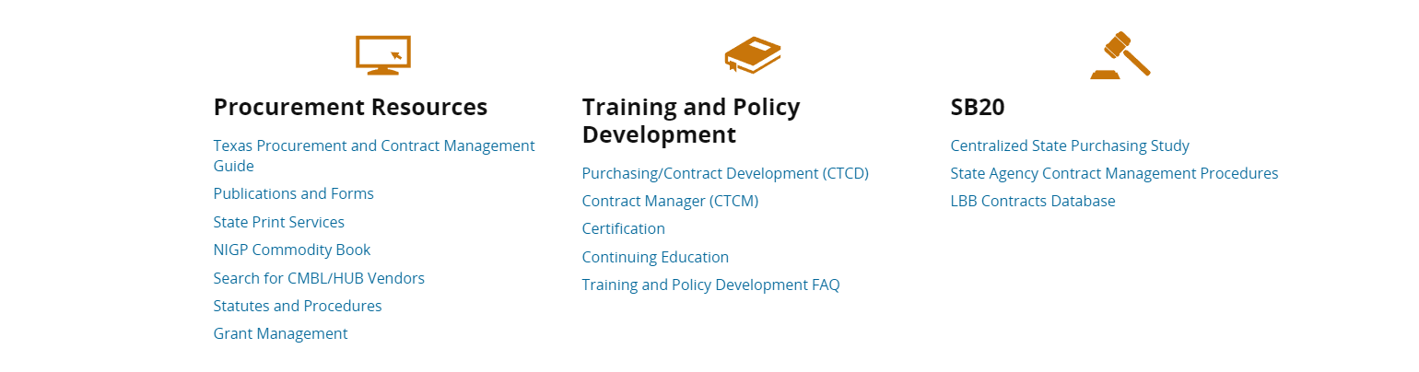
How to Retrieve Debarred Vendor List
1. Go to: https://comptroller.texas.gov/purchasing
2. Scroll down to Procurement Resources and click “Search for CMBL/HUB Vendors.”
Click

Slide 39
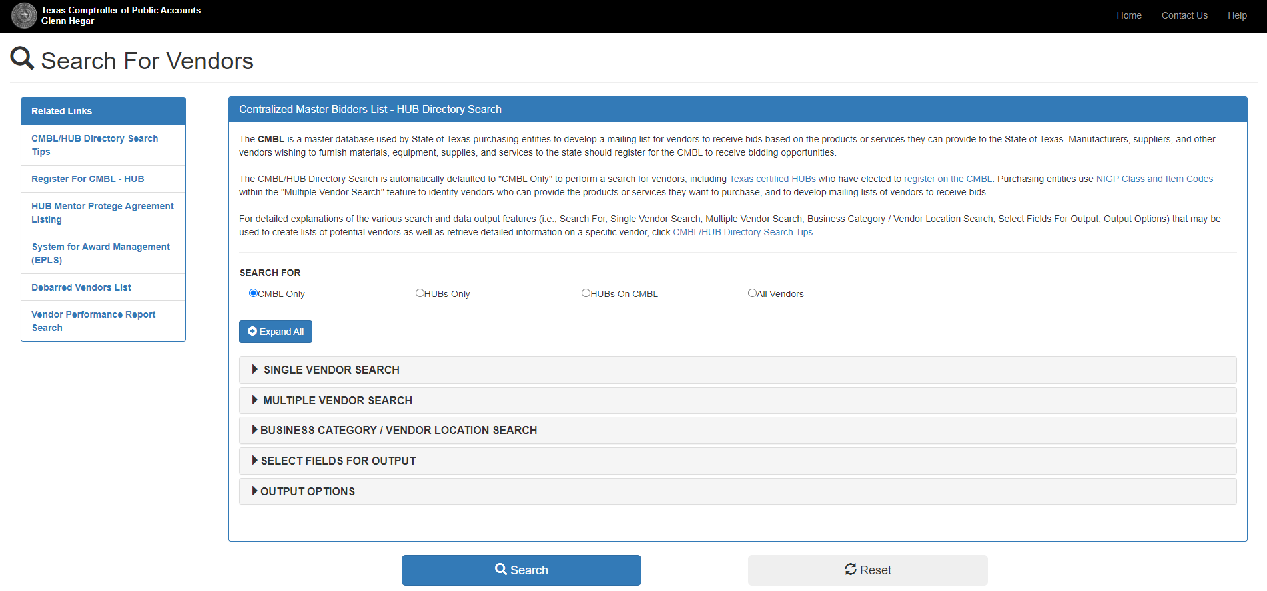
How to Retrieve Debarred Vendor List
3. Click on the Debarred Vendors List on the left-hand side:
Click
Notes:
Once you have clicked the Debarred Vendors List the next screen will appear

Slide 40
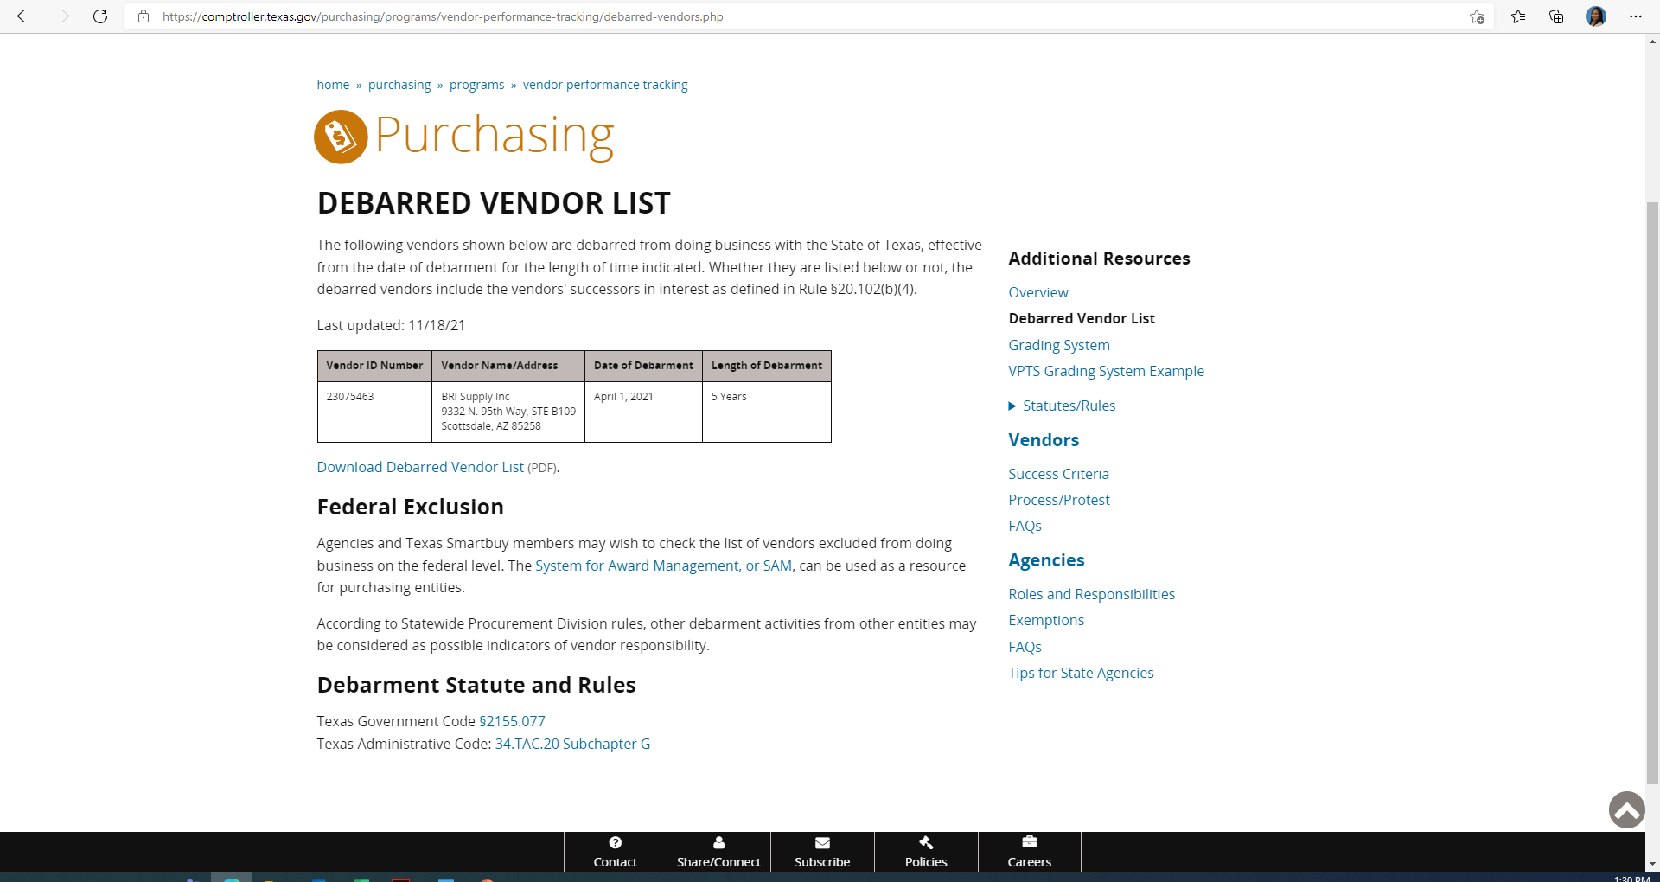
How to Retrieve Debarred Vendor List
4. The Debarred vendor list will appear on the screen:
5. “Ctrl + P” to print or save as PDF. Ensure that the date is on the list. (Note: Date does not appear on the download form, therefore, DO NOT use the Download link for the Debarred Vendor List)
6. Upload copy of the Debarred Vendor List into LCP tracker under “Annual Contractor Verification” document type.

Slide 41
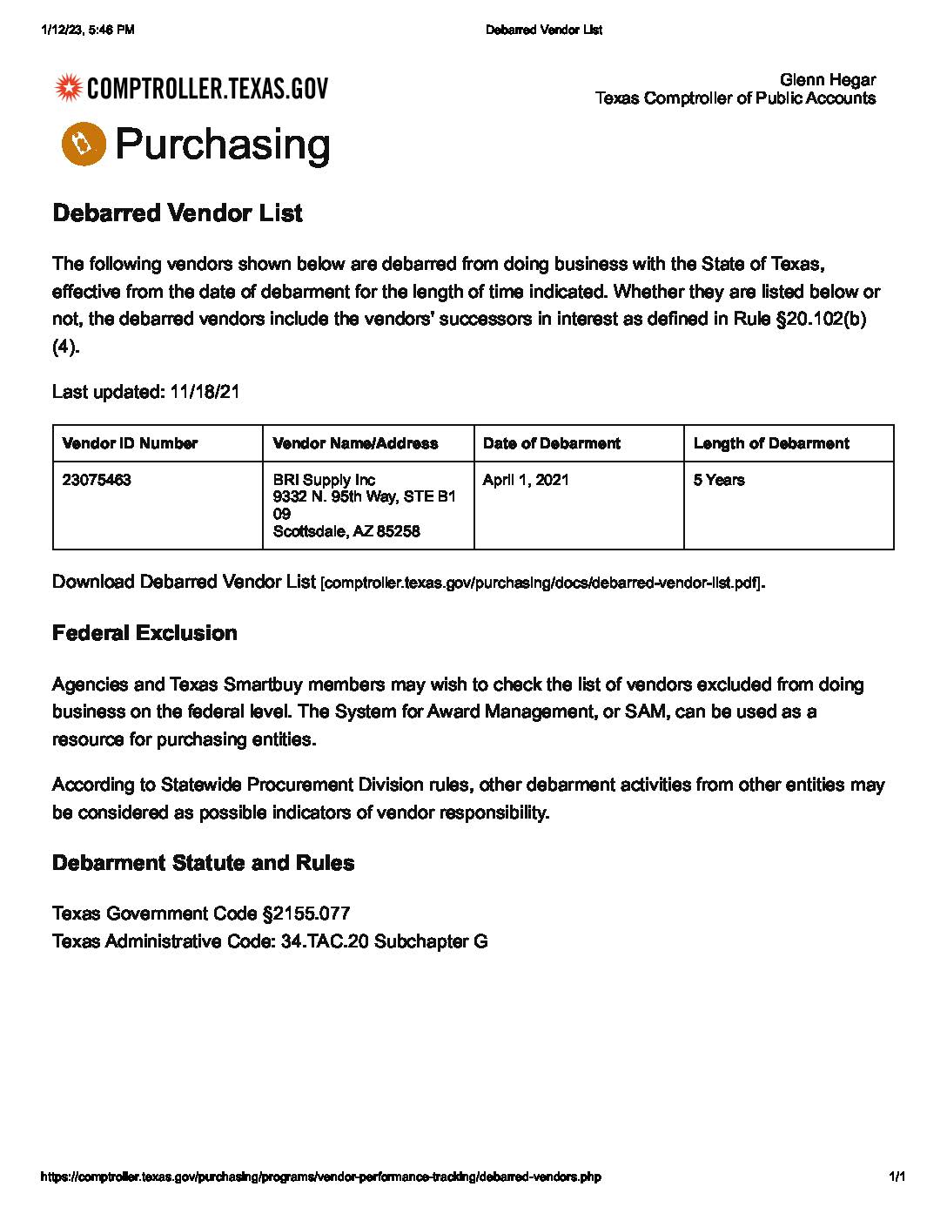
Notes:
These are non acceptable and acceptable forms. The date and website are visible for the acceptable form. This form is also uploaded as an annual form.

Slide 42
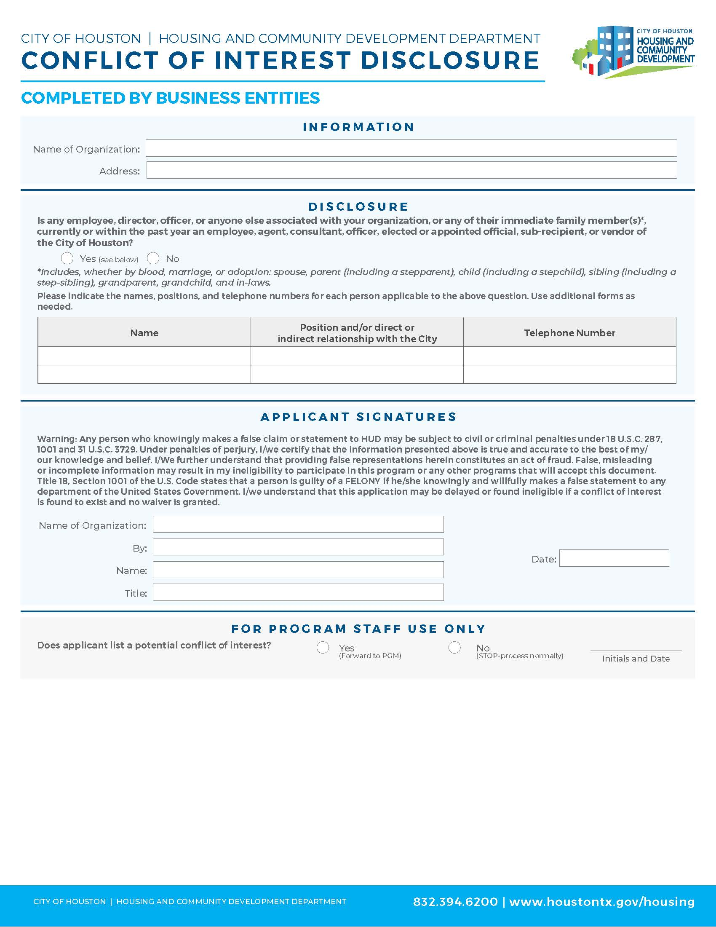
This form will help ensure full disclosure and no personal interests that violate program rules.
Document must include either a wet or electronic (cursive) signature.
Document must include a date.
Do not write in area below the blue line "For Program Staff Use Only".
Notes:
As simple as this document may seem to complete, this document is gets rejected the most! Please follow the instructions before uploading in LCP Tracker! Please do not write below the blue line!!

Slide 43
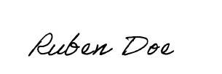
Baldwin Lofts
Baldwin Lofts
5500 Baldwin Road, Houston, TX 11111
UNACCEPTABLE
FORM
x
x
Baldwin Lofts
Baldwin Lofts
Ruben Doe
1/12/2023
Ruben Doe
1/12/2023
Owner
ACCEPTABLE
FORM
Notes:
You can see the difference between what is acceptable and what isn't acceptable to upload into LCP Tracker. Please review all forms before you upload them. This document is uploaded under Annual contractor verification

Slide 44
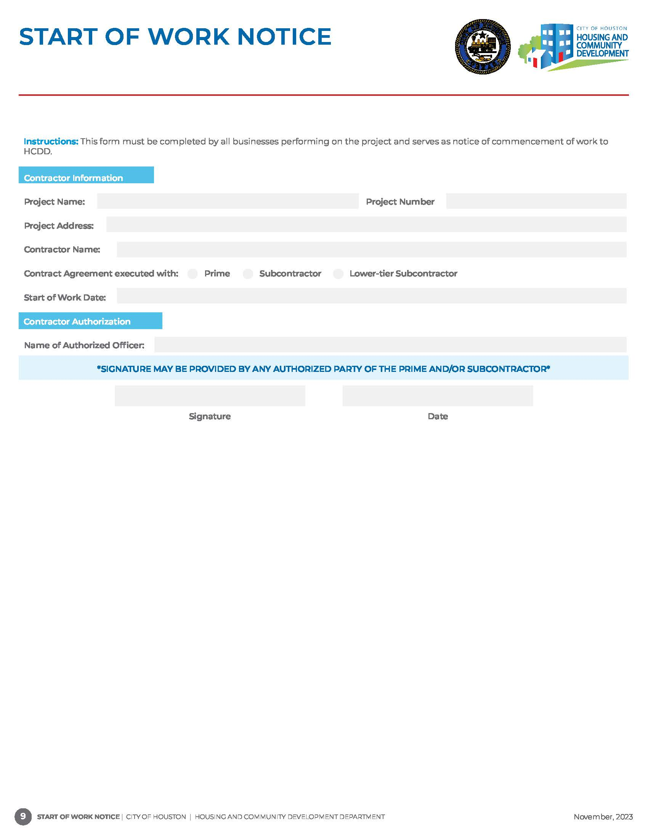
This form must be completed by the prime contractor, subcontractors, suppliers, and professional service providers as notice of commencement of work.
Document must include both the prime contractor and subcontractor name.
Document must include month, day and year when contractor scope of work has started.
Baldwin Lofts
5500 Baldwin Road, Houston, TX 11111
Jones Construction
X
1/20/2023
Ruben Doe
Ruben Doe
1/19/2024
Start of Work Notices submitted with the following language will be rejected in LCP Tracker:
TBD
Estimated
January 2024
Notes:
Upload into the Share Compliance Form location.

Slide 45
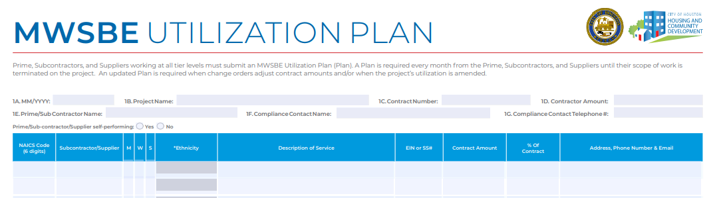
Utilization Plan
All contractors are responsible for submitting a Utilization Plan prior to the start of work.
All contractors must submit a Utilization Plan once every month until termination of work.
Prime contractors must include all subcontractors, suppliers, professional services, etc., on their monthly utilization plan who worked on the project for the reporting month.
Subcontractors who hire lower tier contractors must include the subs on their monthly utilization plan if they worked on the project for the reporting month.
Notes:
This is the only form that is required to be uploaded monthly until a TOW is submitted! Once the start of work notice is uploaded we expect to also have a MWSBE UP uploaded in LCP Tracker.
Prime contractors must include all subcontractor certified and non-certified on this form. Subcontractors who hire lower tier contractors must include the subs on their monthly utilization plan.

Slide 46
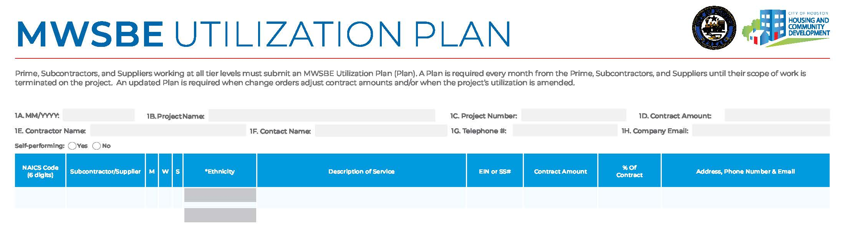
Utilization Plan
NOT
SELF PERFORMING
01/2023
Baldwin Lofts
4600011111
$3,000,000.,00
Jones Construction
Jill Doe
555-555-5555
JillDoe@email.com
x
238910
11-1111111
x
Concrete Paving
$500,000.00
8%
111 Avenue K, Houston, TX 11111
BBB Construction
SELF PERFORMING
01/2023
Baldwin Lofts
4600011111
$500,000.00
BBB Construction
Ruben Doe
888-888-8888
RubenDoe@email.com
x
Notes:
If you are not self performing 100% of the work you must enter the lower tier on this form.
The contactors self performing will only need to complete the top of the form. Monthly you would simply change the month and year on the left top corner and upload under MWSBE Utilization Plan/Schedule. I advise you to name the form using the date and year first in lcp tracker. Example April 2023 MWSBE UP

Slide 47
Contract Agreements
A contract agreement and/or purchase order should be executed with every subcontractor, supplier and professional service provider including lower tier subcontractor participating on a project.
A contract agreement and/or purchase order must include the following:
Scope of Work
Contract Amount
Signatures & Dates for Prime & Subcontractor
Address(es) of home(s) – Single Family
Mediation Clause

Slide 48
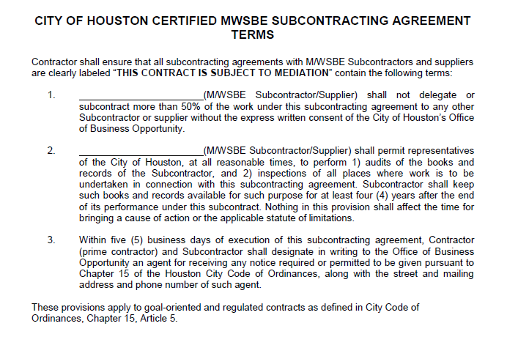
Mediation Clause
Mediation is used to try to resolve differences between the prime and subcontractors and get the companies back to working together.
Mediation can be initiated by either party or HCDD.
Notes:
The Medication Clause can included into the contract or it can simply attached to the contract. If it cannot be identified in a contract or purchase order, it will be considered non-compliant.

Slide 49
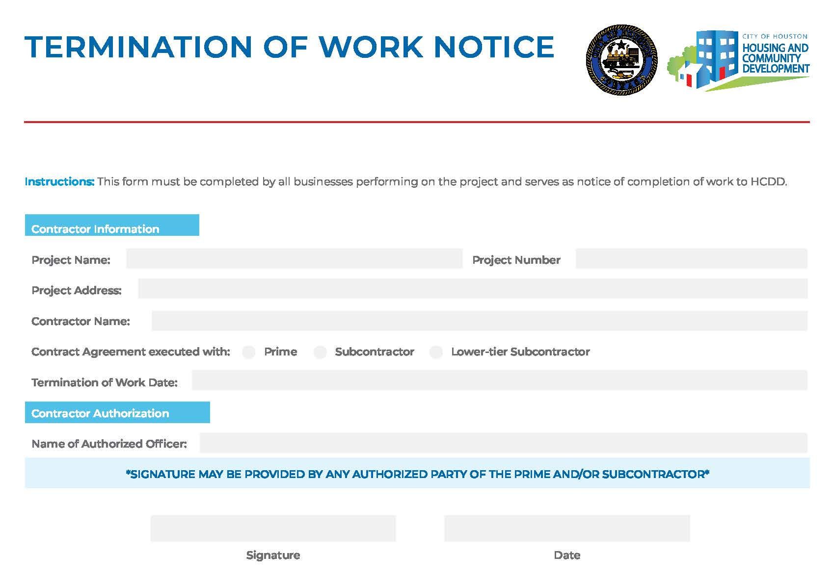
This form must be completed by the prime contractor, subcontractors, suppliers, and professional service providers as notice that work has been completed.
Document must include both the prime contractor and subcontractor name.
Document must include month, day and year when work has finished.
Baldwin Lofts
5500 Baldwin Road, Houston, TX 11111
Jones Construction
X
Termination of Work Notices submitted with the following language will be rejected in LCP Tracker:​
​
TBD​
Estimated ​
January 2024​
9/25/2023
Ruben Doe
Ruben Doe
1/19/2024
Notes:
Upload under Shared Compliance document. The TOW notice informs us that we no longer need to monitor that subcontractor if all items are compliant. Otherwise, the subcontractor will continue to receive notices from B2GNow.

Slide 50
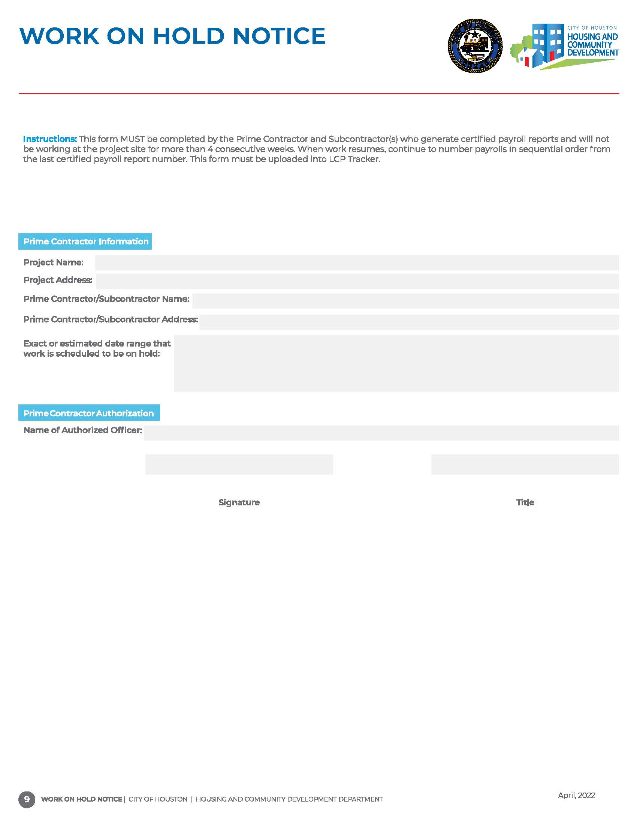

  It is not a part of the MWSBE, Section 3 or Pay or Play programs.
  Monthly compliance documents are still required to be submitted for these program areas unless a termination of work is submitted.
Work on Hold Notices are only applicable to DBRA.
Notes:
Work-on-Notices do not apply to MWSBE

Slide 51
Single Family Prime Contractor Requirements
Must submit an executed contract agreement, Contract Coversheet, Utilization Plan (UP), Start of Work Notice and Termination of Work Notice for every project address;
All contractor including lower tier subcontractors, suppliers, consulting firms, professional service providers, etc. are required to submit a monthly UP on every address by the end of every month.
A Request for Contractor/Subcontractor Clearance form and SAM verification, Debarred Vendor List and Conflict of Interest form is required for all subcontractor, supplier, and professional service provider ONCE throughout program.
If a contractor has not previously worked under this program and/or has not been verified through SAM.gov, verification records will be required to ensure the contractor is eligible to perform on federally funded projects.
Notes:
For the single family home projects, A executed contract with mediation clause, contract coversheet, utilization plan, start of work notice and termination of work notice must be submitted for every address on the project. The one time documents and annual forms are submitted like any other project.
The prime contractor is responsible for all compliance documents uploaded in LCP Tracker for their project. I advise your compliance team to review all document from your subs before they are uploaded. Any rejected documents will reflect on the primes compliance report.

Slide 52
Single Family Subcontractor Requirements Example
Contractor: ABC Company
1112 Lane Road
Start of Work (SOW)
2221 Lane Road
Compliance Coversheet
Start of Work (SOW)
Utilization Plans
Contract/ PO Agreement
Termination of Work
Compliance Coversheet
Utilization Plans
Contract/PO Agreement
Termination of Work
Document Provided Once/Annually
Request for Clearance Form/ Sam Verification Results
Debarred Vendor List
Conflict of Interest Form
Notes:
This is an example of the Single Family

Slide 53
DEVIATION REQUEST

Slide 54
Deviation Request Requirements
Work designated in your approved plan cannot be completed by any other subcontractor and/or supplier unless you receive permission from the Housing and Community Development Department.
To deviate from the approved MWBE Participation Plan, the request must be submitted in writing to the assigned MWSBE compliance monitor stating your proposed change, the specific reason for removal and how you plan to meet your MWBE goal.
A Deviation Request is only required to add or remove a certified MWSBE firm.
The request should include reasons for the deviation; Who, What, When and Why.
When removing a firm, a plan to achieve the impacted MWSBE goal is required.
A deviation request does not reduce or increase the contract goal. The prime contractor is responsible for achieving the approved participation goal at the time of award.
Prime contractor cannot replace a certified firm with a non-certified firm.
Notes:
The deviation request is to remove or add a MWSBE on the project that will impact the participation goal. The prime can not remove a MWSBE contractor without submitting a deviation request, notify your contract administrator and they will assist with the process. I strongly advise you to submit a deviation form for every MWSBE working on the project, this can help you with your projected goal. The prime contractor can not replace a certified firm with a non-certified firm. City of Houston has a directory with thousands of certified companies and may easily find an replacement.

Slide 55
ONGOING MONITORING

Slide 56
Ongoing Monitoring
Random site visits will be conducted to monitor project activities and contractor’s participation.
Compliance documents will be compared with information gathered from interviewing employees and site action.
Documents submitted for reporting and monitoring purposes by all contractors will be reviewed for accuracy and compliance with requirements.
The Prime Contractor will be notified of any items identified as non-compliant via email, by the 5th of every month.
Notes:
Random site visits will be conducted once a month. The MWSBE compliance administrator will arrive on the project site and we look for a sign in sheet so that we may identify any MWSBE's working on site and we interview one of the workers regarding their scope of work. In some cases there are companies working onsite that are not documented and must be added into LCP tracker and B2G Now. That is another reason why it is important for us to obtain a sign in sheet.
A Compliance Status Report will be sent out the 1 thru the 5 of the month reporting compliance documents on the project. All contractors will be reviewed for compliance documents uploaded into LCP Tracker and every red item will need to be addressed by the Prime Contractor. I advise the prime contractor to review all documents from the subcontractors before uploading into LCP Tracker, its your project and you want to ensure the correct document completed and uploaded correctly. This save the Contract Administrator time and also prevents forms being rejected.

Slide 57
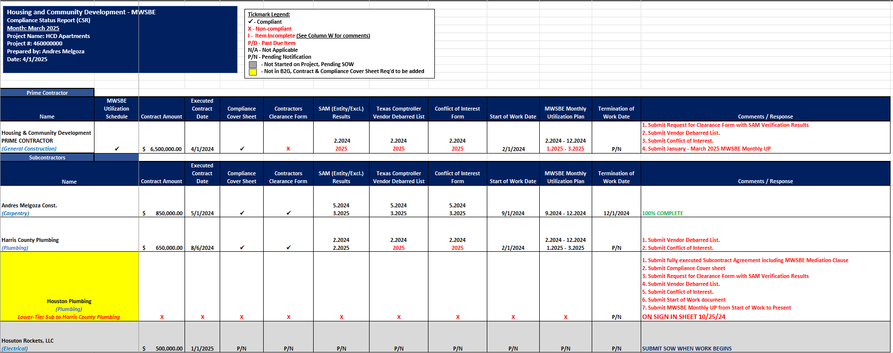
Compliance Status Reports

Slide 58
Commercially Useful Function (CUF) Audits
A CUF Audit is authorized by the City of Houston Code of Ordinances under Chapter 15, Article V, Section 15-84 (a).8.d.
HCDD will perform CUF audits of certified firms to assess the level of credit the Prime Contractor should receive for the certified firm’s performance. In determining whether a certified firm is performing a Commercially Useful Function, factors including but not limited to the following shall be considered:
  Whether it is performing a real and actual service that is a distinct and verifiable element of the work called for in a contract.
  Whether it has the skill and expertise to perform the work solely, for which it is being utilized and possesses all the necessary licenses.
  Whether it is in the business of performing, managing, or supervising the work for which it has been certified and is being utilized.
  Whether it is certified in the North American Industry Classification System (NAICS) code in which it is performing, and the firm is certified in that scope.
An audit will be conducted on each certified firm to ensure contractors are performing in the NAICS code of their certification, using their own forces. Credits are being applied according to their actual performance on the project.
Notes:
The Commercially Useful Function Audit is to ensure the MWBSE is self performing in the NAICS code of their certification, using their own resources. A brief interview will be conducted on site with a random worker, we check to see if they use their own equipment, tools, and materials. Professional service contractor on the project will be sent questions regarding the scope of services in email form.. All required forms will be sent to the CA for review.

Slide 59
CONTRACTOR PERFORMANCE

Slide 60
Compliance Red Flags
Prime Contractor fails to meet MWBE goal requirements and does not demonstrate acceptable Good Faith Efforts.
Prime Contractor fails to submit required compliance documents.
Prime Contractor fails to review and/or submit accurate compliance documents for subcontractors and suppliers.
Prime Contractor fails to complete monthly payments audits in B2G Now.
Prime Contractor fails to submit a deviation request to remove goal credit firms.
Prime Contractor fails to comply with program requirements.
Notes:
These are some compliance red flags

Slide 61
Substantial Non-Compliance
If contractors fail to comply with program requirements, the Compliance Monitor may recommend withholding of payment draws.
Payment Withholding
If Contractor(s) fail to comply with the terms of the contract documents, HCDD may temporarily suspend/terminate the contract at any time.
Termination of Contract
Suspension, Debarment, Suspension, or Limited Denial of Participation
Upon termination, HCDD may also include Contractor(s) on Nationwide Debarred and Suspended List of Contractors.
Notes:
All the red flags mentioned are reasons subject to your payment being with held, termination of contract or suspension, debarment or Denial of participation.

Slide 62
PENDING CLOSEOUT PROJECT ACTIVITIES
Notes:
We are getting close to the end of the MWSBE Technical Assistance Training and but before I close we will discuss project closeout and evaluation. This may determine if the city will offer the prime more invitation to bid to work on another City project.

Slide 63
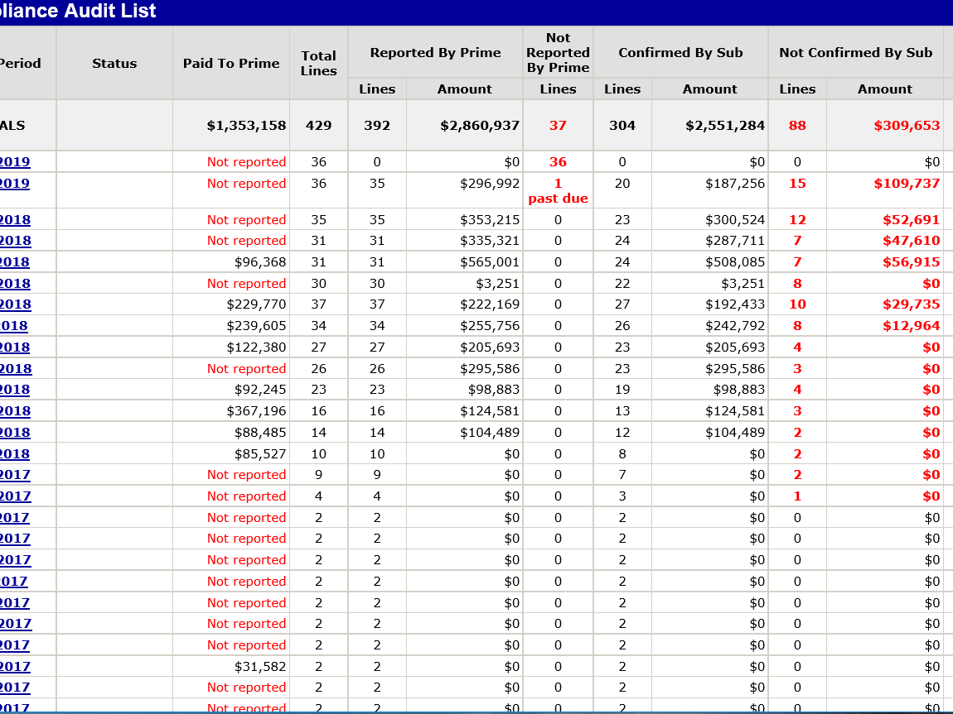
Pending Closeout Project
When site activities are completed under contract terms, contractors should submit a Termination of Work Notice.
The final payment in B2GNow should also be marked “final.”
Retainage payments must be entered in B2G by contractors with the total amount of retainage being held.
A project CANNOT be closed with any “Outstanding” compliance audits. Outstanding audits are a result of unconfirmed payments, unreported payments and payment discrepancies.
47

Slide 64
Project Close Out & Evaluation
A Closeout evaluation consists of evaluating the Prime Contractor MWBE goal and compliance with program requirements.
Subcontractors’ performance may impact evaluation ratings of the Prime Contractor.
Notes:
A closeout evaluation consists of evaluating the prime contractor MWSBE goal and compliance with program requirements. Also subcontractors performance may impact the prime contractors evaluation ratings. As mentioned it is the primes responsibility to make sure the compliance documents are uploaded and all payments are confirmed.

Slide 65
Resource Links
24 CFR 85.36 Federal Procurement
https://www.hud.gov/sites/documents/24CFR85-36PROC.PDF
Chapter 15 Article V of the City of Houston Code of Ordinances
https://library.municode.com/tx/houston/codes/code_of_ordinances?nodeId=COOR_CH15 CO_ARTVMIWOSMBUEN
City of Houston Good Faith Efforts Policy
http://www.houstontx.gov/obo/docsandforms/goodfaithefforts.pdf
Notes:
As we come to a close of the training, here are resource links that may be beneficial to you.

Slide 66


Comments & Questions
Notes:
This comes to the conclusion of the MWSBE training.
Please take a moment to complete the survey.

Slide 67


Slide 68
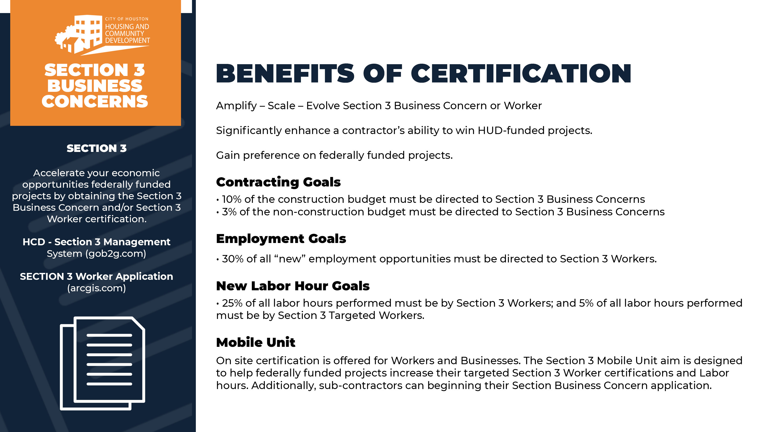

Slide 69


Slide 70


WHAT’S
SECTION 3 NEWS:
Make the most of your opportunities on federally funded projects by obtaining your Section 3 certification!
Section 3 Program requirements, certifications, and related inquiries are now managed by the Real Estate Compliance team, led by Laura Serrano.
For certification assistance or questions, please contact the team at hcdsection3@houstontx.gov or call the Section 3 Hotline at (832) 394-6257.
PAY OR PLAY:
We are continuing to accept POP payments; however, there has been a notable increase in refund requests due to duplicate payments. To help prevent this, we kindly ask all POP vendors to report any system-related issues and notify us before submitting an additional payment. This precaution is necessary due to integration issues between the Paymentus portal and B2GNOW, which can affect the transfer of payment data.
As a reminder, all POP vendors should email a copy of their payment confirmation number to the HCD POP team.
If PAY vendors encounter an error when accessing the Paymentus portal via B2GNOW, please use the direct link below:
🔗 https://ipn4.paymentus.com/rotp/chbo
NEW!
PRE-AWARD SERVICES:
Multifamily projects in the pipeline New Hope Housing Wheatley, New Faith Senior Village and Andover Village.
Infrastructure project for Cambridge Park Village and Ramblewood Neighborhood Drainage and Paving
Level Up with Section 3 & MWSBE – Get Certified and Unlock New Opportunities!
Ready to elevate your business or career? Earning your Section 3 and/or MWSBE certification opens the door to exclusive opportunities on federally funded projects. Whether you're a small business pursuing contracts or a job seeker looking to advance, Section 3 and MWSBE certifications create pathways to growth, new possibilities, and long-term success.
Don’t miss out—certify today and start building your future! The certification links are shared below
SECTION 3 WORKER APPLICATION
HCDD - Section 3 Management System
City of Houston Office of Business Opportunity System

