Slide 1
Hardy Yards NOFA
Pre-Application Conference
November 10, 2022

Slide 2



Introductions
Olivia Christina Bush
Jeremiah Rivera
Andrea Smith
Linsi Broom
LARGE TRACT DIVISION
Division Manager
LARGE TRACT DIVISION
Community Outreach Coordinator
LARGE TRACT DIVISION
Administration Manager
FINANCE
Staff Analyst
City of Houston
Housing and Community
Development
City of Houston
Housing and Community
Development
City of Houston
Housing and Community
Development
City of Houston
Housing and Community
Development

Slide 3

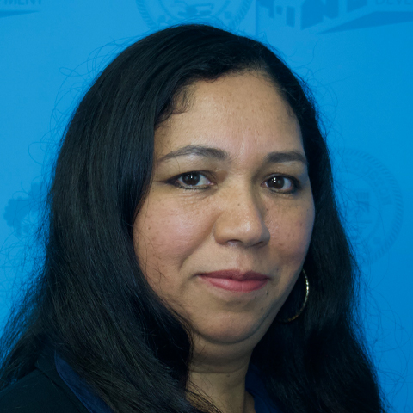

Introductions
Chrystal Boyce
Maribel Rodriguez
Dawn Lee
COMPLIANCE & OPERATIONS
Division Manager
COMPLIANCE & OPERATIONS
Administration Coordinator
LARGE TRACT DIVISION
Administration Coordinator
City of Houston
Housing and Community
Development
City of Houston
Housing and Community
Development
City of Houston
Housing and Community
Development

Slide 4
Housing Keeping
Please mute your microphone
The pre-proposal conference is being recorded
Send questions into the chat box
Q&A

Slide 5
Today’s Agenda
1
Funding & Solicitation Schedule
2
Hardy Yards Site
3
NOFA Summary & Selection Criteria
4
Compliance Requirements
5
Submitting an Application
6
Key Resources / Q&A

Slide 6
Funding & Solicitation Schedule
Linsi Broom

Slide 7
Funding
Approximately $20,000,000
Hurricane Harvey Community Development Block Grant Disaster Recovery (CDBG-DR) 2017
Funds allocated by the US Department of Housing and Urban Development (HUD) to the Texas General Land Office (GLO)

Slide 8
2022-2024 Estimated Timeline
Applications Due | December 5, 2022
Threshold Review Completed and Amendments Due | December 16, 2022
Award Announcement | Before Year-End 2022
Legal Review & Underwriting | 120 Days
City Council/Loan Closing | April 2023
Construction Time | May 2023-July 2024

Slide 9
Reference Materials
Harvey Single Family Development Program Guidelines
Hardy Yards Solicitation Files
New Homes for Near Northside(Community Feedback)
City of Houston Hurricane Harvey website:
https://recovery.houstontx.gov/
Texas GLO Hurricane Harvey website
https://www.glo.texas.gov/recovery/index.html

Slide 10
Hardy Yards Site
Jeremiah Rivera
Notes:
Reminder: Please put questions into the chat.

Slide 11
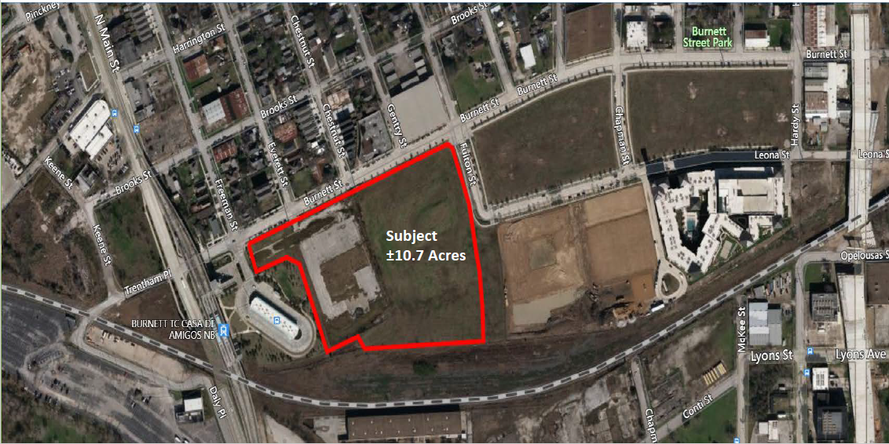
Hardy Yards Site

Slide 12
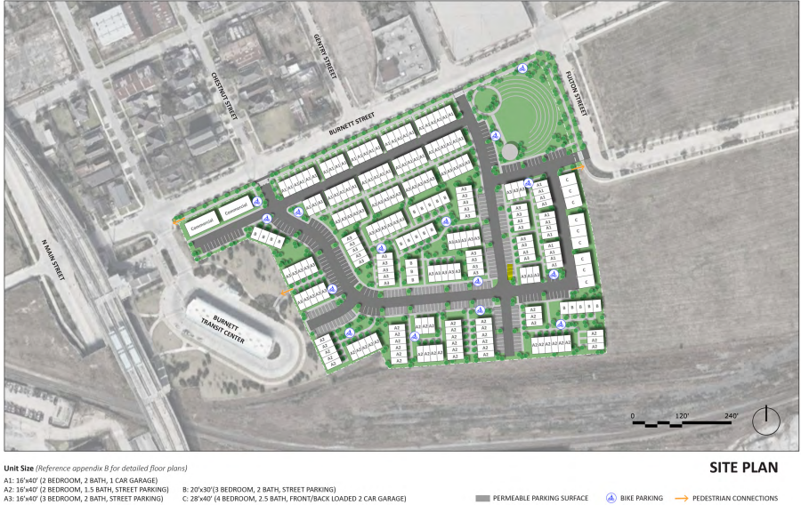
Hardy Yards Site

Slide 13
Hardy Yards Site
10.7 acres
Near North Main Street and Burnett intersection
Adjacent to Burnett Transit Center
Downtown view

Slide 14
NOFA Summary & Selection Criteria
Jeremiah Rivera
Notes:
Remind to put questions into the chat

Slide 15
Project Summary
At least 51% of homes sold at affordable prices for low-to-moderate (LMI) income homebuyers
City will convey land, finance a portion of infrastructure or construction costs
Developer will build, market, sell homes
Notes:
Ultimately, affordable homeownership program
At each site, 51% of homes must be sold to LMI homebuyers
City will convey the land, and make available forgivable loans that can be used for infrastructure or home construction
Developer has responsibility to build, market and sell homes. We’ll talk about later how the City will assist in these areas, but underscoring again this will be the developer’s responsibility

Slide 16
Project Summary
Community Development Block Grant Disaster Recovery (CDBG-DR17)
  $15,800,000.00 in land acquisition and due diligence
  $4,200,000.00* for land infrastructure or home construction
*Forgivable loan

Slide 17
Eligible Project
3 and 4-bedroom only
Affordable Homes must be of equivalent size, quality, materials, and finishes as Market Rate Homes
No perceptible concentrations of homes by income level
New construction. City may consider site-built or pre-fabricated approaches
Refer to Master Declaration of Covenants, Conditions and Restrictions– Exhibit Master Declaration

Slide 18
Eligible Project
At least 51% of homes built sold to households at or below 80% area median income (AMI)
Affordable homes sold ONLY to households directly or indirectly impacted by Hurricane Harvey
HCD will verify incomes based on current year HUD Income limits
Notes:
Affordable homes sold ONLY to households directly or indirectly impacted by Hurricane Harvey – Functionally, the homebuyers must have lived in the City of Houston August 17, 2017, the day Hurricane Harvey hit

Slide 19
Evaluation & Selection Process
Jeremiah Rivera

Slide 20
Evaluation Committee
Evaluation committee to score applications based on listed criteria
May issue letter(s) of clarification as necessary
Notes:
Note about the evaluation committee.
No one from the program team
Capable City employees with different levels of expertise
As you put your application materials together, assume they have no prior knowledge of you or your work and that they are ONLY READING what you submit.
Highly recommend being clear and transparent as you link your materials to the scoring criteria. Consider a cover sheet or summary page
Don’t bury the lead, we’re going to show you where the Committee will be looking for the materials in your application
Explain acroynoms, associations

Slide 21
Threshold Criteria
No officer, director or owner has been banned or debarred from doing business with HUD, GLO or the City
Certificate of Account Status from Texas Comptroller
Developer must have minimum of 5 years prior, proven development experience of 200 or more homes
As applicable: current 501(C)3 tax exempt status
$1,000 Application Fee is required and must be hand delivered to:
  2100 Travis Street, 9th floor,
  Houston, Texas, 77002, by the NOFA deadline

Slide 22
Scoring
Developer Capacity: 50 points
  Prior experience: 10 points
  Single-Family Home Development Experience: 10 points
  Access to capital: 10 points
  Financial strength: 10 points
  Prior experience with affordable housing: 10 points
Disaster Resilience: 10 points
Energy Efficiency: 10 points
Community Feedback & Priorities: 10 points
Affordability Value: 20 points
Notes:
Each scoring criteria is worth up to 10 points, except for one which we will cover
No bonus point criteria or points for categories beyond what’s listed

Slide 23
Developer Capacity (50 total points)
1 of 5: Prior Experience (10 points)
Source: Application Content & Project Narrative: Company Bio
Applicant with greatest number of single-family homes developed in prior 10 years will receive 10 points
Other applicants awarded points proportionally

Slide 24
Developer Capacity (50 total points)
1 of 5: Prior Experience (10 points)
Developer A – 500 homes
  500/500 x 10 = 10 points
Developer B – 375 Homes
  375/500 x 10 = 7.5 points
Developer C – 100 Homes
  100/500 x 10 = 2 points

Slide 25
Developer Capacity (50 total points)
1 of 5: Prior Experience (10 points)
HCD will accept multifamily development based on units produced (rental) or sales (condo)
Highest scoring developer may not score more than 5 points greater than second highest scoring developer
Final outcomes rounded to hundredths place

Slide 26
Developer Capacity (50 total Points) –
2 of 5: SF Home Development Experience (10 points)
Source: Application Content & Project Narrative: Company Bio
10 points = 20+ years SF experience
7 points = 15-20 years SF experience
5 points = 10-14 years SF experience
3 points = 5-9 years SF experience
0 points = Less than 5 years SF experience

Slide 27
Developer Capacity (50 total Points)
3 of 5: Access to Capital (10 points)
Source: Conditional Letter of Commitment from Financial Institution
10 points – Letters demonstrating past financing on similar scale projects indicating interest to finance
5 points – Letters demonstrating past financing on lesser but relevant scale projects indicating interest to finance
0 points – Developer fails to submit letters

Slide 28
Developer Capacity (50 total Points)
4 of 5: Financial Strength (10 points)
Source: Financial Statements
Financial statements demonstrating liquidity proportional to development cost
Developer A: $60M cost, $30M liquidity
$30M/$60M x 10 = 5 total points
Maximum of 10 points

Slide 29
Developer Capacity (50 total Points)
5 of 5: Developer Affordable Housing Experience (10 points)
Source: Application Content and Project Narrative: Company Bio and Org Chart Supplement
Developer with greatest depth & range will receive 10 points
Others will receive fewer points in proportion to City’s determination compared to highest-ranked developer
Criterion will be qualitatively scored
Notes:
Relevancy of experience
Spectrum of experience

Slide 30
Disaster Resilience (10 Total Points)
Source: Application Content and Project Narrative
All applicants must commit to IBHS Fortified Gold standard
10 points – Home design adherence to and ability to qualify for IBHS Fortified Gold Standards Certification
7 points – Home design adherence to HCD Minimum Construction Standards for New Construction
5 points – Home design adherence to City of Houston Building Code

Slide 31
Energy Efficiency (10 Total Points)
Source: Application Content and Project Narrative
All applicants must commit to EnergyStar requirements
10 points – Home design adherence to and ability to qualify for Energy Star Certification
7 points – Home design adherence to HCD Minimum Construction Standards for New Construction
5 points – Home design adherence to City of Houston Energy Conservation Code
Notes:
To be clear, the selection is required, but points are earned for it.

Slide 32
Community Feedback and Priorities (10 Total Points)
Source: Application Content and Project Narrative
10 points – Incorporate 4 of 4 Community Feedback priorities
7.5 points - Incorporate 3 of 4 Community Feedback priorities
5 points - Incorporate 2 of 4 Community Feedback priorities
2.5 points - Incorporate 1 of 4 Community Feedback priorities
0 points - Incorporate 0 of 5 Community Feedback priorities
Community feedback can be found at the New Homes for Near Northside webpages respectively

Slide 33
Affordability Value (20 Total Points)
Source: Application Workbook
Affordability Value = Total Homes Sales – Total Market Rate Sales
Developer A applicant: Total Home Sales of $69.1M, Market Rate Sales of $54.4M
Affordability Value: $69.1M - $54.4M = $14.7M

Slide 34
Affordability Value (20 Total Points)
Applicant with most Affordability Value will receive 20 points; all others awarded points proportionally
Developer A = $14.7M
Developer B = $12.2M
Developer B calculation – 12.2/14.7 x 20 = 16.6 points

Slide 35
Compliance Requirements
Chrystal Boyce
Notes:
Don’t forget to put your questions in the chat.

Slide 36




Compliance Requirements
Minority Women Owned Small Business Enterprise (MWSBE)
Section 3: Economic Opportunities
Pay or
Play
Davis Bacon Labor standards

Slide 37
MWSBE
PROGRAM REQUIREMENTS
2 CFR 200.321
Chapter 15 Ordinance Part V

Slide 38
MWSBE Compliance Requirements
Construction projects will be advertised with a 29% MWBE goal (21% MBE and 8% WBE)
MWBE Primes are allowed to meet advertised goals by self-performing up to 50% of the total contract goal(s). MWBE Primes will have to choose which goal they would like to receive credit for on construction projects (MBE or WBE). Once a goal type for participation is selected, the Primes participation credit will be capped at the proposed percentage or the approved goal, whichever is lower.
The General Contractor shall make Good Faith Efforts to award subcontracts or supply agreements to MWSBEs to achieve goal requirements.
Only firms certified through the City of Houston, Office of Business Opportunity can be used to meet MWBE goal requirements.
For more information about the City of Houston MWSBE certification process, visit: https://houston.mwdbe.com/

Slide 39
SECTION 3
PROGRAM REQUIREMENTS
24 CFR PART 75

Slide 40
Section 3 Compliance Requirements
All contractors or subcontractors with a covered contract in excess of $100,000 will be subject to Section 3 requirements.
If contracting or employment opportunities arise, contractors are required to meet the following Numerical Goal Requirements:
10% of the dollar amount of “hard cost” (construction) should be directed to Section 3 Business Concern(s).
3% of the dollar amount of “soft cost” (non-construction) should be directed to Section 3 Business Concerns.
30% of new employment should be directed to Section 3 Workers.

Slide 41


Section 3 Labor Benchmark
25%
25%
25 % of the total number of labor hours worked MUST be performed by certified Section 3 Workers.
The benchmark for Targeted Section 3 workers is set at 5 percent or more of the total number of labor hours worked by all workers on a Section 3 project. This means that the 5 percent is included as part of the 25 percent threshold.

Slide 42
Section 3 Business & Worker Eligibility Criteria:
Section 3 Business Concern
A Section 3 Business Concern is a business that can provide evidence they meet one of the following:
51% or more of business is owed and controlled by low and very low income persons;
Over 75 percent of the labor hours performed for business over the prior three month period are performed by Section 3 workers
A business at least 51 percent owned and controlled by current public housing residents or residents who currently live in Section 8 assisted housing.
Section 3 Worker
A Section 3 Worker is any worker who fits, or when hired within the past five years fit, at least one of the following categories, as documented:
The worker’s income for the previous or annualized calendar year is below the income limit established by HUD; or
The worker is employed by a Section 3 business concern; or
The worker is Youth Build participant.

Slide 43
Section 3 Certification Process
To receive credit towards numerical goal requirements, businesses and residents must be certified through the City of Houston, Housing and Community Development Department.
The certification process takes 7 to 14 days once application requirements are met.
To complete the online application to certify as a Section 3 Business Concern, click the following link: https://hcddsection3.gob2g.com/
Section 3 Worker applications may only be submitted, through the following email:hcdsection3@houstontx.gov
For more information about HCD Section 3 certification process, visit www.houstontx.gov/housing/compliance.html

Slide 44
PAY OR PLAY (POP) PROGRAM REQUIREMENTS
Executive Order 1 – 7 and Ordinance 2007 - 534

Slide 45
Covered Contracts
Subcontracts valued at or above $200K including contingencies, amendments, and supplemental terms;
Professional Service, Construction and Service contracts

Slide 46
Covered Employees
The program applies to employees of a covered contractor or subcontractor, including contract labor, who are:
Over the age of 18
Work at least 30 hours per week
Work any amount of time under a covered City contract or sub-contract.

Slide 47

Pay Option
“Pays” by contributing $1.00 per covered employee per regular hour for work performed under the contract with the City;
Funds are deposited in the Contractor Responsibility Fund.

Slide 48
Play Option
“Plays” by providing health benefits to covered employees. Health benefits must meet or exceed the following standards.
Employer contributes no less than 75% of the monthly premium towards the total premium cost of the covered employee per month.
The employee contribution if any, will be no greater than 25% of the monthly premium cost.

Slide 49
Pay or Play Workforce Provisions
All Section 3 Workers and Apprentices MUST receive Pay or Play incentives.

Slide 50
POP Additional Information
HCDD provides POP related help, POP forms and all POP related updates through their website http://houstontx.gov/obo/popforms.html

Slide 51
DAVIS-BACON AND RELATED ACTS (DBRA)
CFR 29 Part 1, 3 & 5

Slide 52
Davis-Bacon and Related Acts
Davis-Bacon is a federal regulations which includes numerous related acts.
Applies to federally-assisted contracts in excess of $2,000 for construction, alteration, and/or repair, including painting and decorating. Federal assistance is provided through: Grants, Loans, and Loan Guarantees
Requires contractors and subcontractors to pay their laborers no less than the local prevailing wages and fringe benefits, determined by the United States Department of Labor (U.S. DoL)

Slide 53
Davis-Bacon and Related Acts
Contract Work Hours and Safety Standards Act(CWHSSA)
  Establishes the regulation of time and a half after 40hrs.
  Establishes the $29 per day liquidated damages penalty for unpaid overtime
  Fair Labor Standards Act(FLSA)
  Establishes minimum wage, overtime pay, record keeping, and youth employment standards affecting employees in the private sector and in Federal, State, and local governments.
  Copeland (Anti-Kickback) Act
  Anti-Kickback provision prohibits the kickback of fees, wages, commissions or granting of gifts by employees or contractors to work or benefit from project federal funds.
  Requires submission of certified weekly payrolls (every 7 days).
  Regulates allowable and disallowable employee payroll deduction wages
  DOL Code of Federal Regulations-29
  Part 1 Determination of Wage Decisions
  Part 3 Copeland Act Provisions
  Part 5 Labor Standards Provisions for Contracts

Slide 54
City of Houston Workforce Protection Measures
The COH-WPM are additional workforce requirements enforced by DBRA.
Safety Training
OSHA 10 for all construction workers
OSHA 30 for all construction supervisors
At least one supervisor with OSHA 30 certification must always be present onsite while work is under progress by construction workers.
Hourly Base Rate
Any individual performing work regardless of job designation or employment status must receive a minimum hourly wage of no less than the higher of
(1) $15 per hour or
(2) equal/greater than the prescribed Federal Prevailing Hourly Wage Rate.
Apprentice Hours
20% of all labor hours must be performed by Apprentices certified by the Department of Labor.

Slide 55
DBRA Requirements- for Competitively Bidding for a General Contractor
Once the Owner/ Developer is granted an award and is ready for soliciting bids for a General Contractor(GC); ensure the Bid Advertisement makes reference of the DBRA requirements prior to posting. In addition, Application must include the DBRA language and the applicable General Wage Decision(s).
The Request for GWD form must be completed and submitted to DBRA for the processing and issuance of the applicable wages.
The selected GC must be cleared from any federal debarments and exclusions prior to any construction contract award. The Request for Contractor Clearance form must be completed and submitted to DBRA for processing and approval of the Contractor.
Construction Contract must incorporate the DBRA Language-Contract Packet(Labor Standards Provisions/HUD 4010) and the prescribed General Wage Decision(s).
The Contract packet(Labor Standard Provisions/HUD 4010), Request for General Wage Decision form and Request for Contractor Clearance form are available in the City of Houston’s Housing and Community Development Department website.

Slide 56
DBRA Compliance Requirements
Both the Owner and the GC will be responsible to ensure all subcontractors and lower tier sub-contractors comply with the DBRA requirements.
Sub-contractors and lower tier sub-contractors must be cleared by the GC from any federal debarments or exclusions prior to any contractual agreement.
Subcontract Agreements/Purchase Orders must incorporate the DBRA language-Contract Packet (Labor Standards Provisions/HUD 4010) and the prescribed General Wage Decision(s).
Proof of OSHA 10/30 must be provided prior to workers starting work on site.
Construction workers must be classified and paid the applicable hourly prevailing wages based on the trade being conducted.
Construction workers must be paid weekly (every 7 days).
Certified Payroll must be submitted weekly (every 7 days).
Initial compliance documents and payroll-supporting documents must be submitted as required and upon request.

Slide 57
DBRA
The Davis Bacon and Related Acts along with the City of Houston Workforce Measures will be applicable to all construction activities throughout the life of the project regardless of the size and nature of the construction work.

Slide 58
Submitting an Application
Linsi Broom

Slide 59
Application Procedures
All communication must be sent in writing Linsi.Broom@houstontx.gov
No direct contact with program area
Questions must be submitted by Tuesday, November 15, by 5:00pm
Application Due Date – Monday, December 5, 2022, at 3:00 PM

Slide 60
Websites, forms, and portal
City of Houston Housing Website
www.houstontx.gov/housing
  NOFA
  Forms
  Application portal
City of Houston Hurricane Harvey website:
https://recovery.houstontx.gov/

Slide 61
No Contact Period
Neither Applicant(s) nor any person acting on Applicant(s)'s behalf shall attempt to influence the outcome of the award by the offer, presentation or promise of gratuities, favors, or anything of value to any appointed or elected official or employee of the City, their families or staff members.
All inquiries regarding the solicitation are to be directed to the designated City Representative identified on the first page of the NOFA.

Slide 62
No Contact Period
With the exception of Applicant’s formal response to the solicitation and written requests for clarification during the period officially designated for such purpose by the City Representative, neither Applicant(s) nor persons acting on their behalf shall communicate with any appointed or elected official or employee of the City, their families, or staff through written or oral means in an attempt to persuade or attempt to persuade or influence the outcome of the award or to obtain or deliver information intended to or which could reasonably result in an advantage to any Applicant from the time of issuance of the solicitation through the pre-award phase and up to the date the City Secretary publicly posts notice of any City Council agenda containing the applicable award.

Slide 63
No Contact Period
However, nothing in this paragraph shall prevent an Applicant from making public statements to the City Council convened for a regularly scheduled session after the official selection has been made and placed on the City Council agenda for action, or to a City Council committee convened to discuss a recommendation regarding the Application.

Slide 64
Complaints & Appeals
Jeremiah Rivera

Slide 65
Contact Information
Hotline: 832-394-6388
Email: hcddcomplaintsappeal@houstontx.gov
Physical Address:
  HCDD
  2100 Travis Street, 9th FL
  Houston, Texas 77002
  Attention: Complaints/Appeals Team
  Hours of Operation: Monday – Friday 8 A.M. – 5 P.M.

Slide 66
Key Resources
Jeremiah Rivera

Slide 67

HCD Key Resources
New Homebuyer Interest Survey
HCD Website, Contact Lists & Webinars
Income-Eligibility Team

Slide 68

CoH Key Resources
Developer Participation Contract (DPC)
Impact Fee Exemption
Expedited Permit Process
Dedicated Portal Access

Slide 69


Comments & Questions

