Slide 1




Welcome
Mayor’s Volunteer Appreciation Awards Ceremony

Slide 2

President’s volunteer service award recipients
4.5
Emma Awoyesi
Nikita Basappa
Hailin Chen
Deborah H. Chu
Seliena Corrington
Princess Edogiawere
Raymond Floyd
James A. Gonzalez
Daniel Guo
Grayson D. Hall
Jennifer Hamad
Jonathan M. Ji
Sia N. Maredia
Karthika Menon
Ayushi Mohanty
Sukrith Muddasani
Truitt V. Nguyen
Nidhi G. Rao
Ibraheem Z. Razouki
Jonathan Redding
Braedon Sammons
Miranda Santovena
Camille Schneider
Joel N. Shah
Juan A. Sorto
Alan Steinberg
Esther H. Steinberg
Austin Wang
Robert Zhang

Slide 3

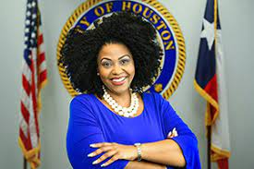
Mayor’s Volunteer Appreciation Awards

Slide 4
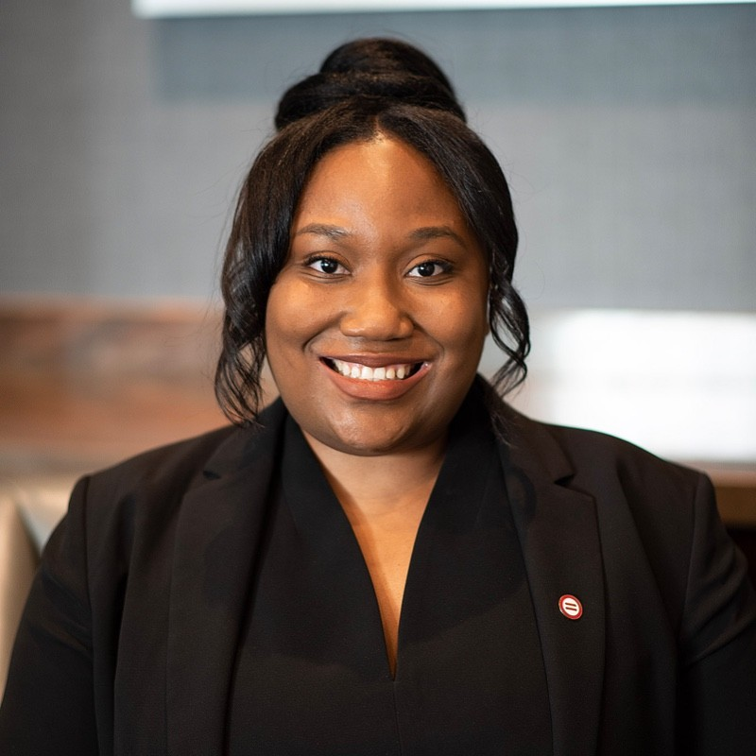
Mayor’s Volunteer Appreciation Award
Cherrelle Duncan
Cherrelle volunteers with Complete Communities University.

Slide 5
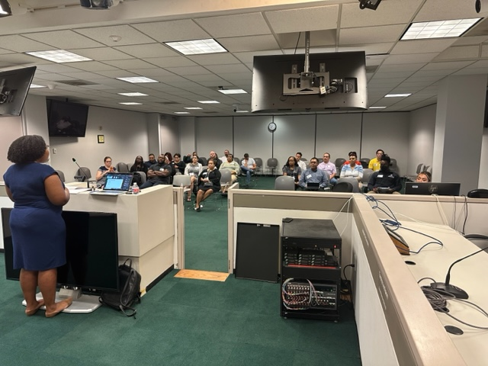
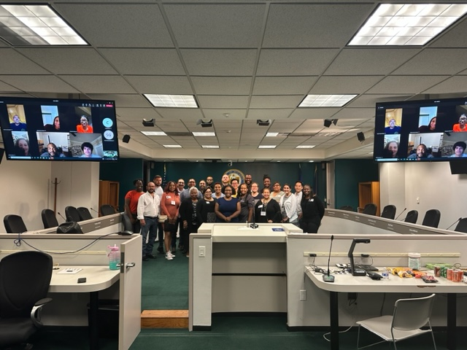
Office of Neighborhood Engagement Complete Communities University

Slide 6
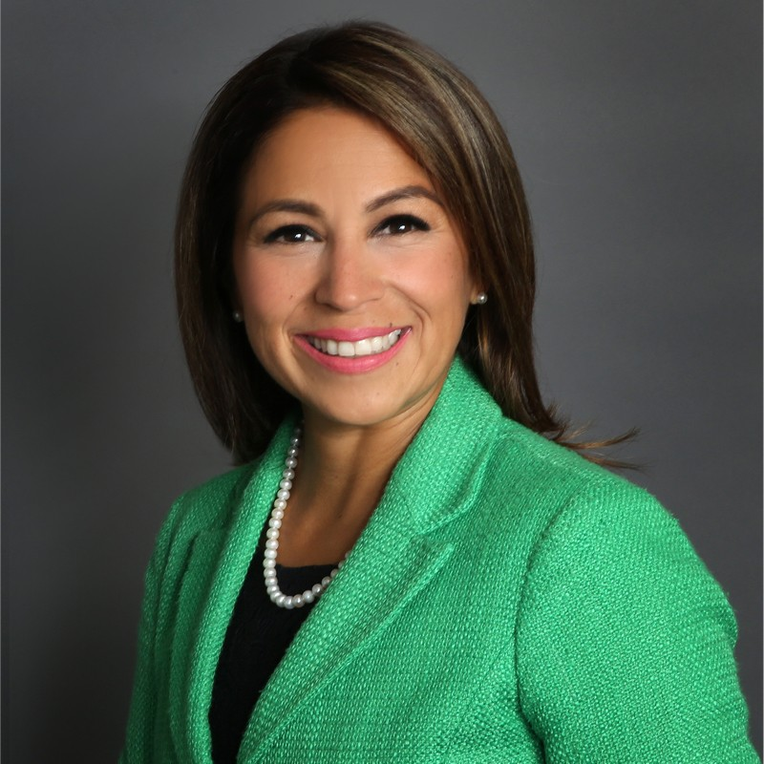
Mayor’s Volunteer appreciation Award
Claudia Ortega-Hogue
Claudia is a member of the Mayor’s Office of New Americans Advisory Council.

Slide 7
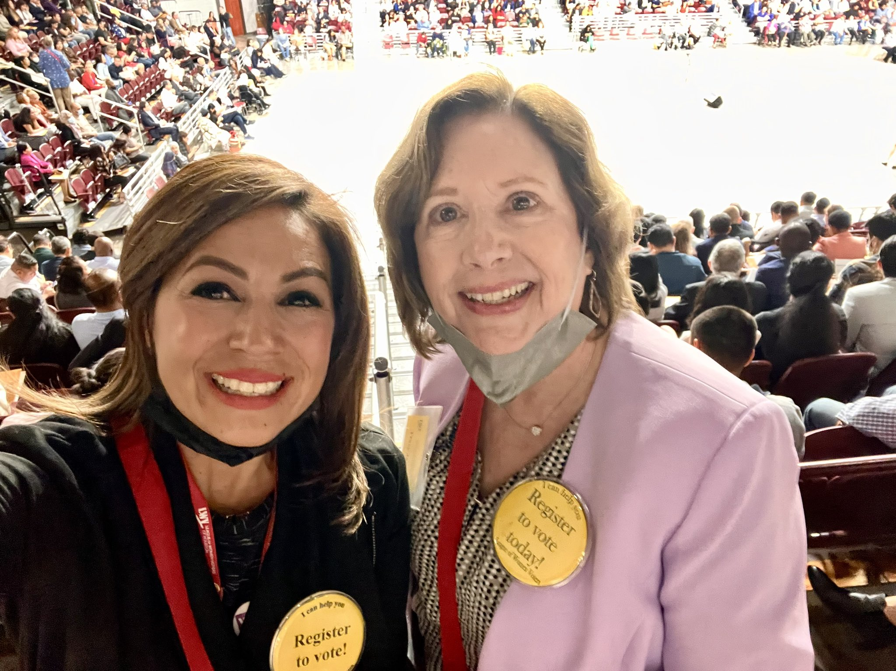
Office of New Americans and Immigrant Communities

Slide 8
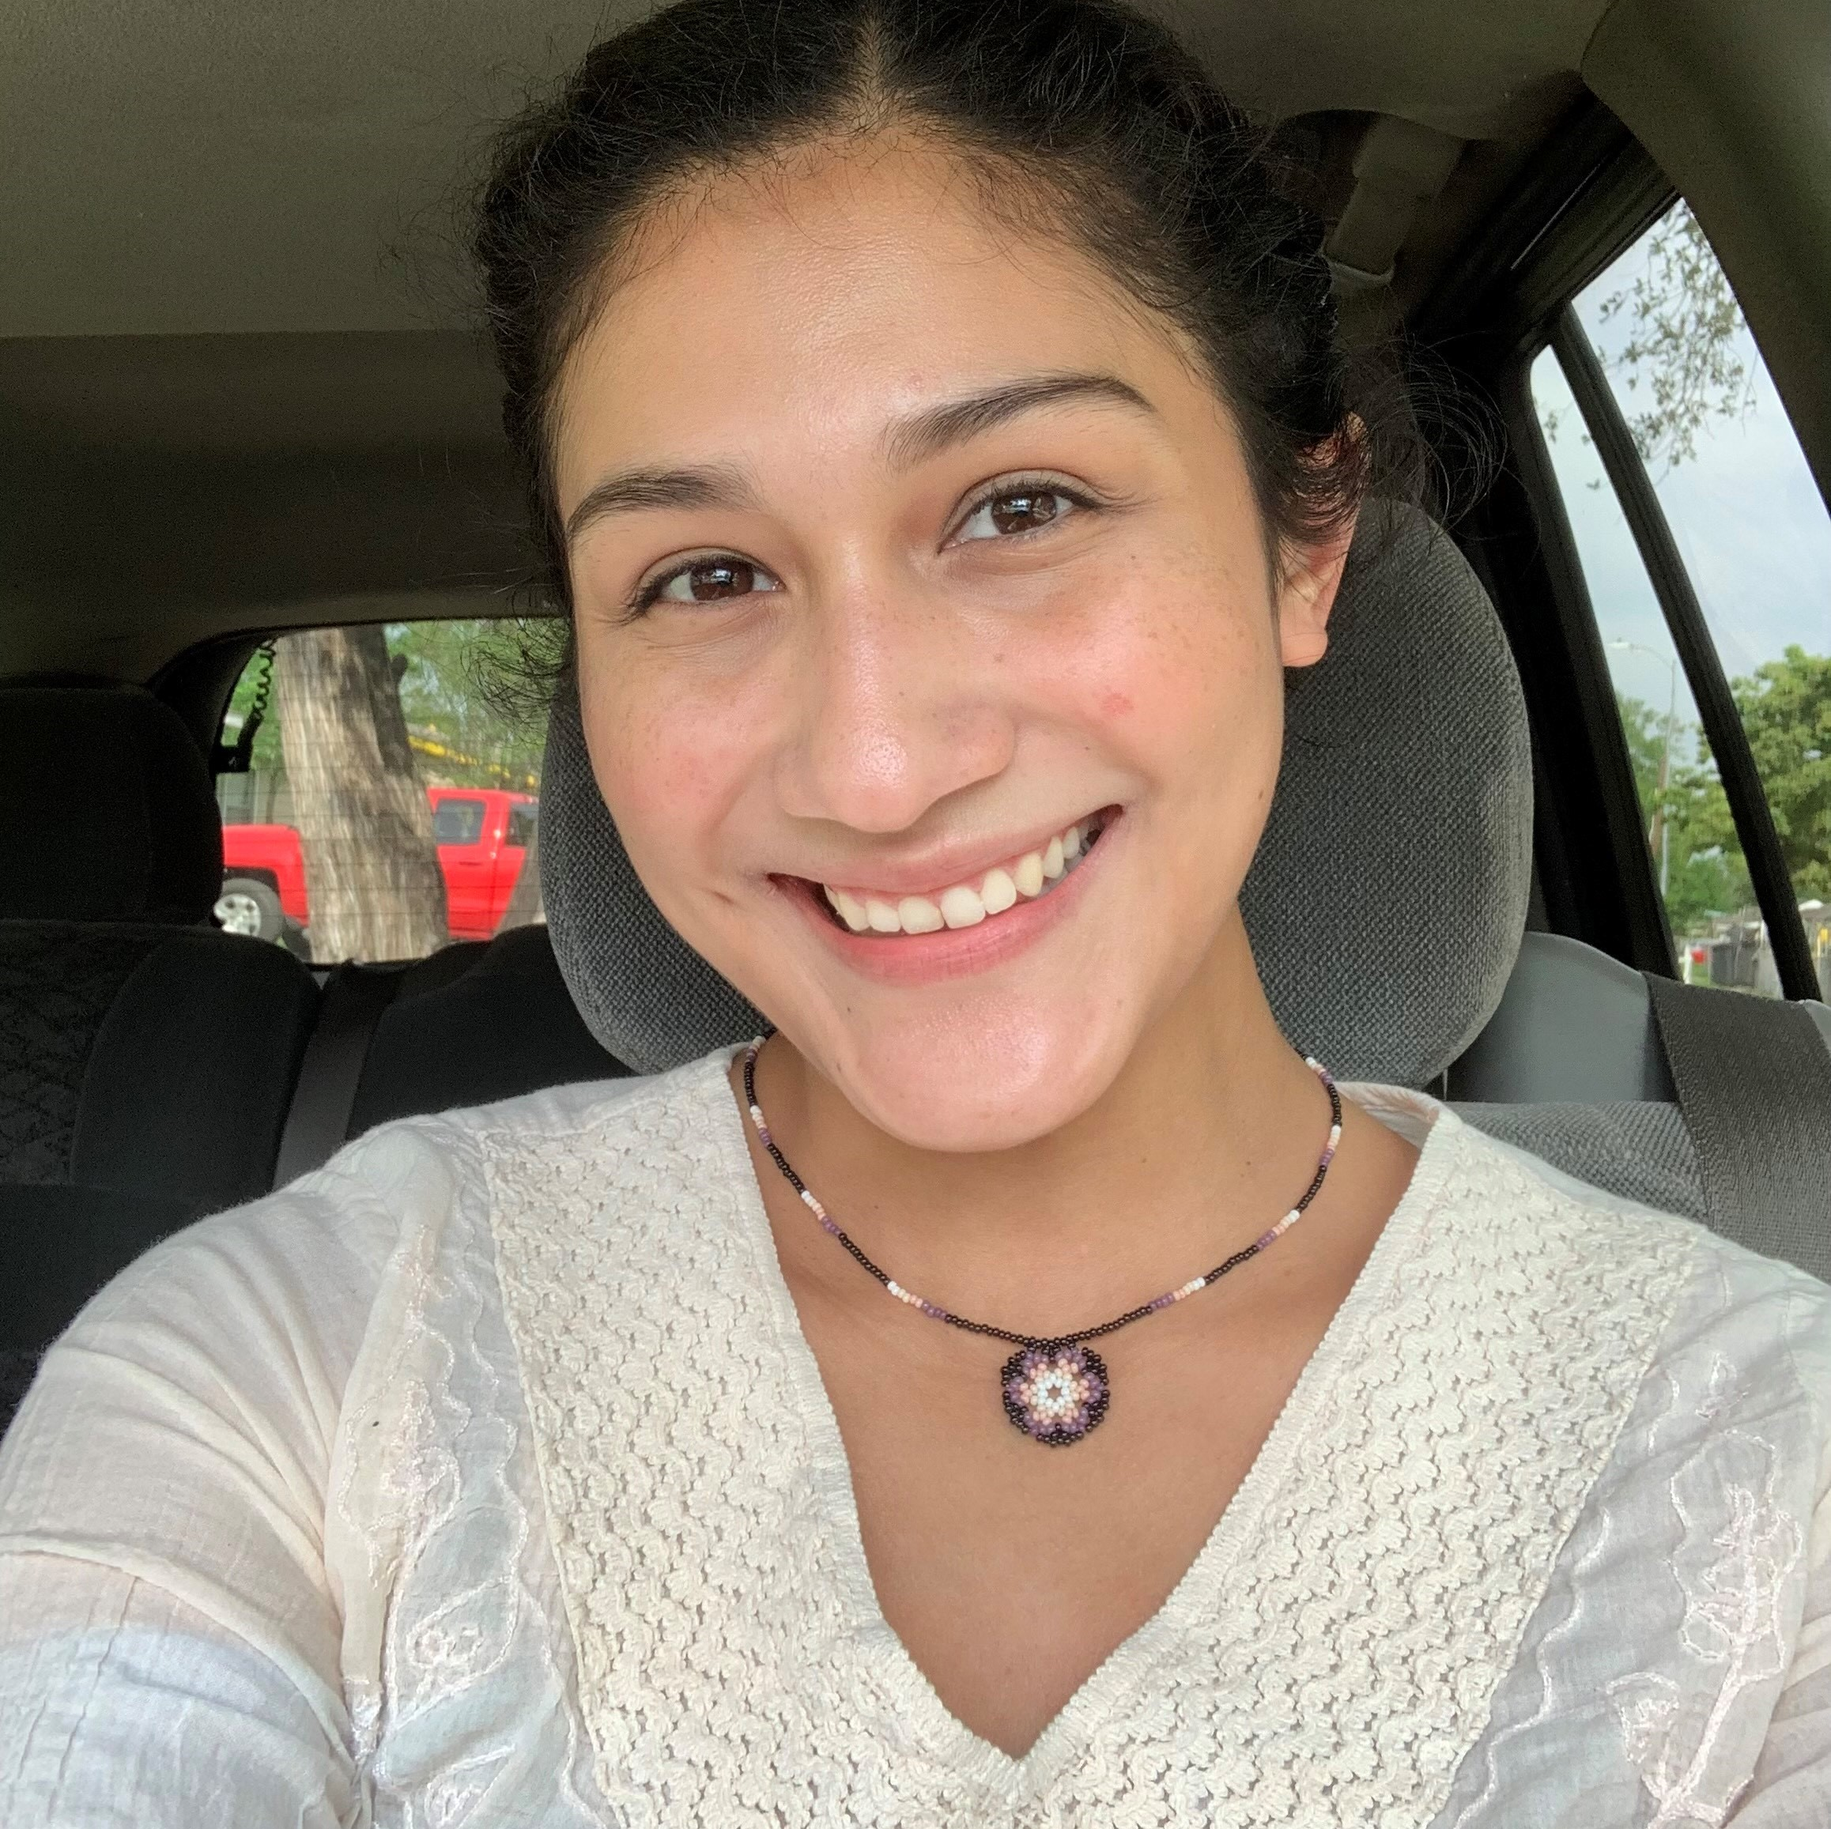
Mayor’s Volunteer appreciation Award
Esmeralda Luna
Esmeralda assists permanent residents with their applications for naturalization.

Slide 9
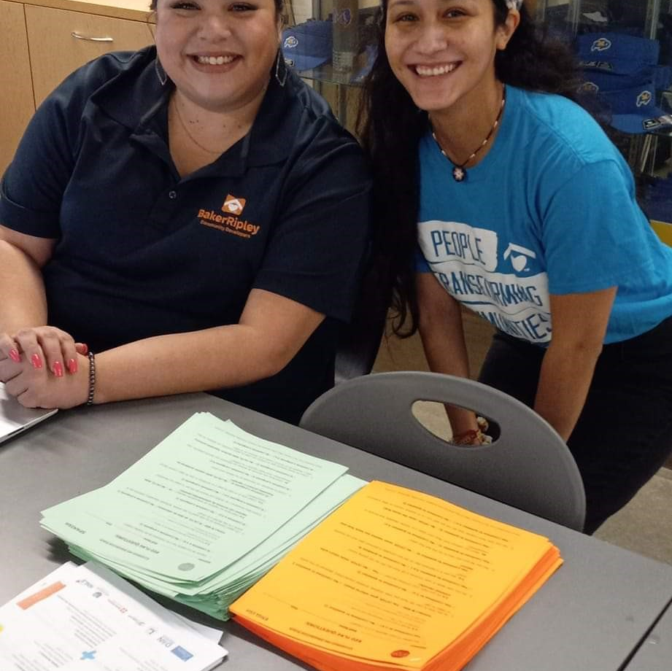
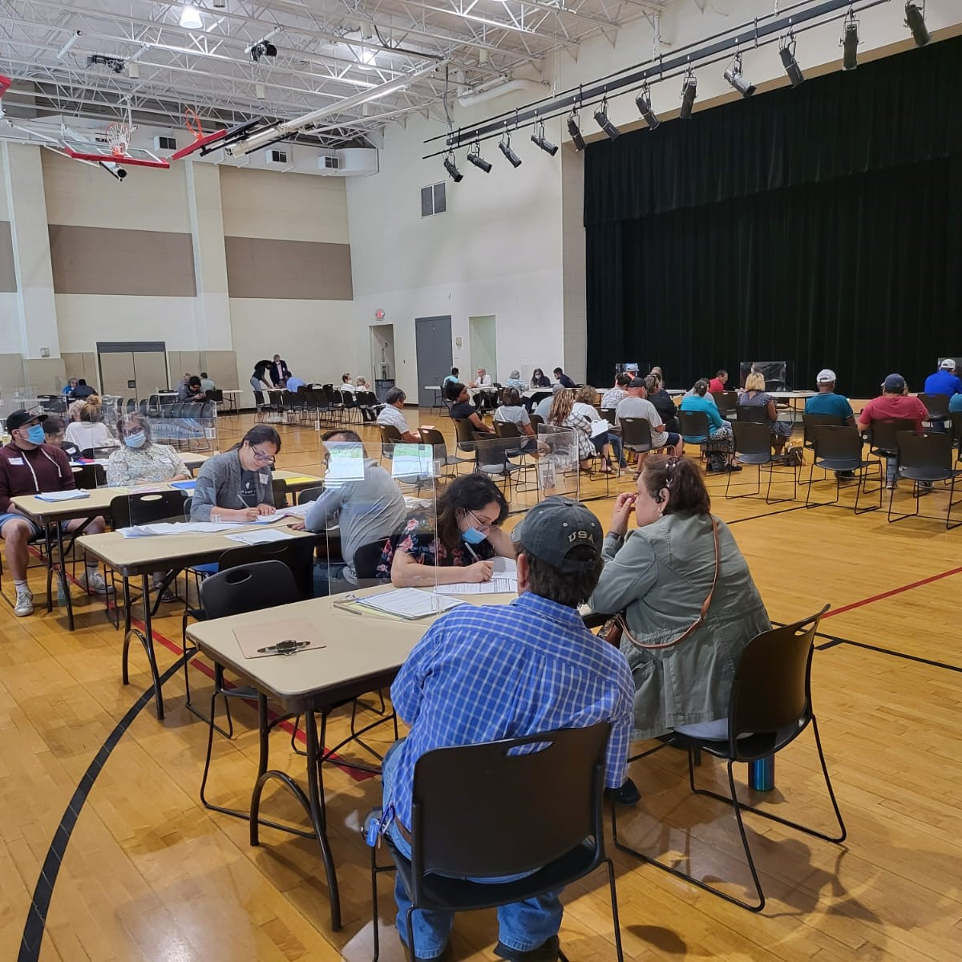
Office of New Americans and Immigrant Communities

Slide 10
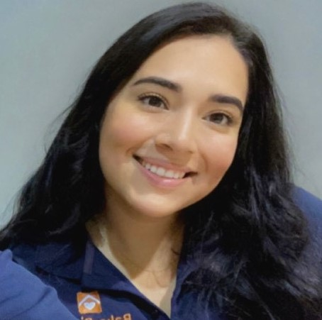
Mayor’s Volunteer appreciation award
Guadalupe Tello
Guadalupe assists permanent residents with their applications for naturalization.

Slide 11
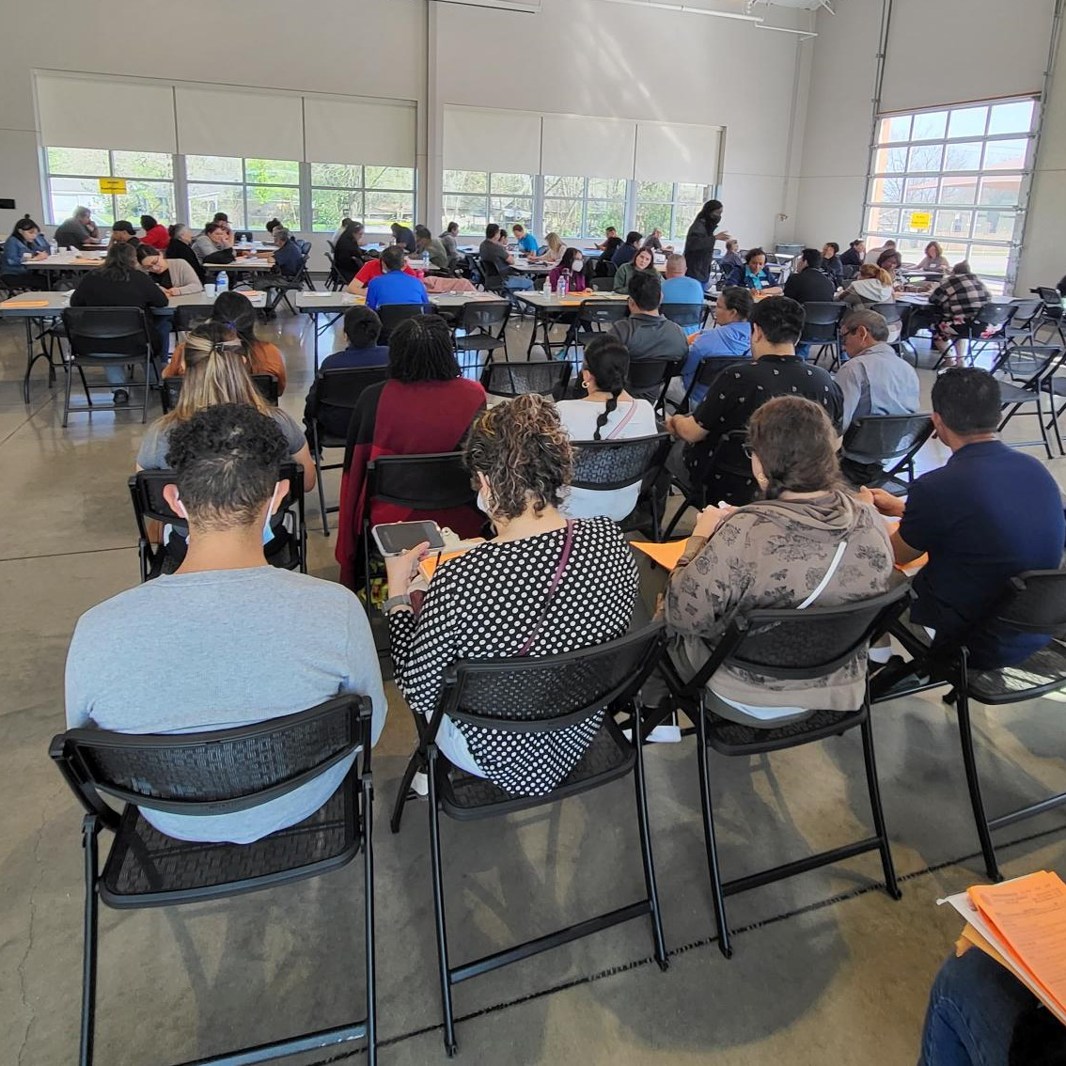
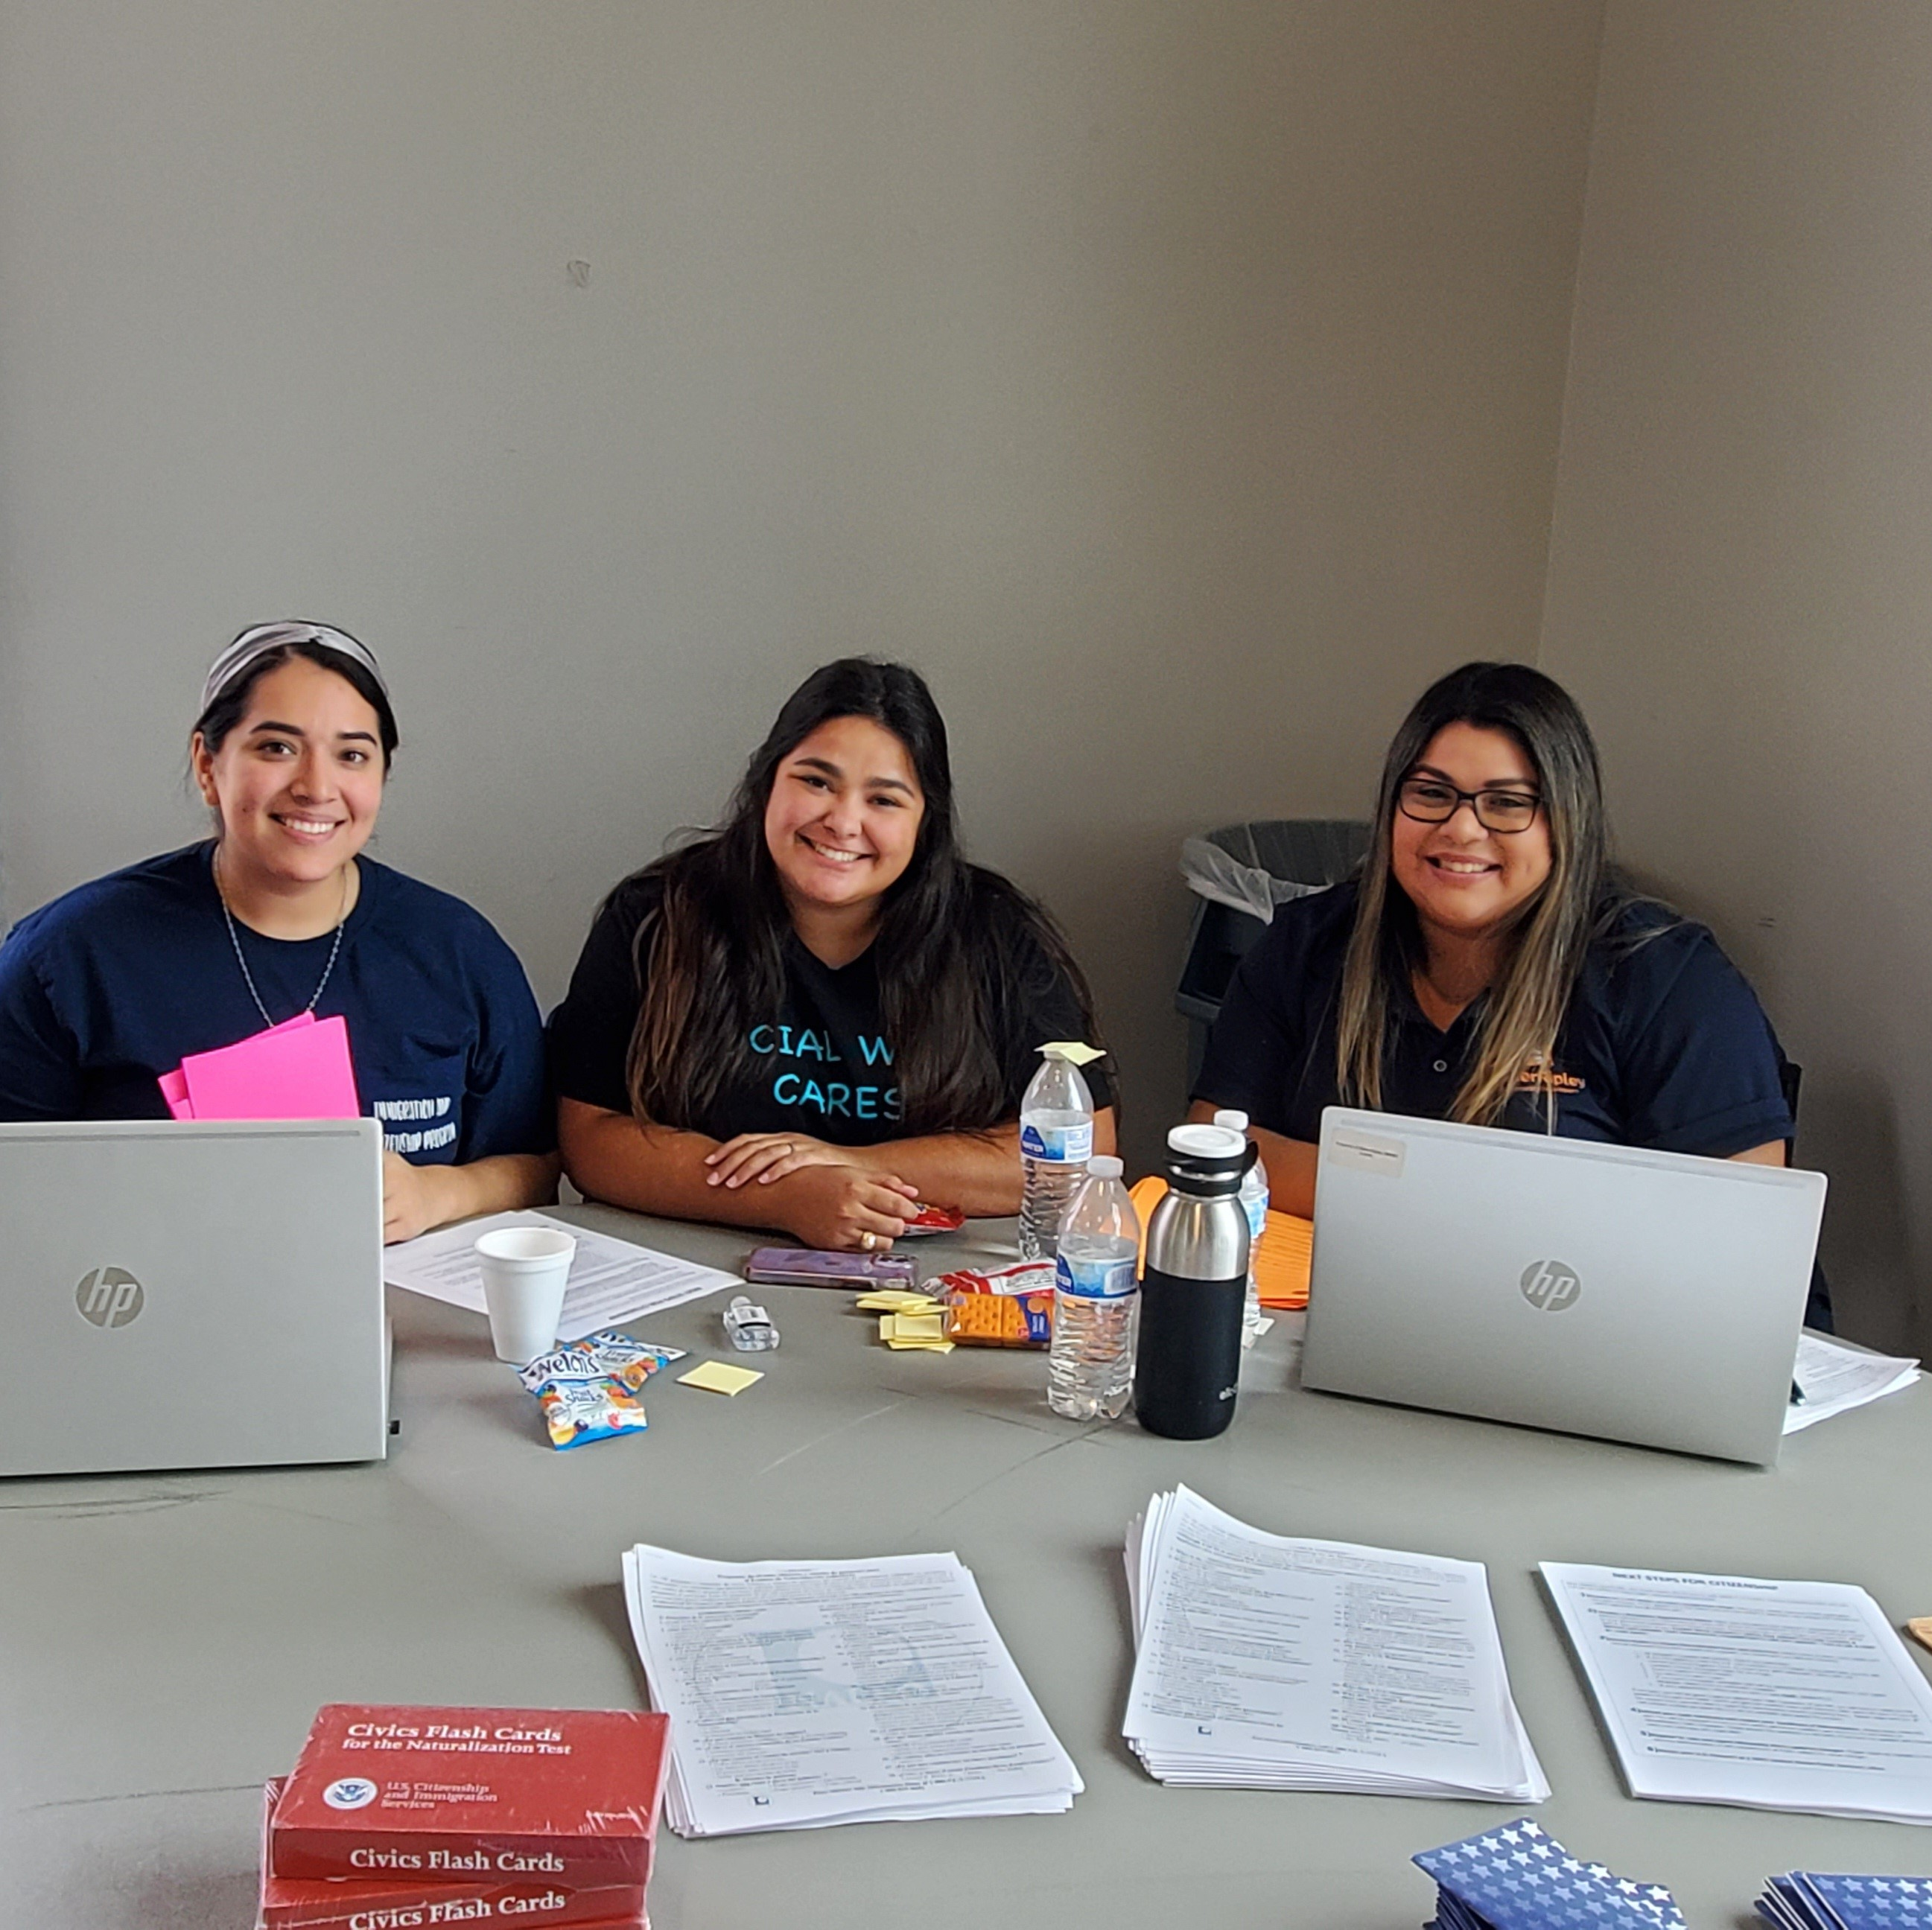
Office of New Americans and Immigrant Communities

Slide 12
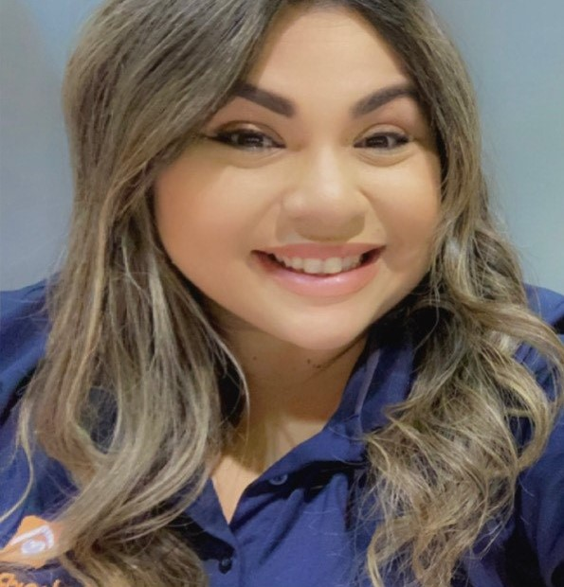
Mayor’s volunteer appreciation award
Nereida Rendon
Nerida assists permanent residents with their applications for naturalization at multiple citizenship forums.

Slide 13
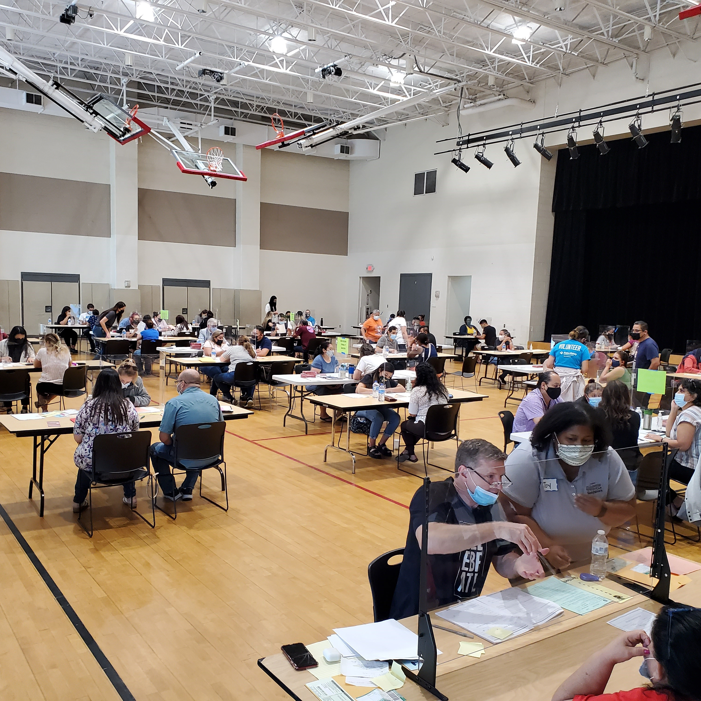
Office of New Americans and Immigrant Communities

Slide 14
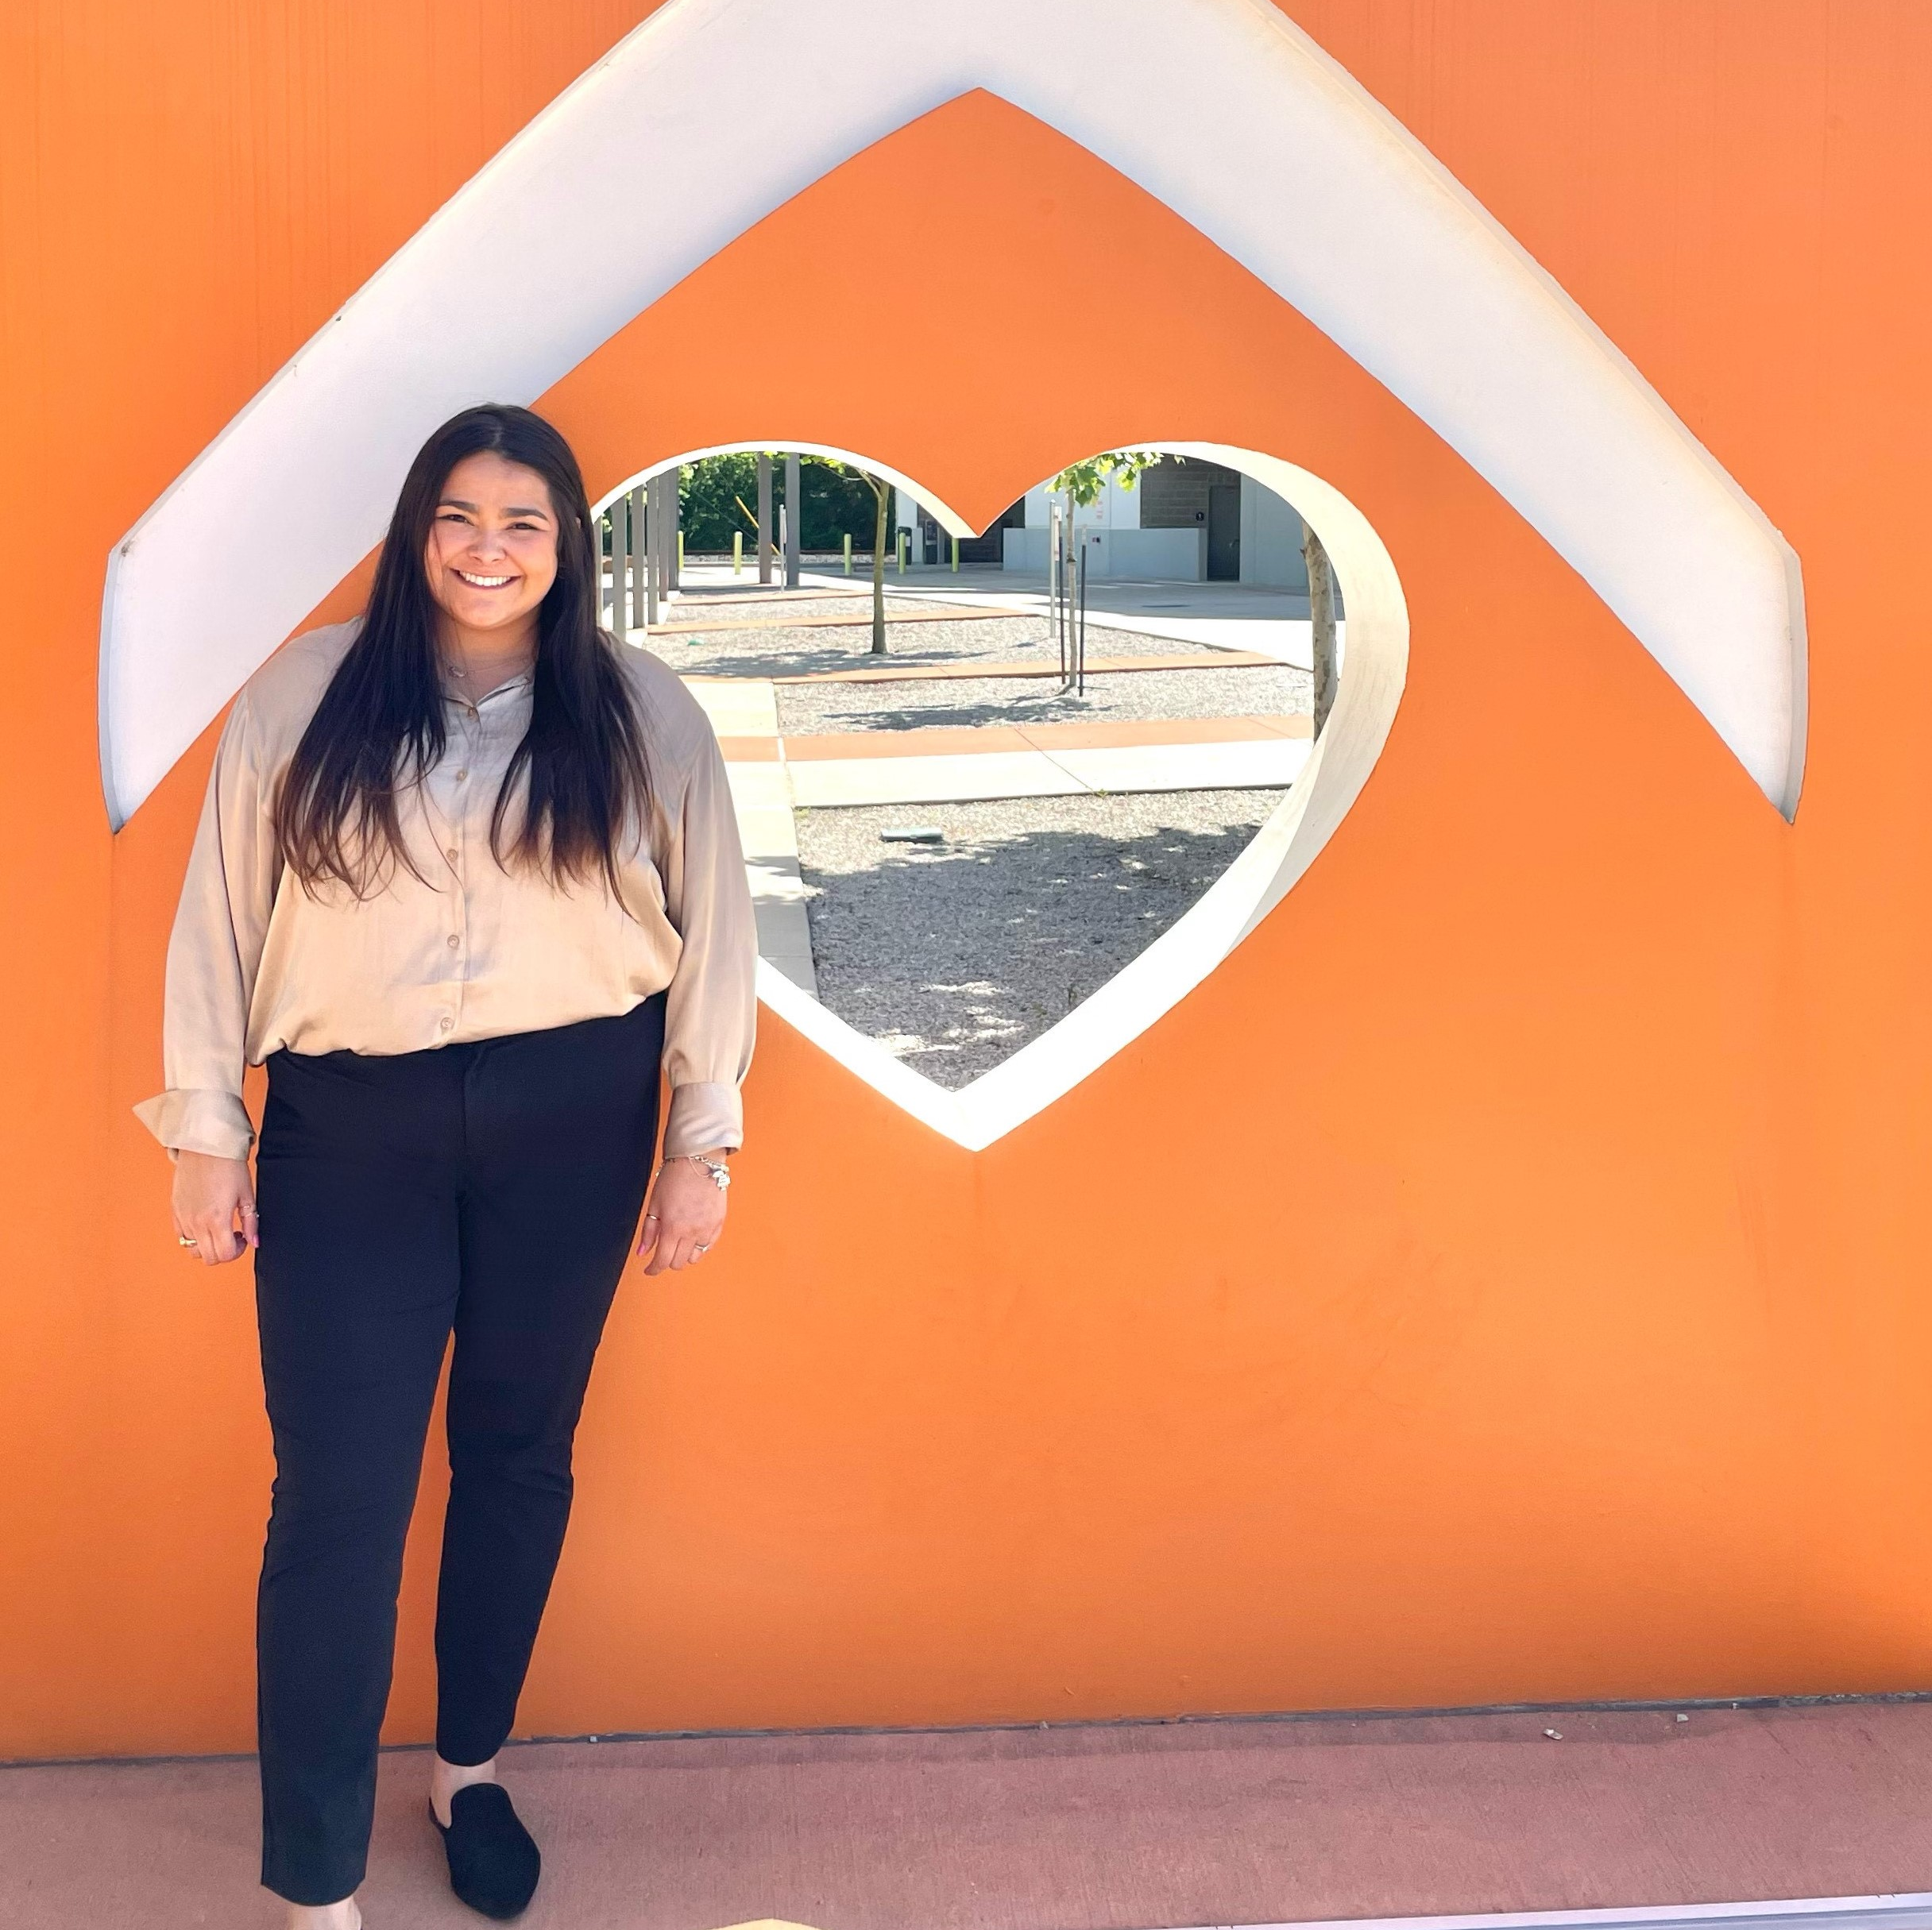
Mayors volunteer appreciation award
Andie Martinez
Andie assists permanent residents with their applications for naturalization.

Slide 15
Office of New Americans and Immigrant Communities

Slide 16
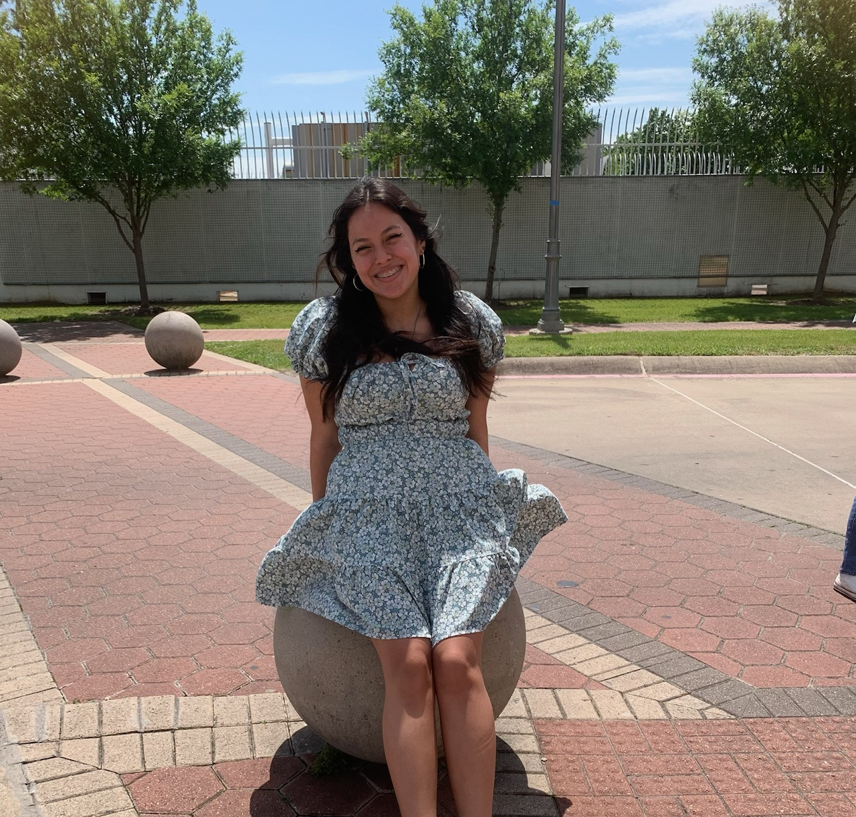
Mayor’s Next Generation Award
Melanie Leon
Melanie has over 120 hours of volunteer service this school year.

Slide 17
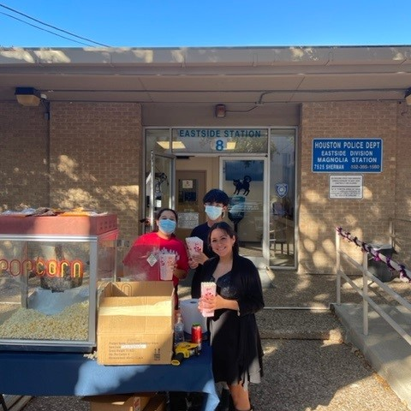
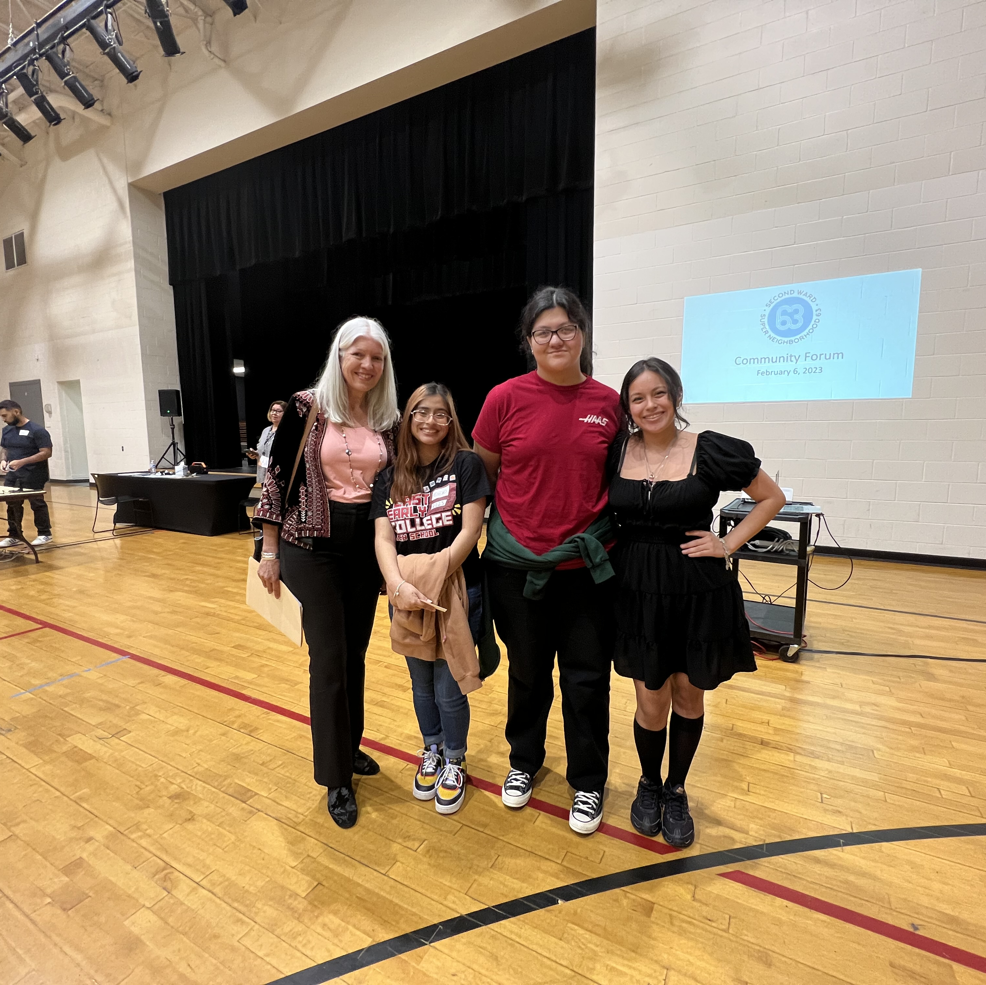
Office of Neighborhood Engagement
Volunteer Initiatives Program

Slide 18
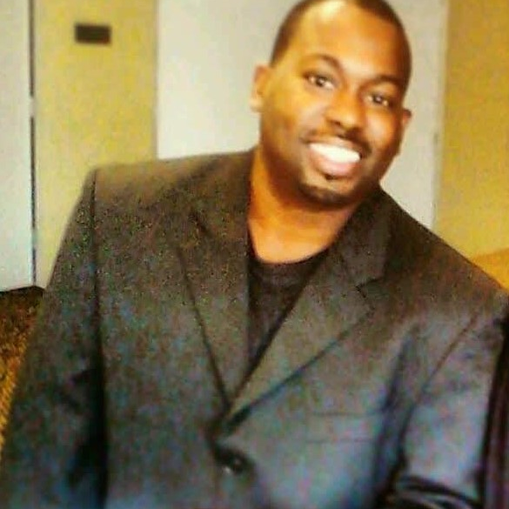
Mayor’s Community Engagement Award
Teen Inc
Barrell Richardson

Slide 19
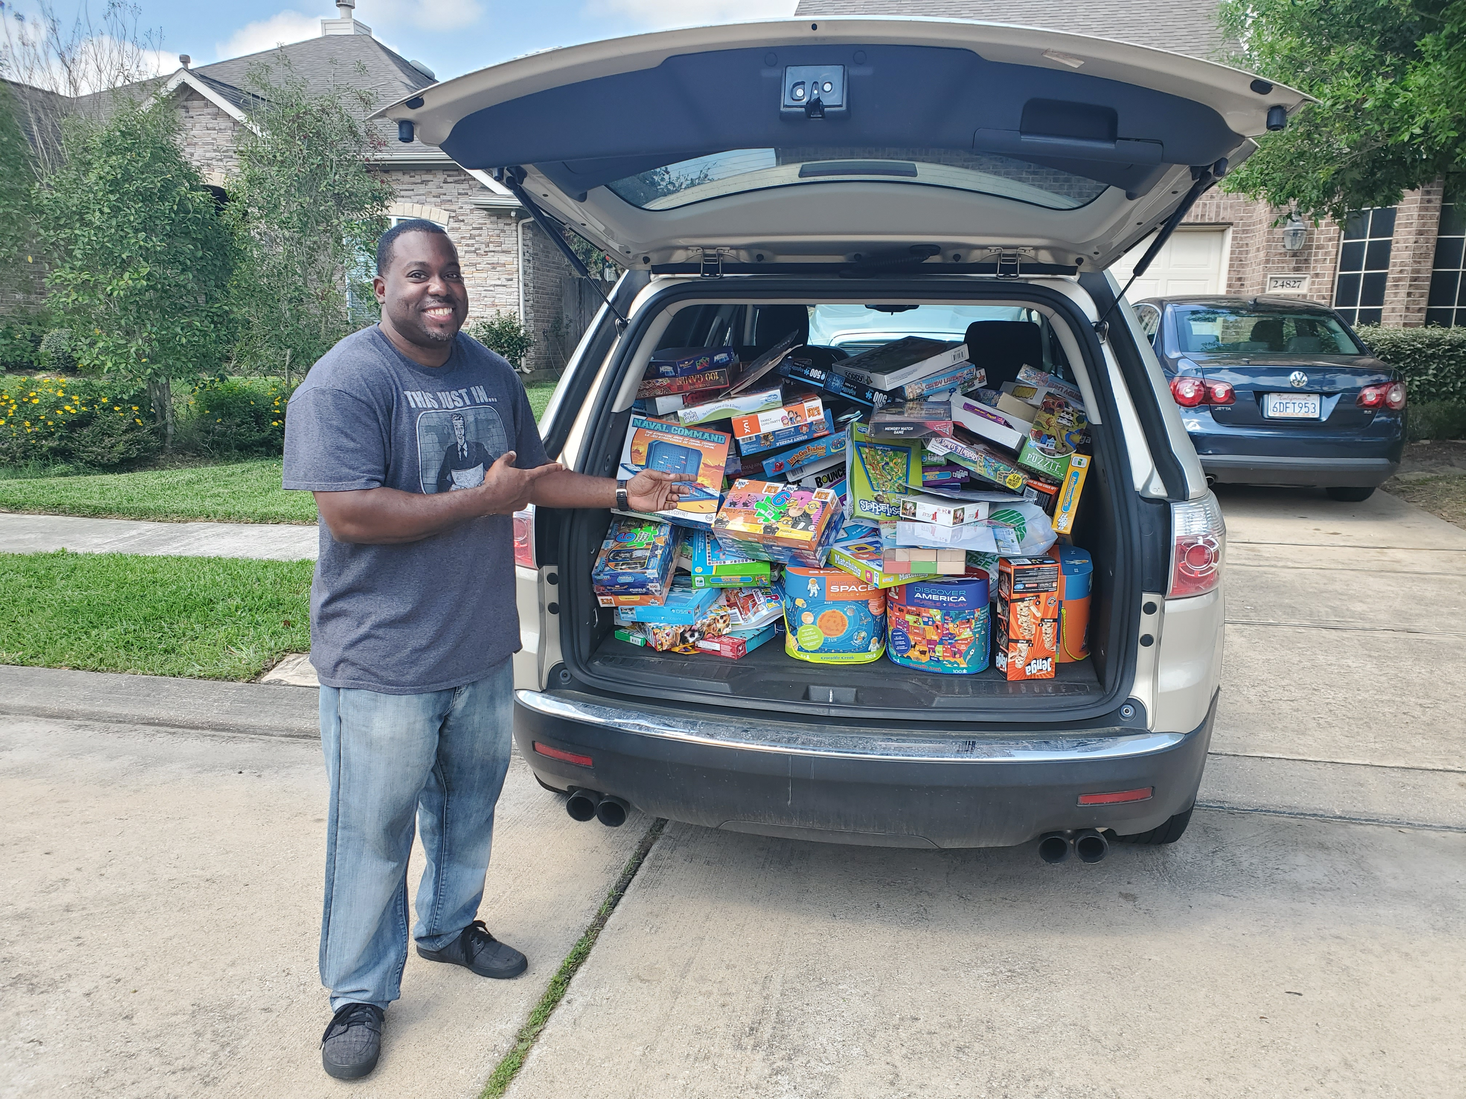
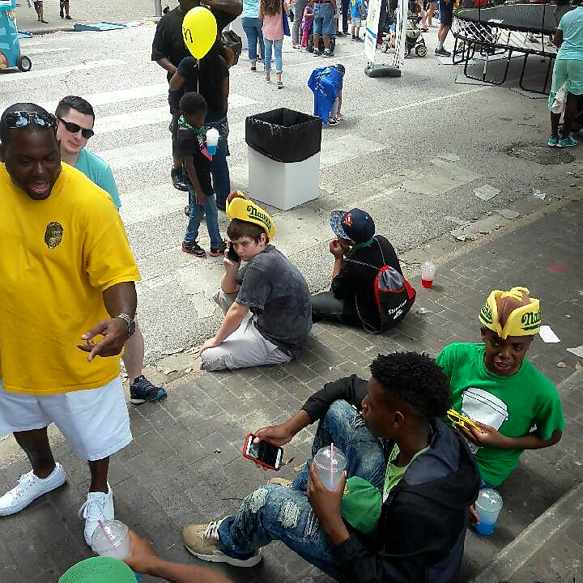
Office of Neighborhood Engagement
Volunteer Initiatives Program

Slide 20
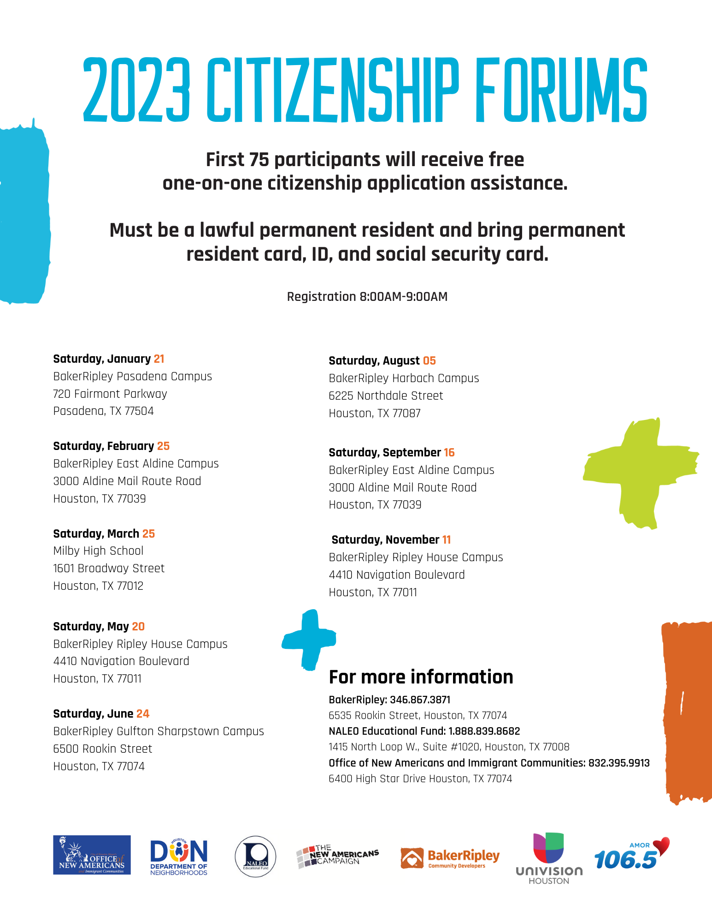
Mayor’s Community Engagement Award
University of Houston Law Center Immigration Clinic
U of H Law Center Immigration Clinic has partnered with BakerRipley Immigration & Citizenship Program and NALEO Educational Fund.

Slide 21
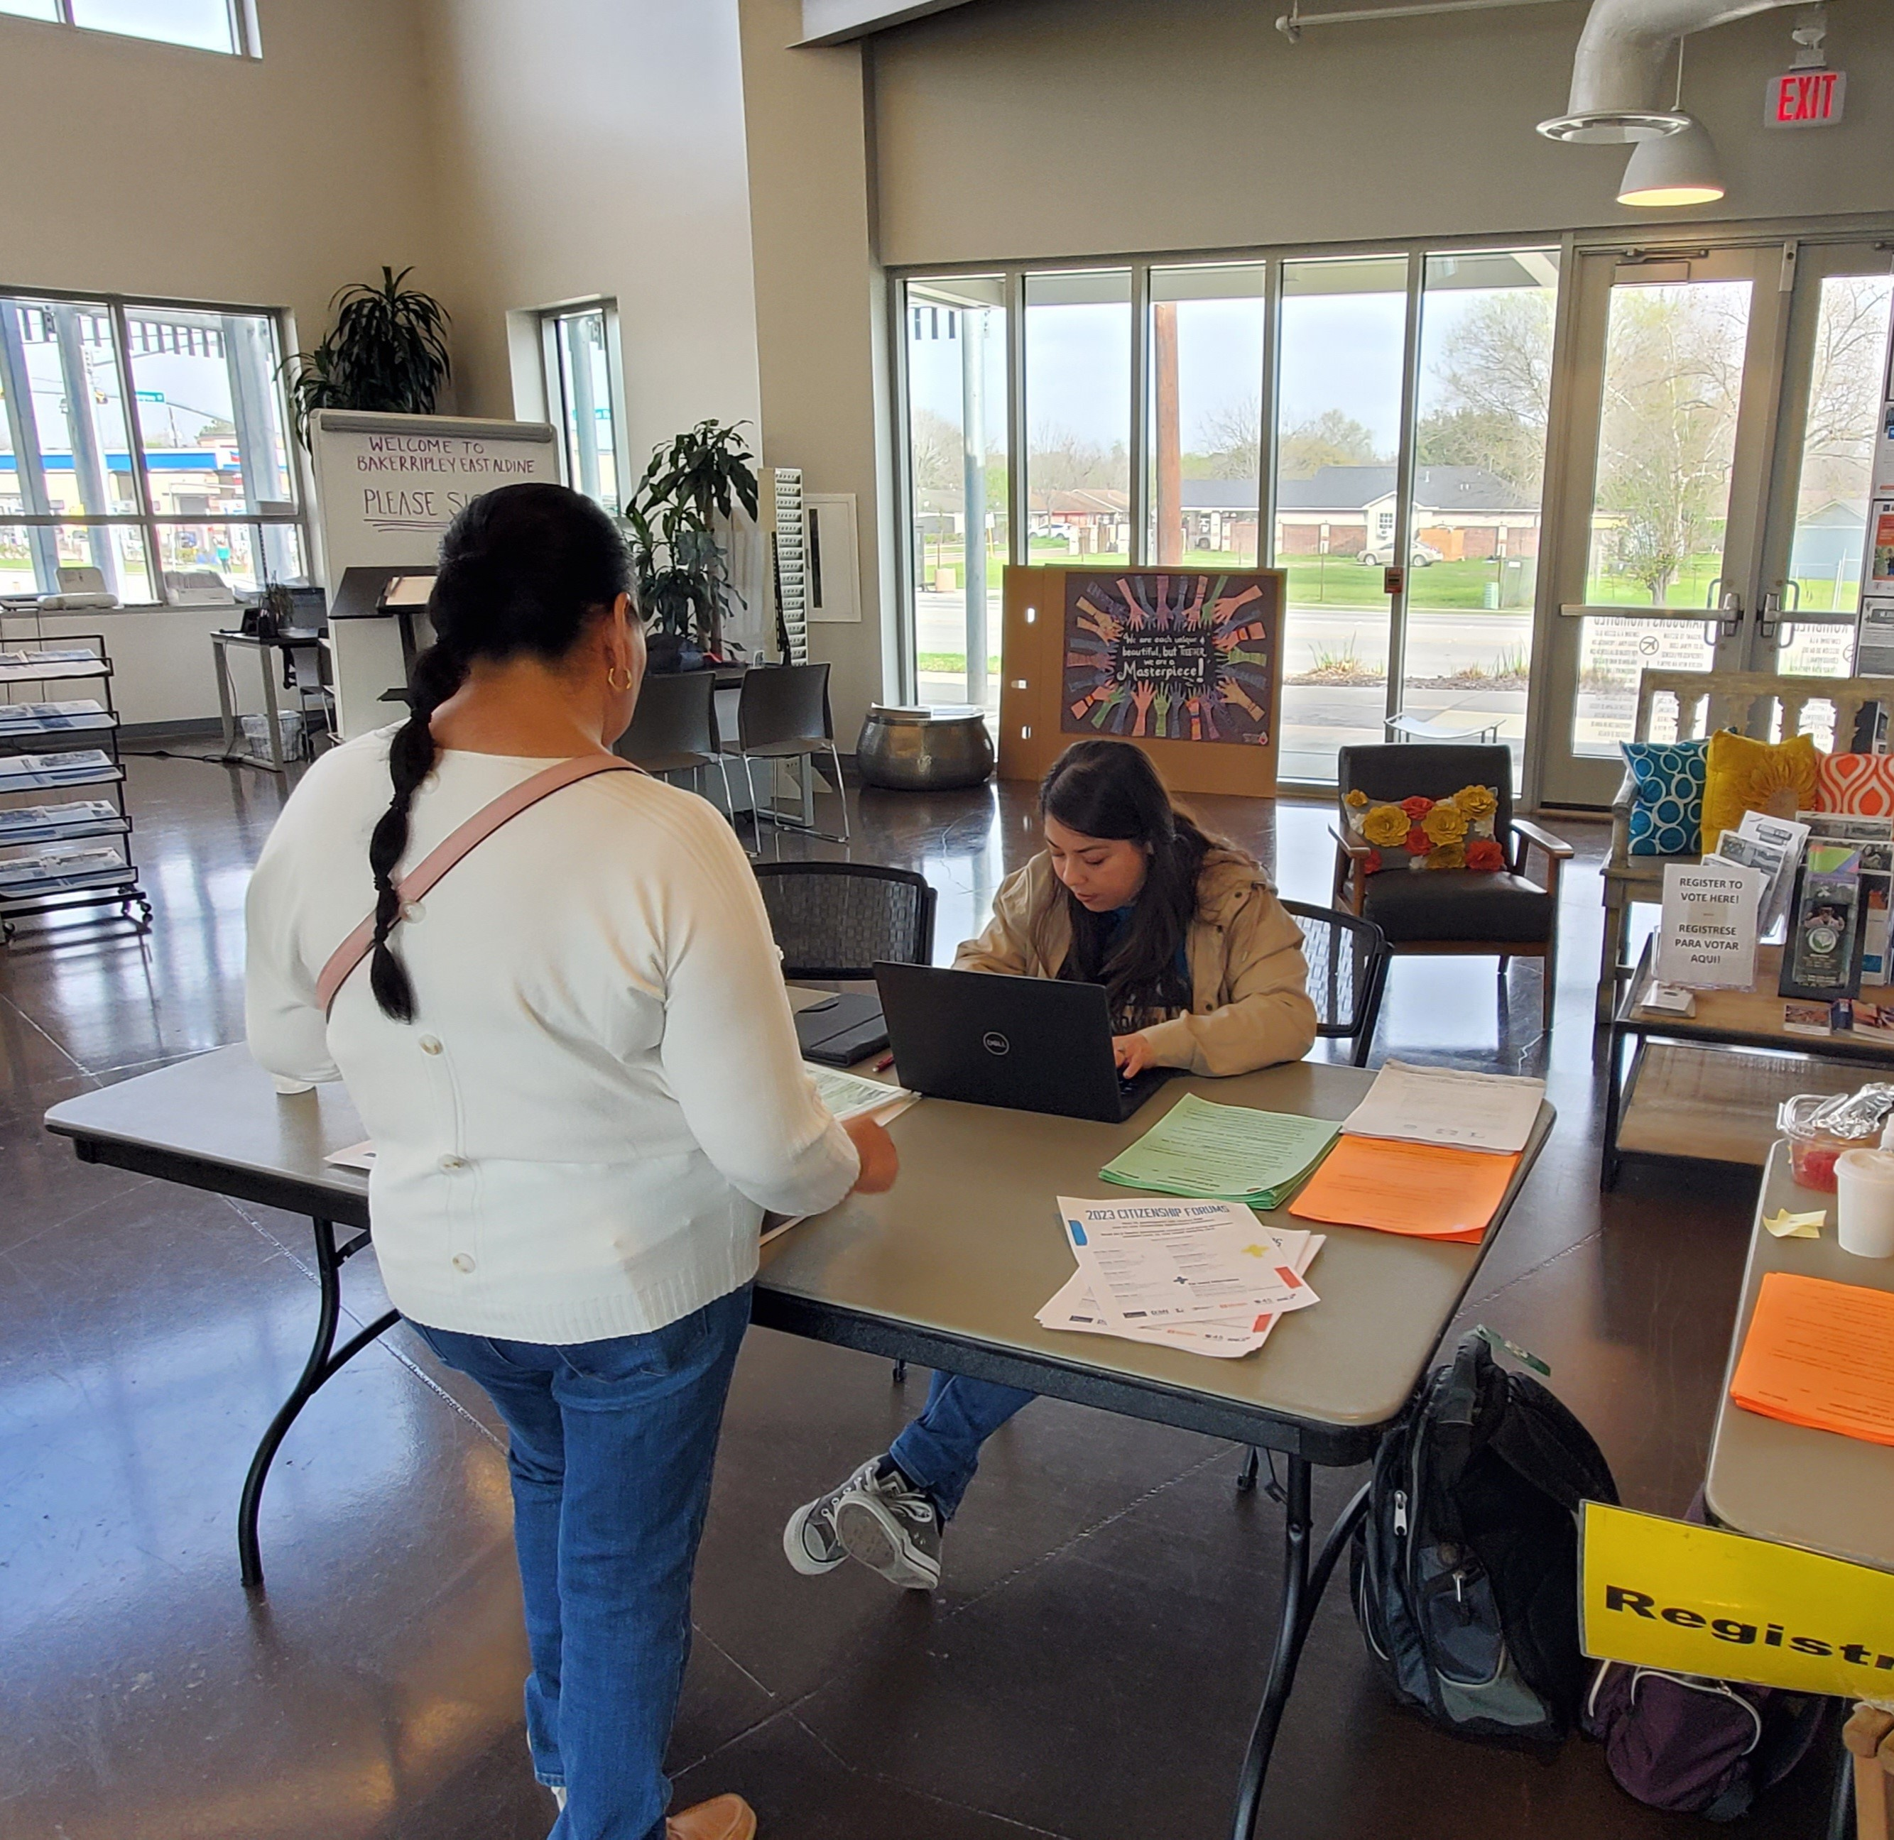
Office of New Americans and Immigrant Communities

Slide 22
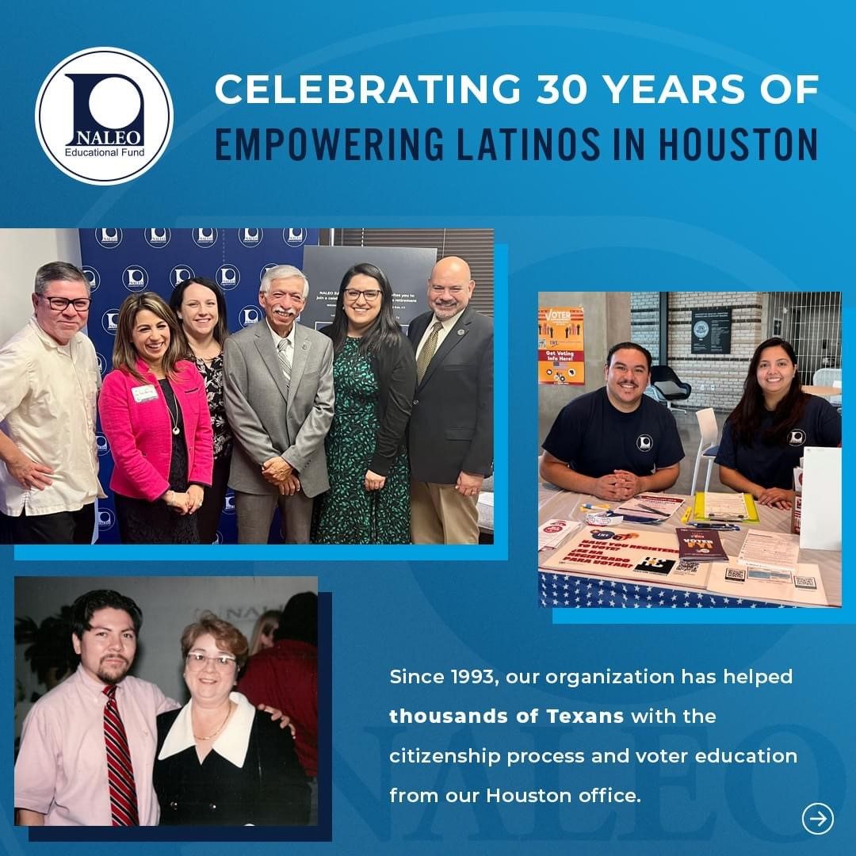
Mayor’s Community Engagement Award
NALEO Educational Fund
NALEO Educational Fund has partnered with U of H Law Center Immigration Clinic and BakerRipley Immigration & Citizenship program.

Slide 23
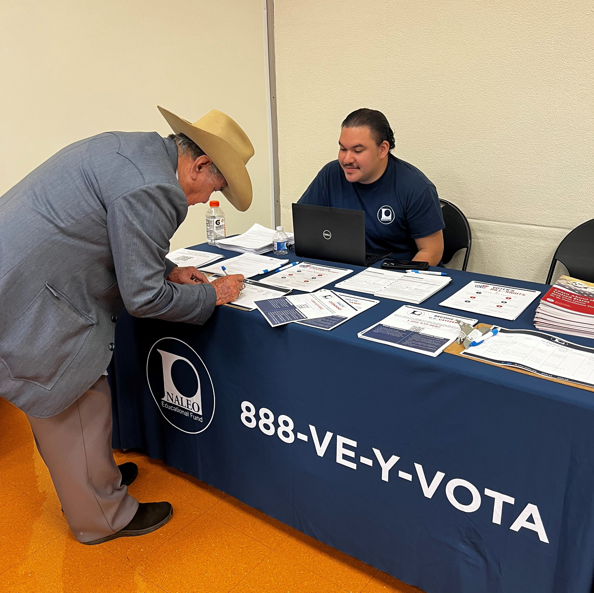
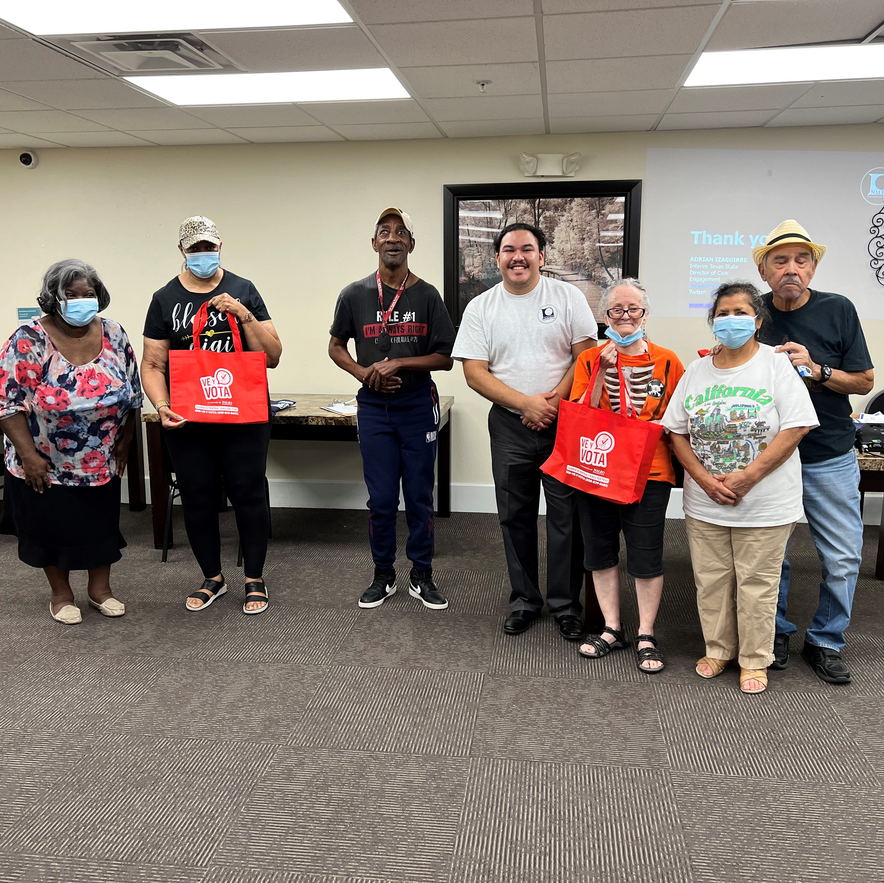
New Americans and Immigrant Communities Voter Registration

Slide 24
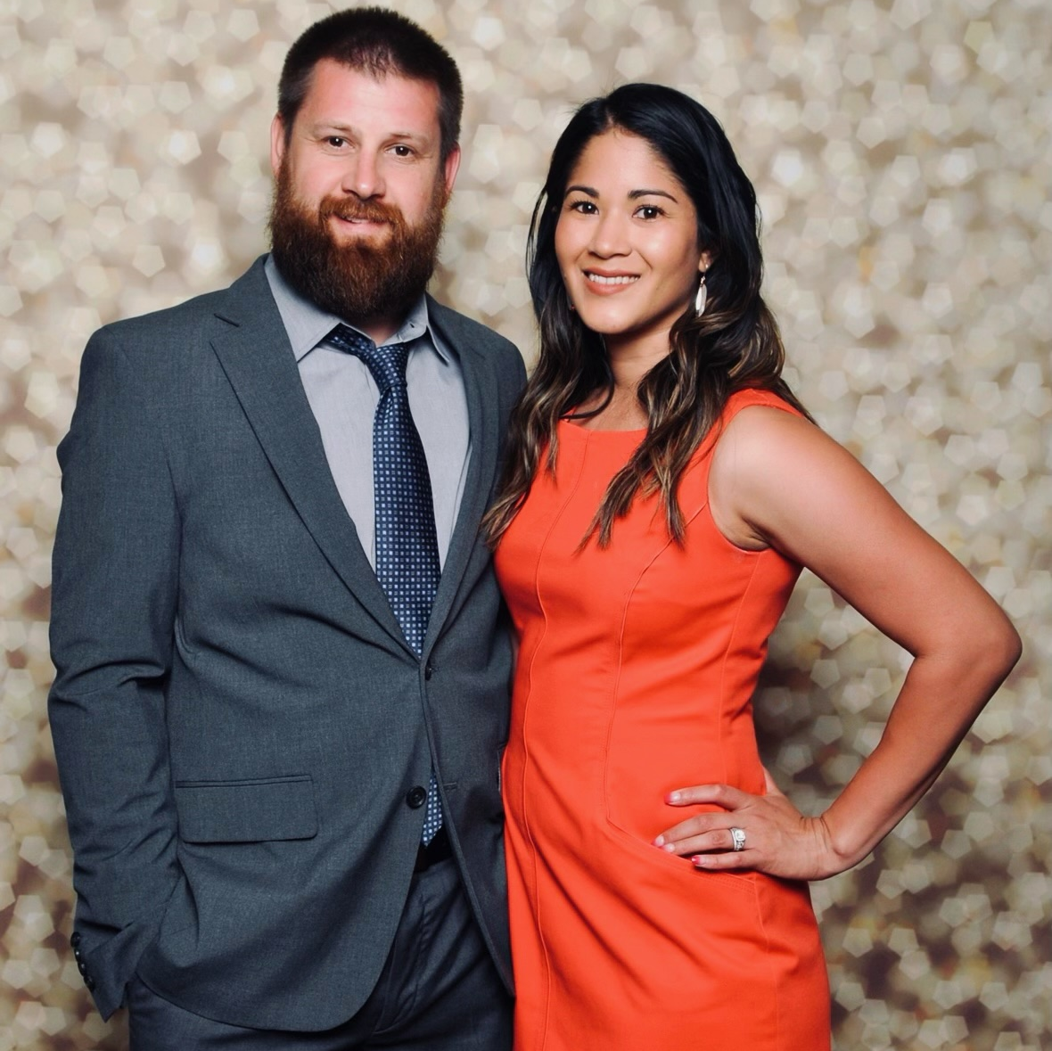
Mayor’s Community Engagement Award
Texas Automotive Performance
TAP has donated and volunteered hours with the Department of Neighborhoods since 2017.

Slide 25
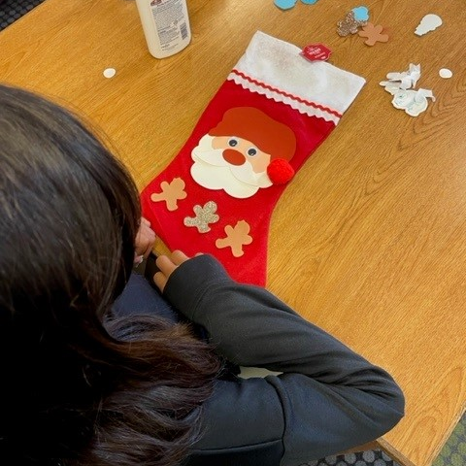
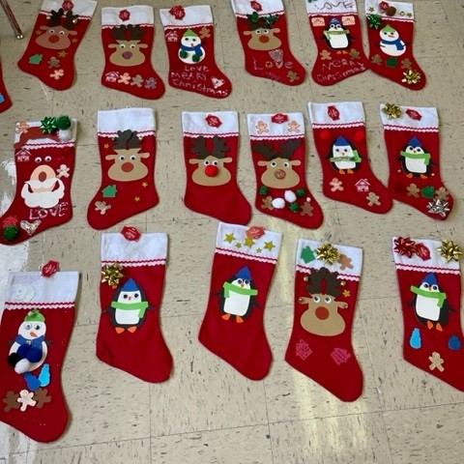
Office of Neighborhood Engagement Volunteer Initiatives Program

Slide 26
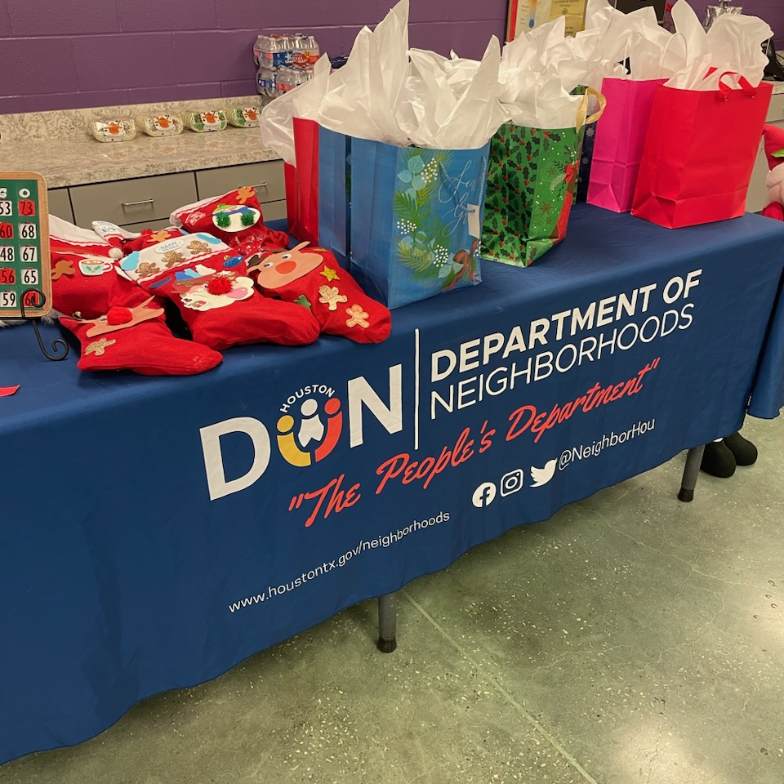
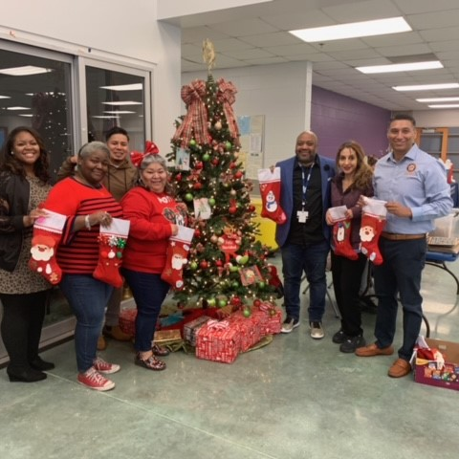
VOLUNTEER INITIATIVES PROGRAM “STOCKINGS FOR SENIORS”

Slide 27
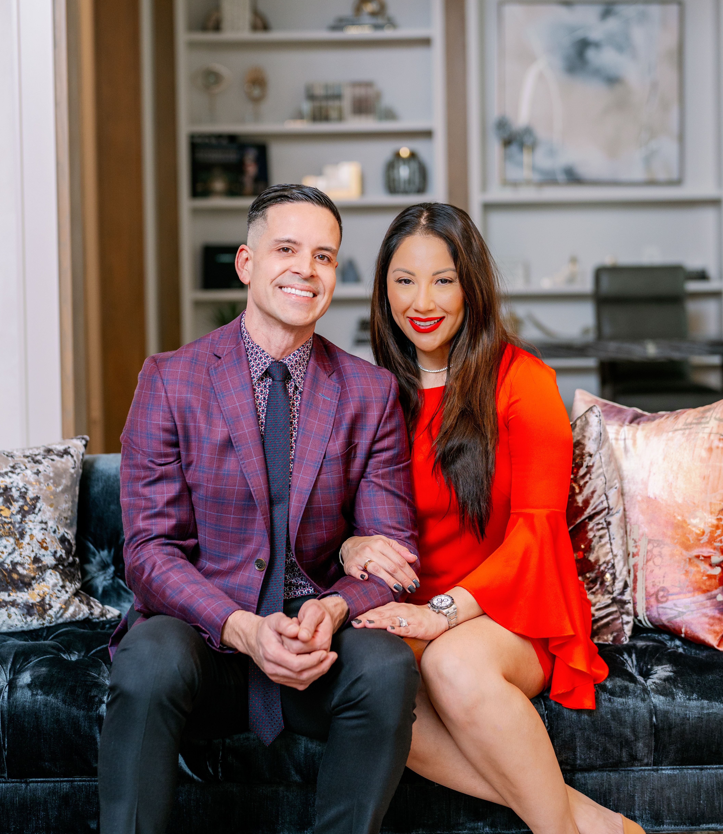
Mayor’s Community Engagement Award
NAN and Company Properties
Nan and Company have donated and volunteered hours with the Department of Neighborhoods since 2017.

Slide 28
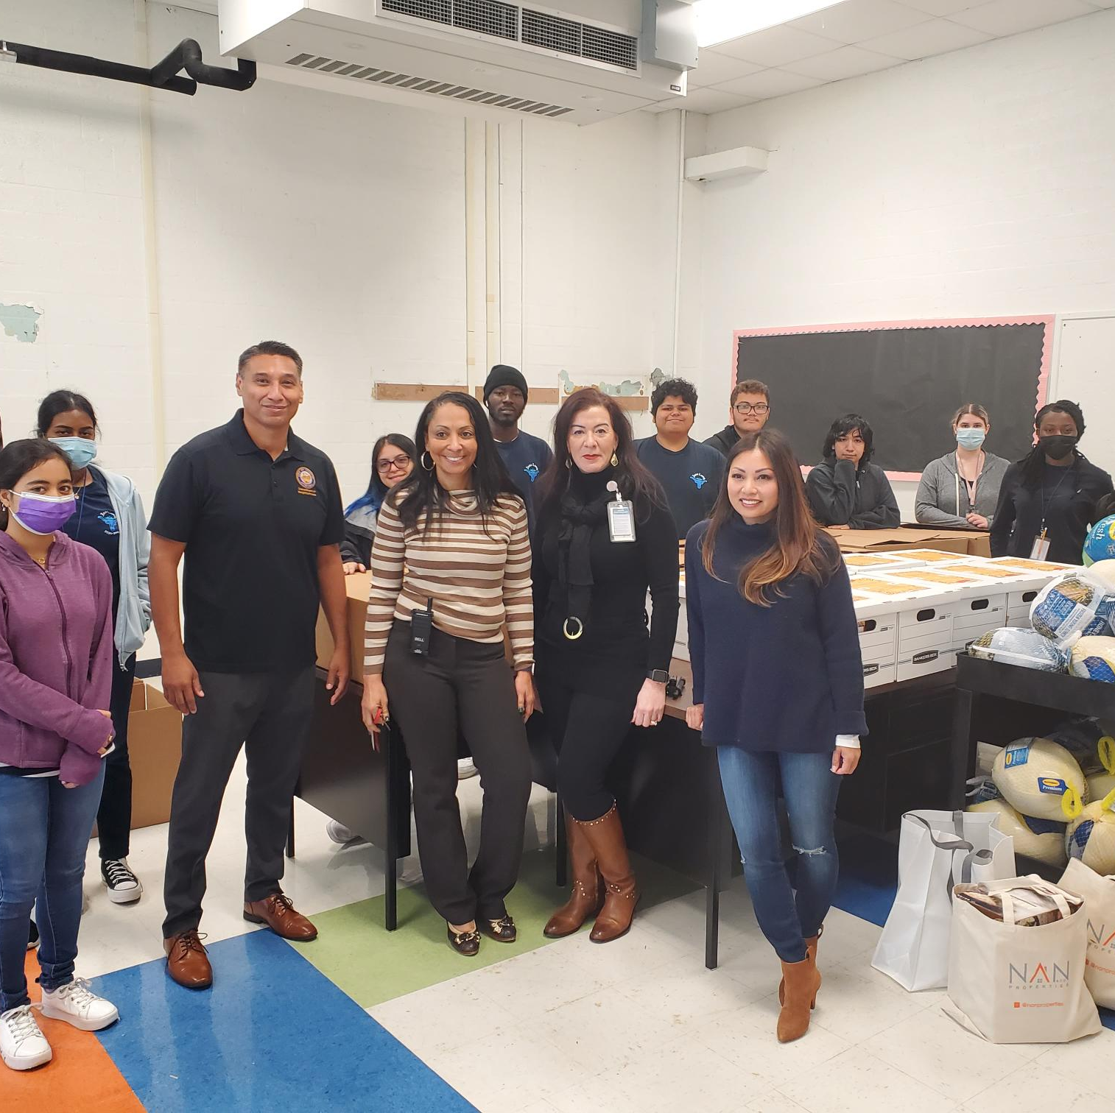
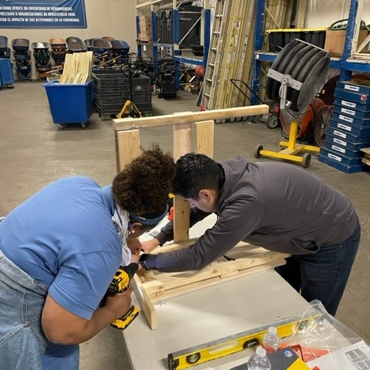
Office of Neighborhood Engagement Volunteer Initiative Program

Slide 29

Mayor’s Community Engagement Award
Neighborhood Recovery Community Development Corporation
NRCDC Houston partners with
A Month Of Service program.

Slide 30

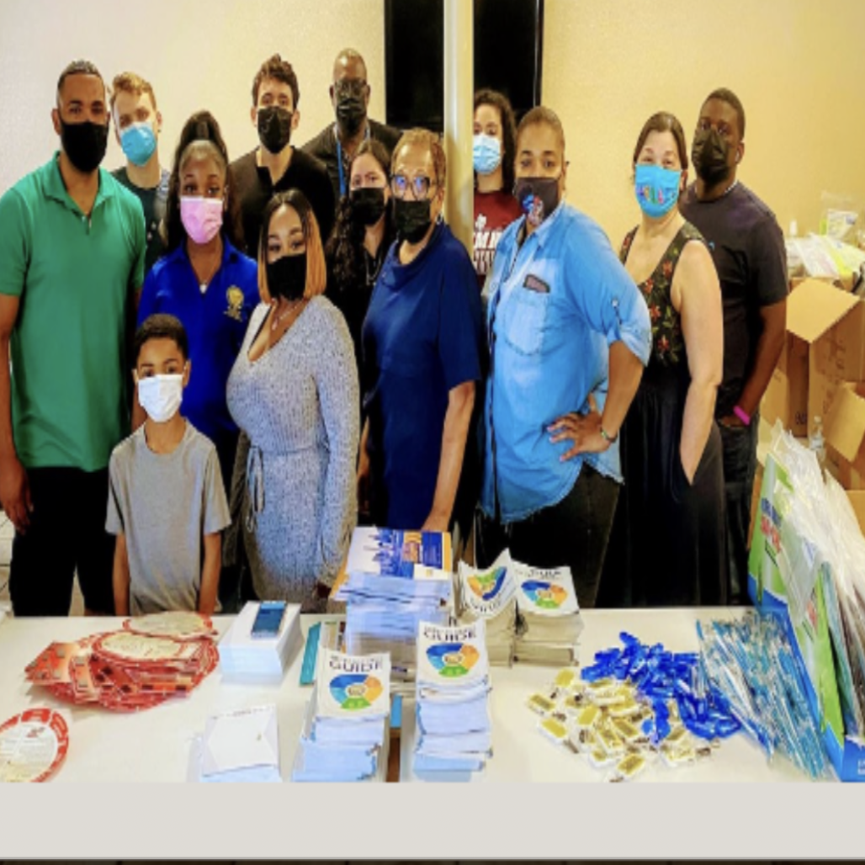
Office of Neighborhood Engagement A Month of Service

Slide 31

Mayor’s Community Engagement Award
Lone Star Legal Aid
Lone Star Legal Aid partners with A Month Of Service Program.

Slide 32


Office of Neighborhood Engagement A Month of Service.

Slide 33

Mayor’s Community Engagement Award
Houston Bar Association
Houston Bar Association partners with A Month Of Service Program.

Slide 34

Office of Neighborhood Engagement
A Month of Service

Slide 35

Mayor’s Community Engagement Award
Houston Volunteer Lawyers
Houston Volunteer Lawyers partners with A Month Of Service Program.

Slide 36
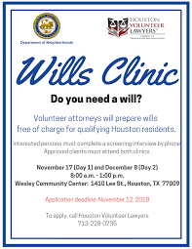

Office of Neighborhood Engagement A Month of Service

Slide 37

Mayor’s Community Engagement Award
TSU Earl Carl Institute
TSU Earl Carl Institute partners with A Month Of Service program.

Slide 38
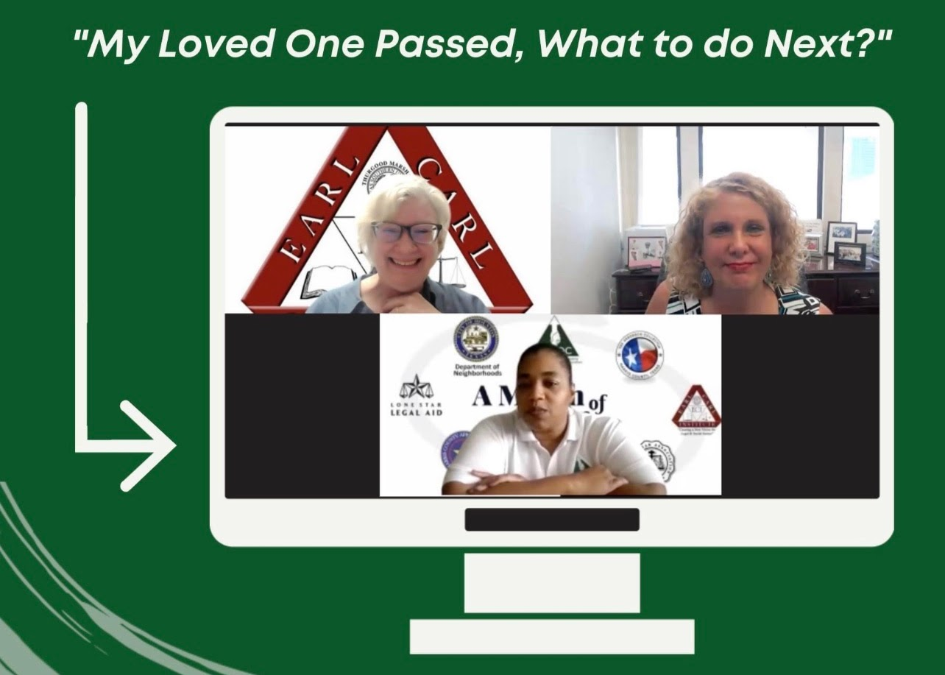
Office of Neighborhood Engagement
A Month of Service

Slide 39

Mayor’s Community Engagement Award
Harris Central Appraisal District
Harris Central Appraisal District partners with A Month Of Service program.

Slide 40
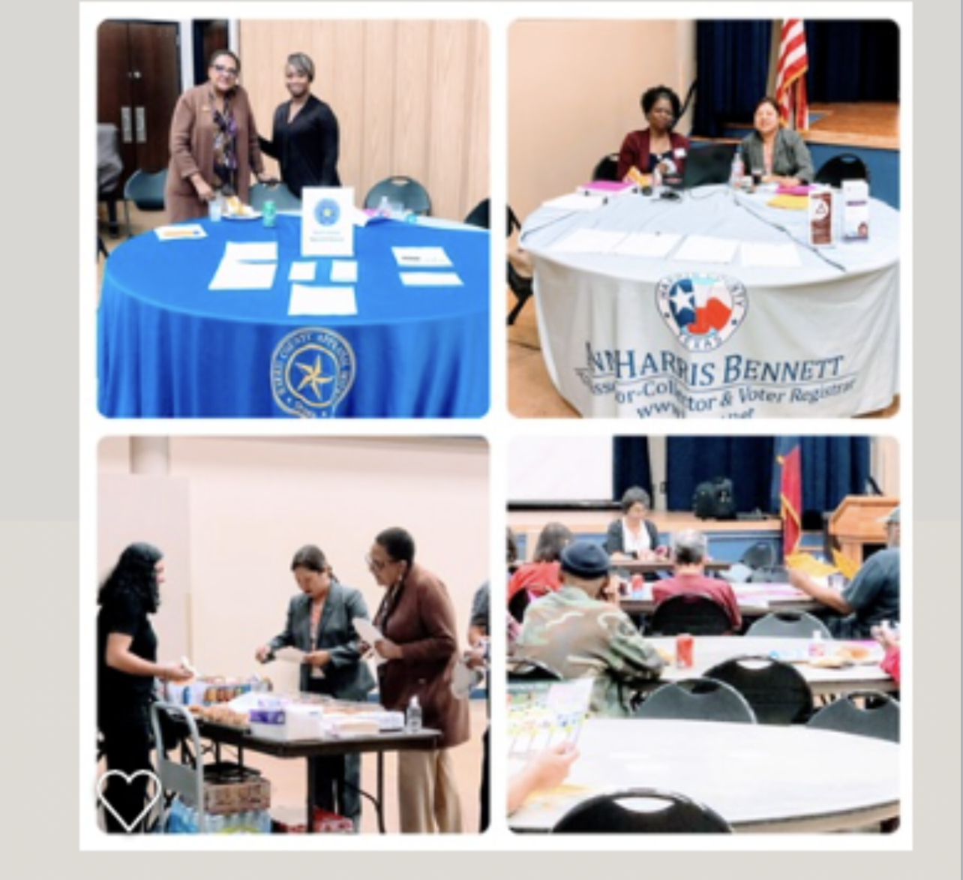
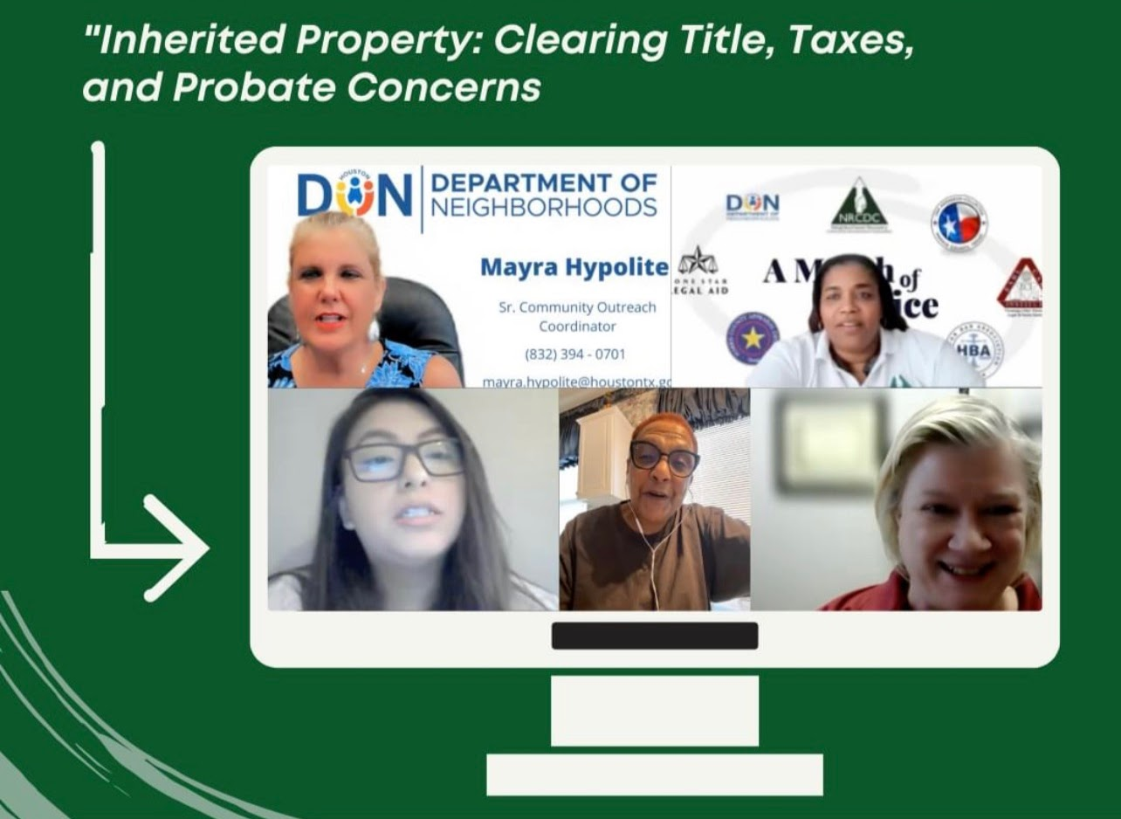
Office of Neighborhood Engagement A Month of Service

Slide 41

Mayor’s Community Engagement Award
Harris County Tax Office
Harris County Tax Office partners with A Month of Service program.

Slide 42
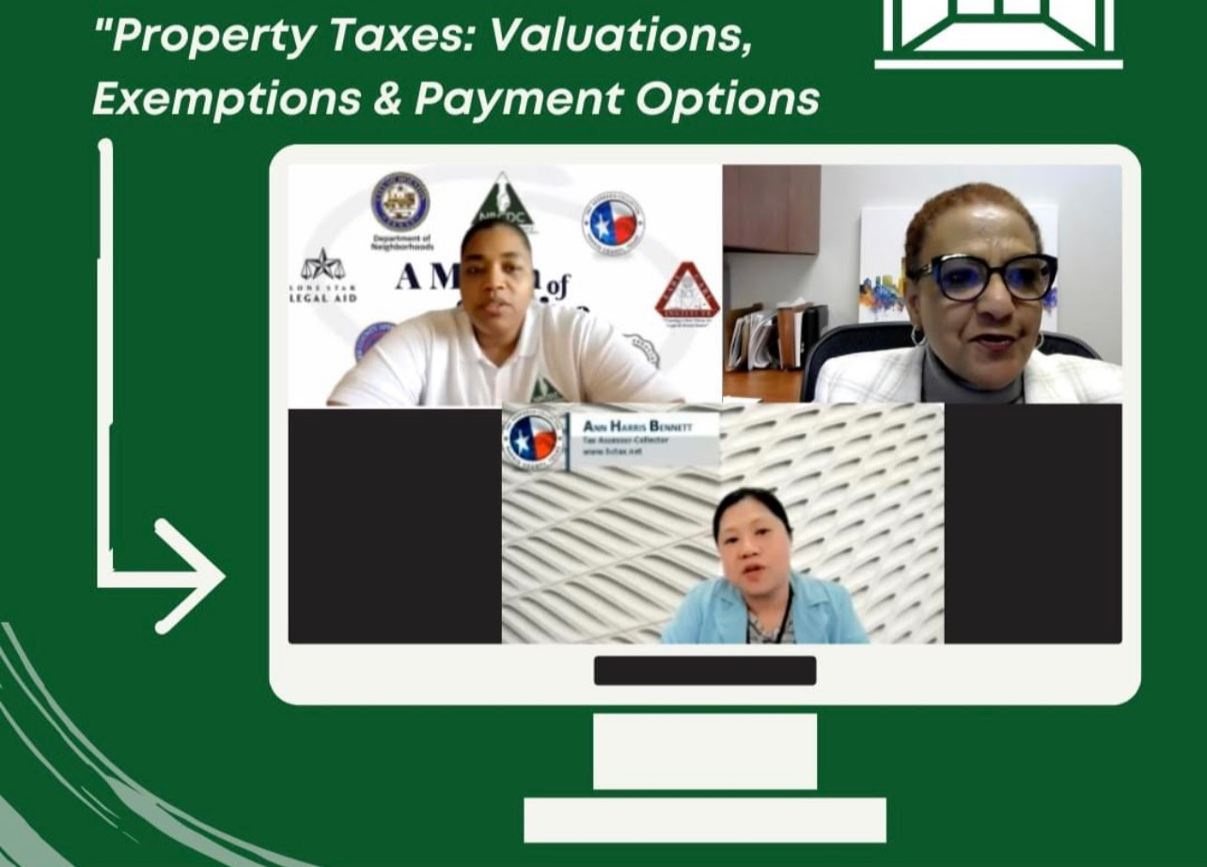
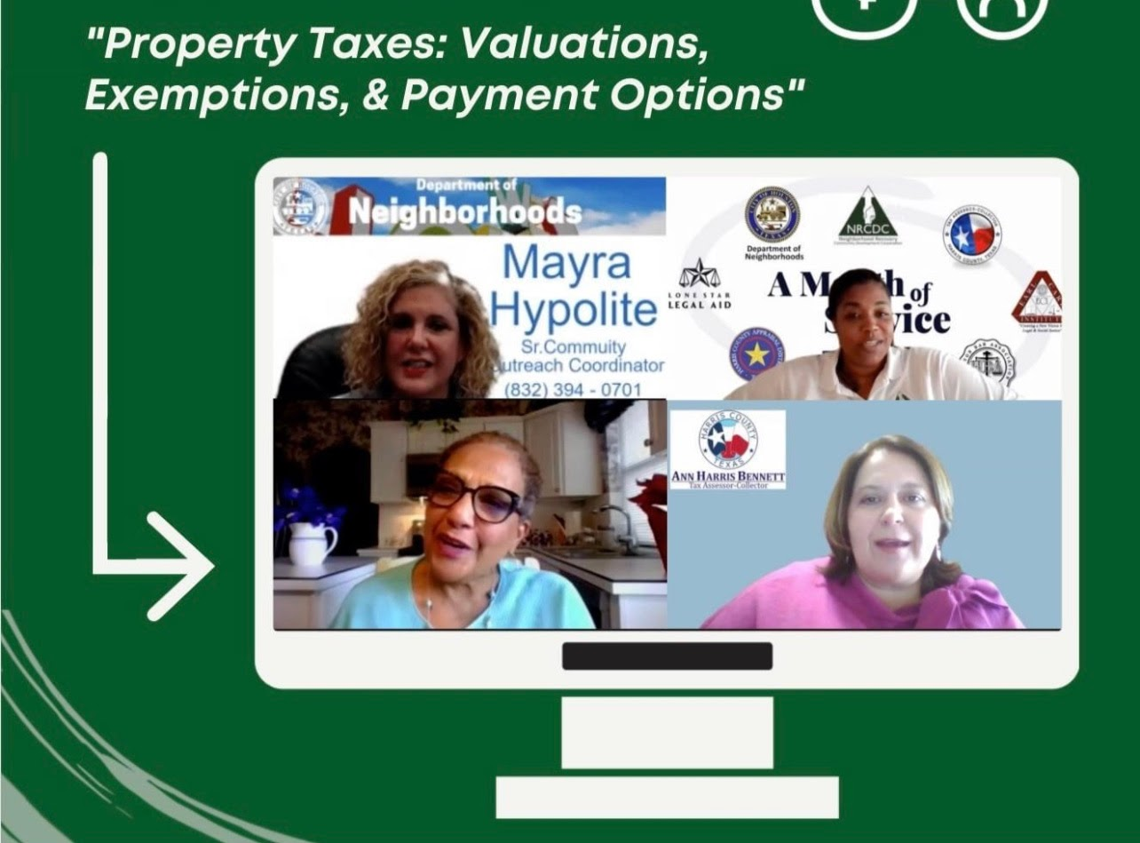
Office of Neighborhood Engagement
A Month of Service

Slide 43

Spotlight VolunteerS

Slide 44
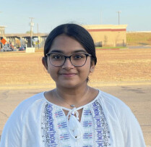
Spotlight Volunteer
Anagharanga Mudigere
UNITE AND INSPIRE

Slide 45
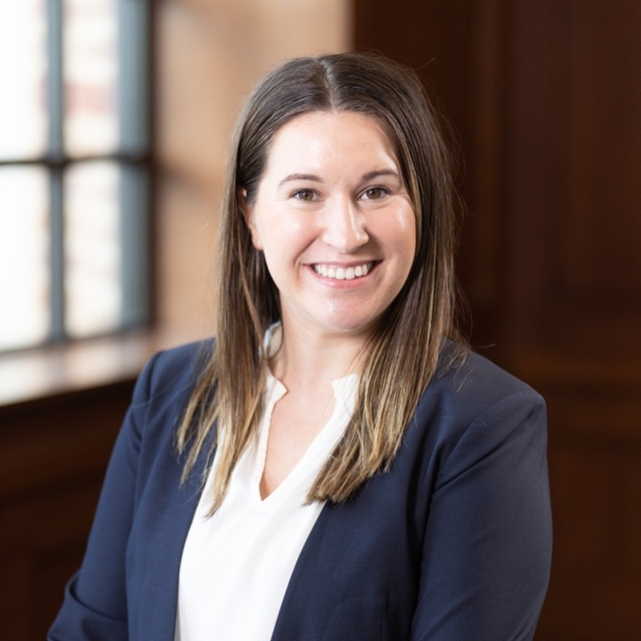
Spotlight Volunteer
Dana Vazquez
KEEP HOUSTON BEAUTIFUL

Slide 46
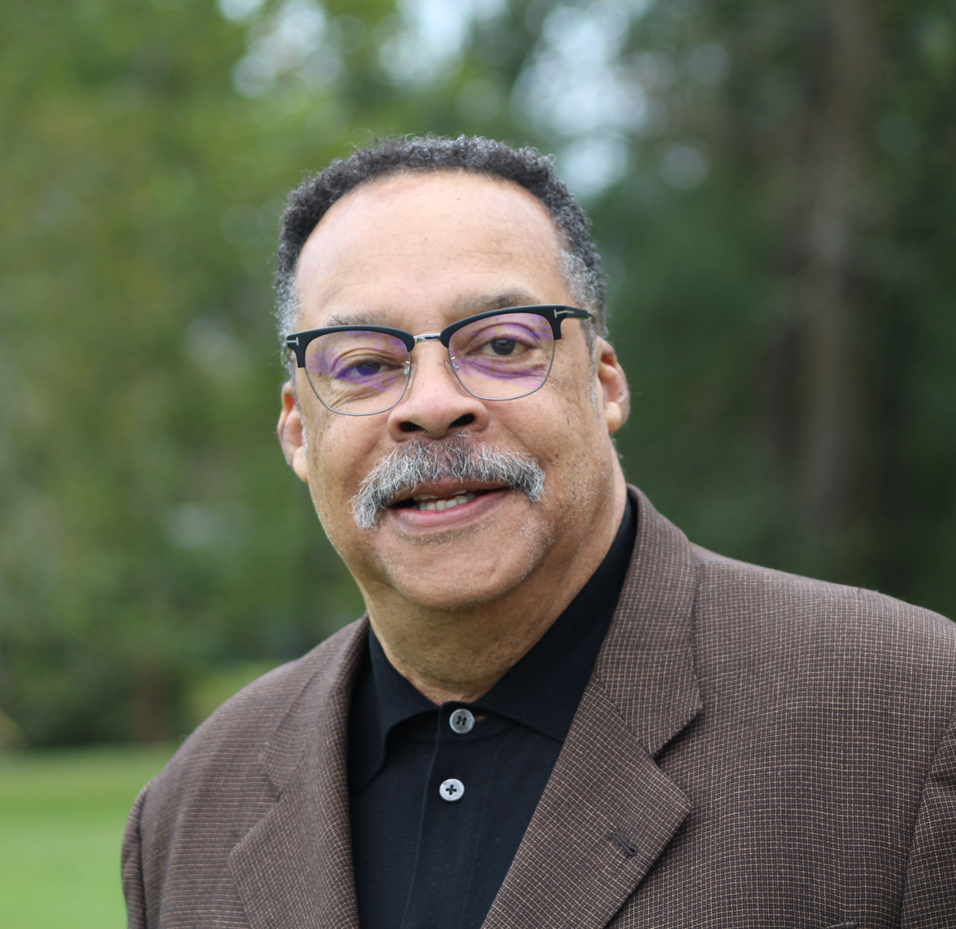
Spotlight Volunteer
Eddie Orum
ALZHEIMER’S ASSOCIATION

Slide 47
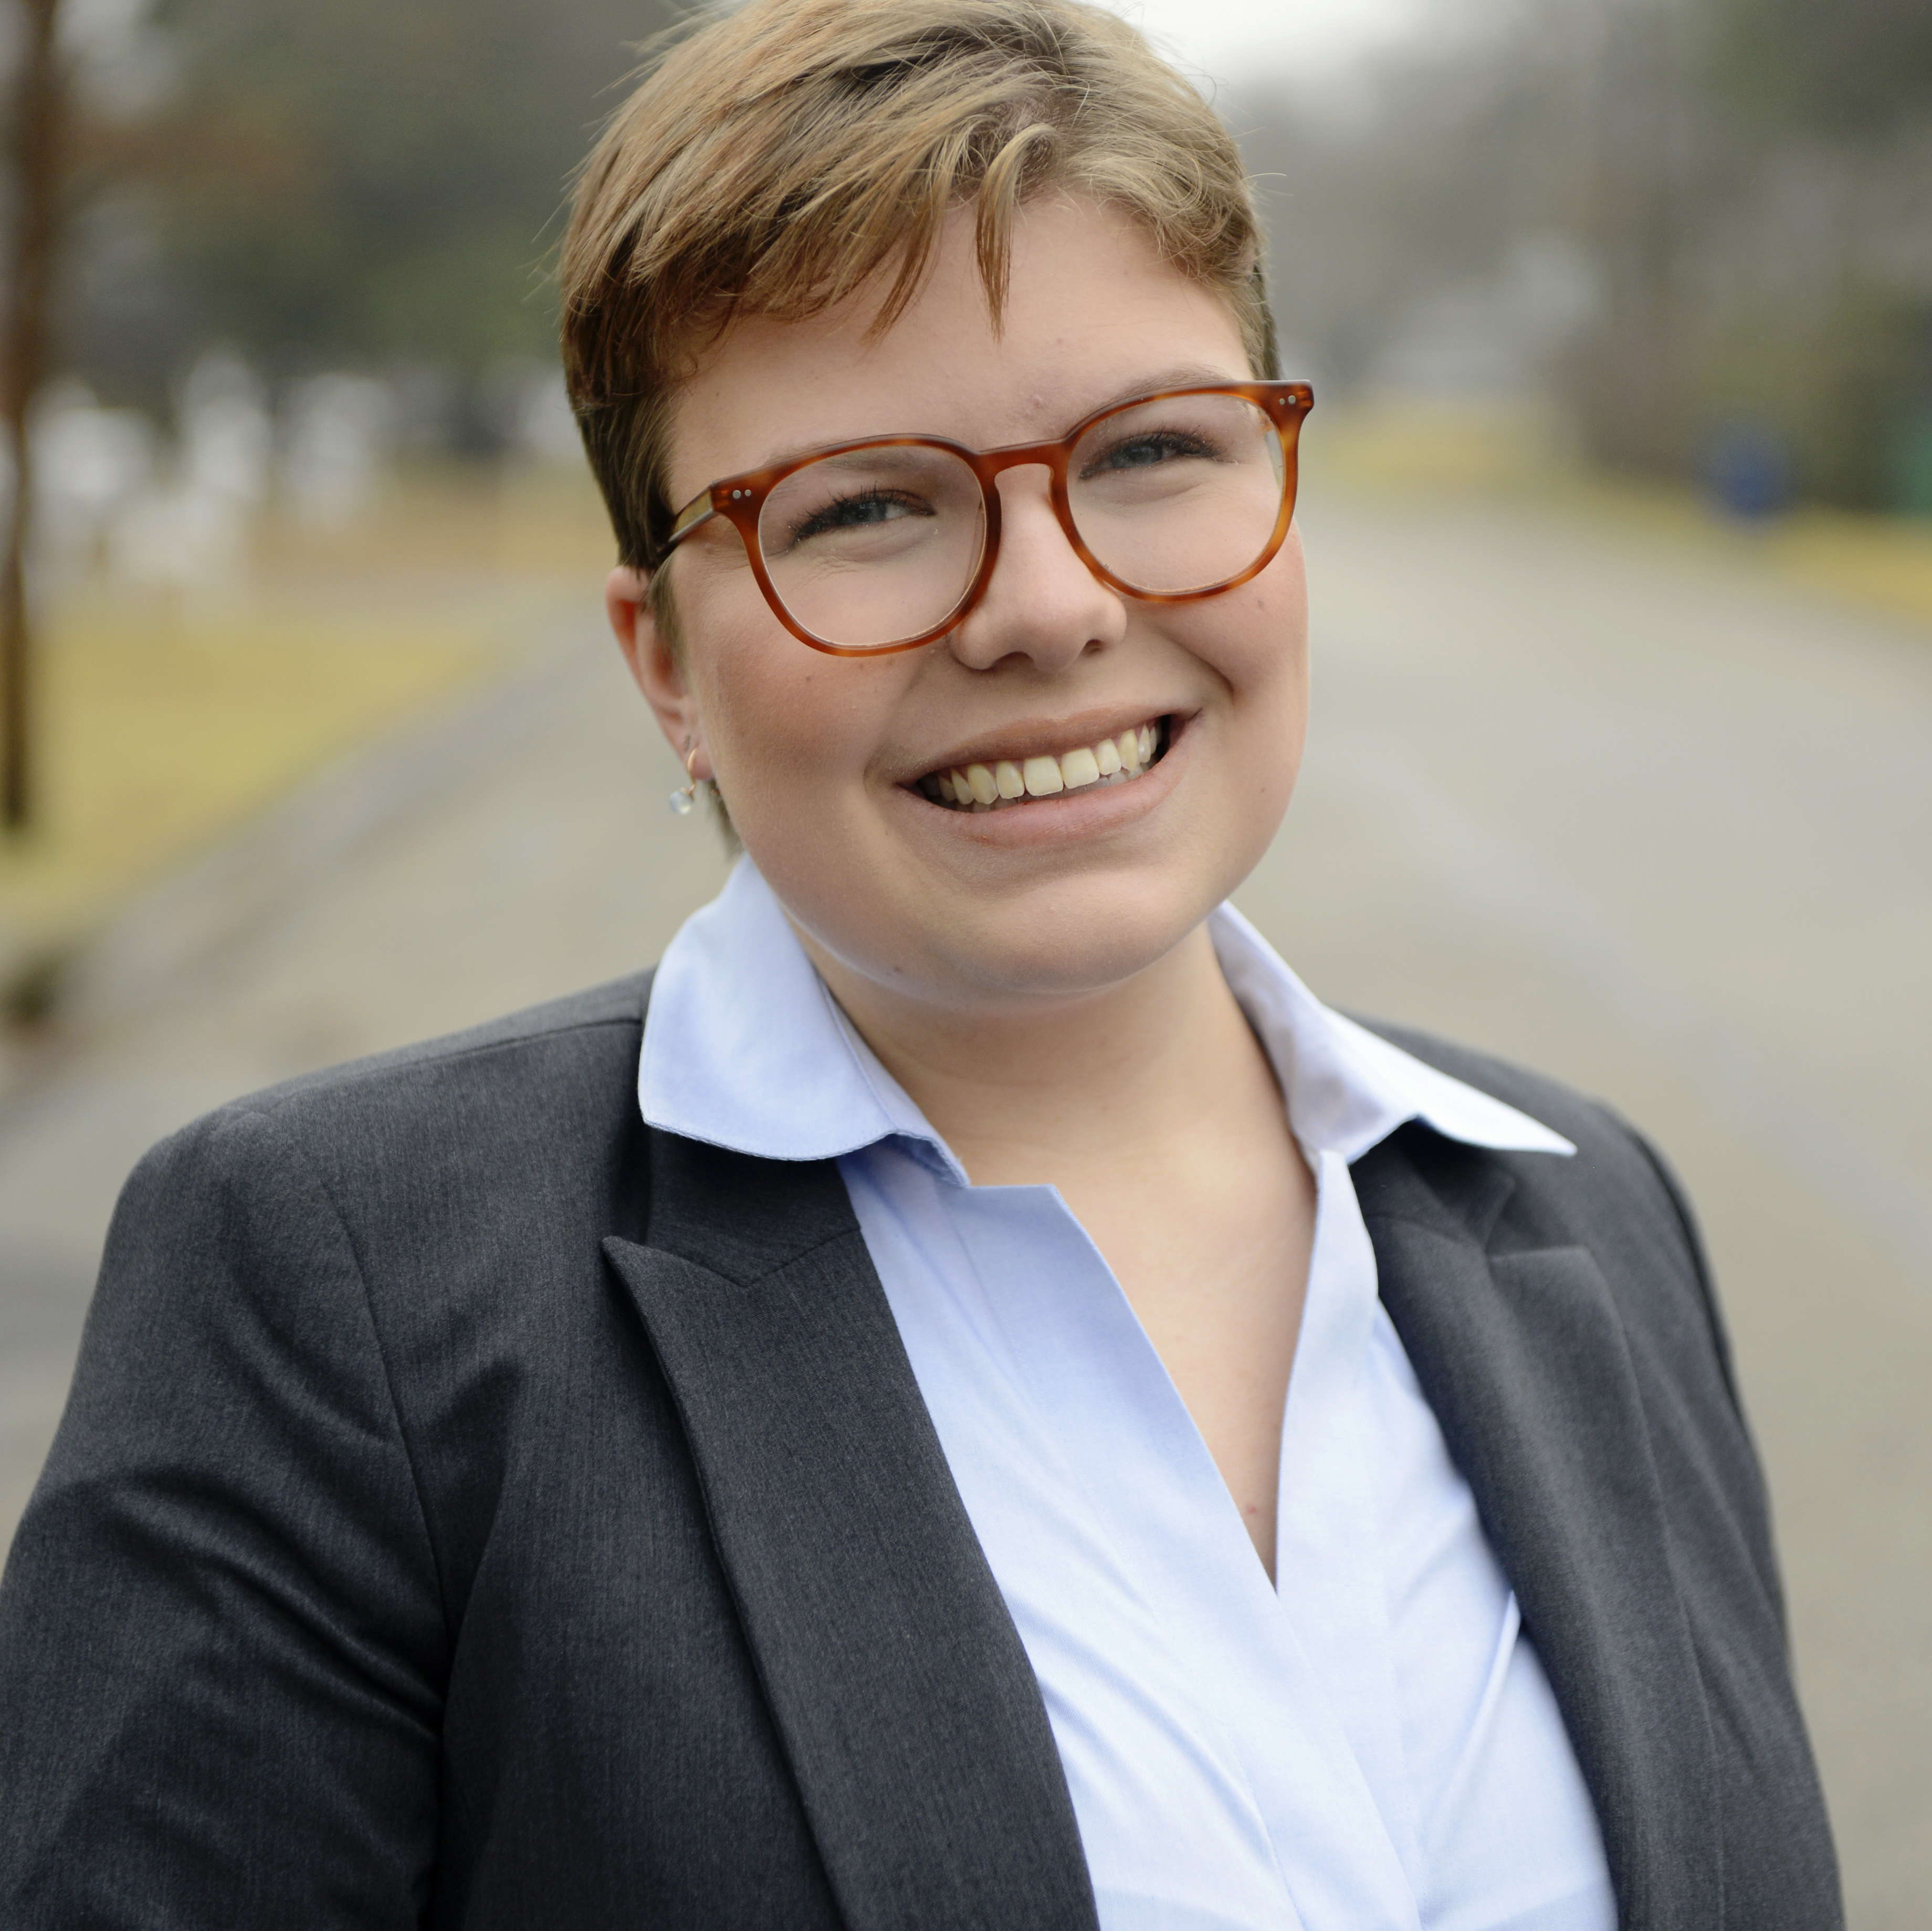
Spotlight Volunteer
Emma Phillips
PAIR HOUSTON

Slide 48
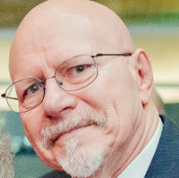
Spotlight Volunteer
James Robin
UNITED WAY OF GREATER HOUSTON

Slide 49
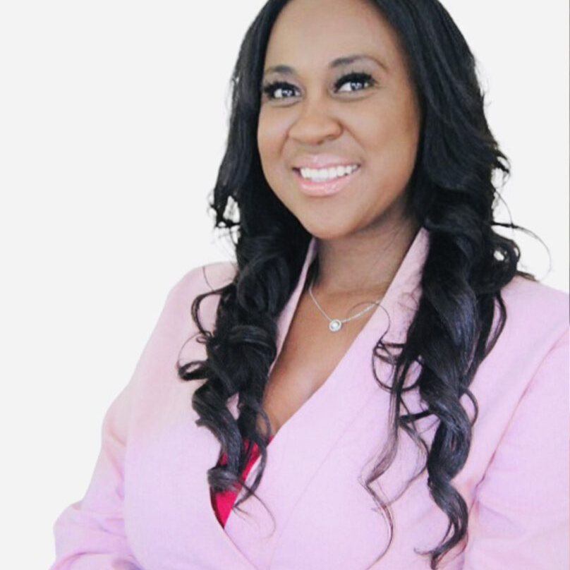
Spotlight Volunteer
LaToya Hurley
SURVIVEHER

Slide 50
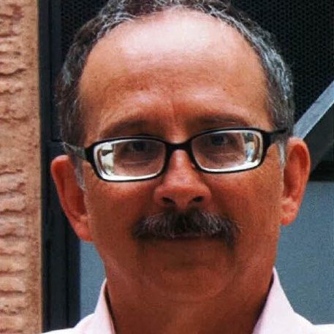
Spotlight Volunteer
Lawrence “Scott” Magelssen
GALVESTON-HOUSTON

Slide 51
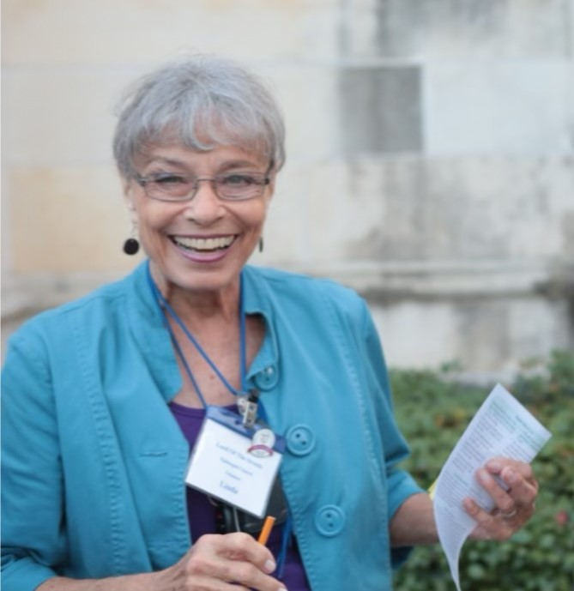
Spotlight Volunteer
Linda Davenport
LORD OF THE STREETS

Slide 52
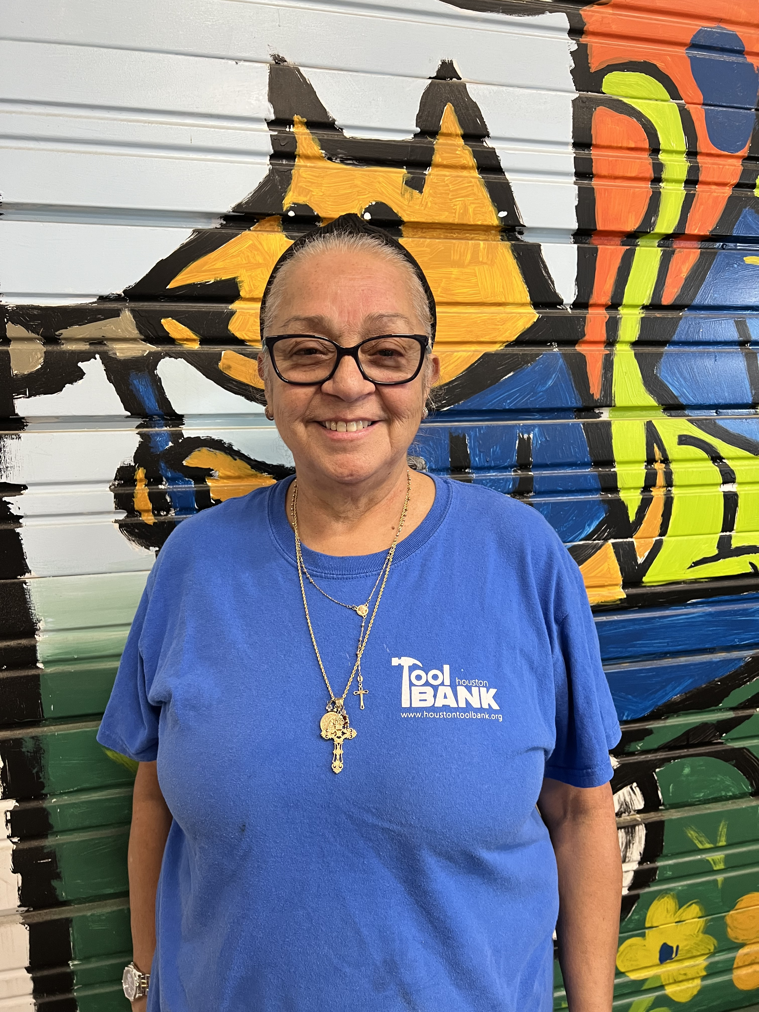
Spotlight Volunteer
Linda Rincon
HOUSTON TOOLBANK

Slide 53

Spotlight Volunteer
Lindsay Kelly
ADULT EDUCATION CENTER

Slide 54

Spotlight Volunteer
MaryBeth Pappas Baun
TERJA FOUNDATION

Slide 55

Spotlight Volunteer
Matthew Catching
HIGHER UP TEXAS

Slide 56

Spotlight Volunteer
Michael Roger Allen
THE WOODS PROJECT

Slide 57

Spotlight Volunteer
Namra Hafeez
THE ALLIANCE TEXAS

Slide 58

Spotlight Volunteer
Owen Zhang
AMERICAN RED CROSS

Slide 59

Spotlight Volunteer
Patty Godfrey
SNOWDROP FOUNDATION

Slide 60

Spotlight Volunteer
Richard Norman Stabell
HOUSTON GROUND ANGELS

Slide 61

Spotlight Volunteer
Richard Remels
GULF COAST REGIONAL BLOOD CENTER

Slide 62

Spotlight Volunteer
Stephen Bernardoni
PARK HOUSTON

Slide 63

Spotlight Volunteer
Tiffany Iwasyk
HEART TO HEART HOSPICE

Slide 64

Spotlight Volunteer
Vanessa Santos Tarcha
LIFE ANIMAL SHELTER

Slide 65

Joan Waite Hanlon
Memorial Award
For outstanding professionalism in volunteer management
Tarynn Brewer
NOMINATED BY
Asekun Kuforiji
American Red Cross

Slide 66
Thank you
Mayor’s Volunteer Appreciation Awards Ceremony

